Slide 2
in INDONESIA

Slide 3
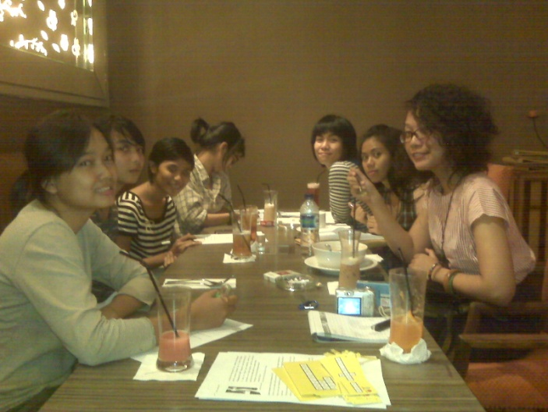
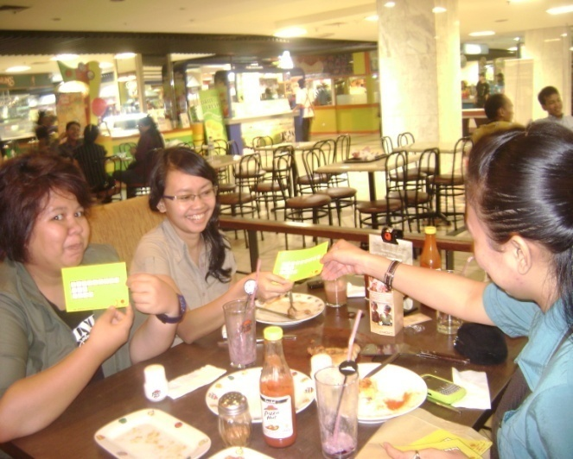
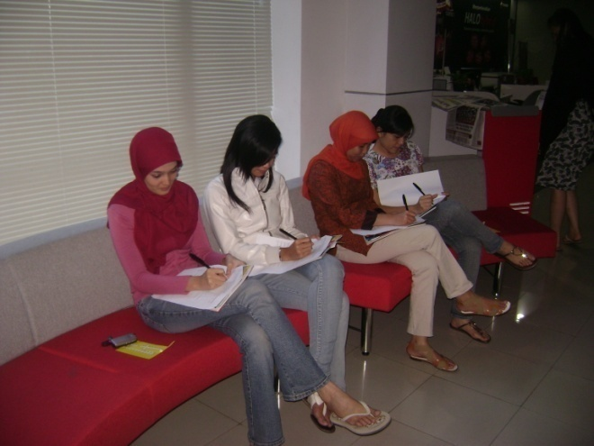
Pre Campaign Activities
Small meetings with young women workers ( TU members and non TU) to find their input on the best way to reach them for the campaign.

Slide 4
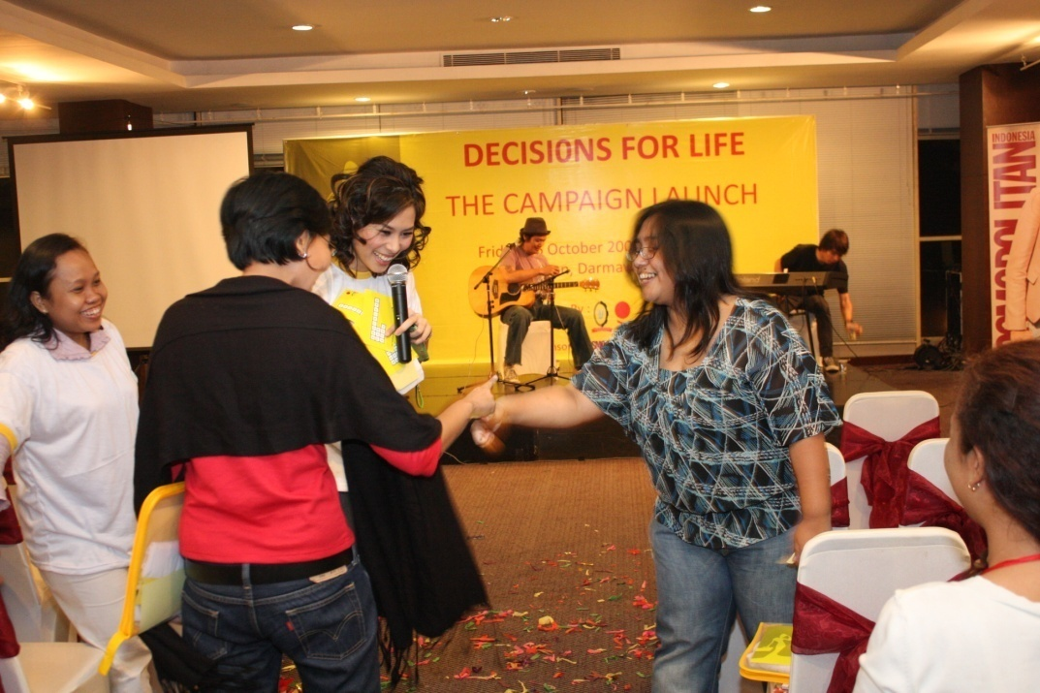
Launch of DFL Indonesia

Slide 5
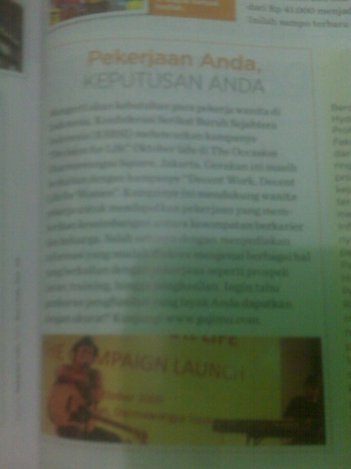
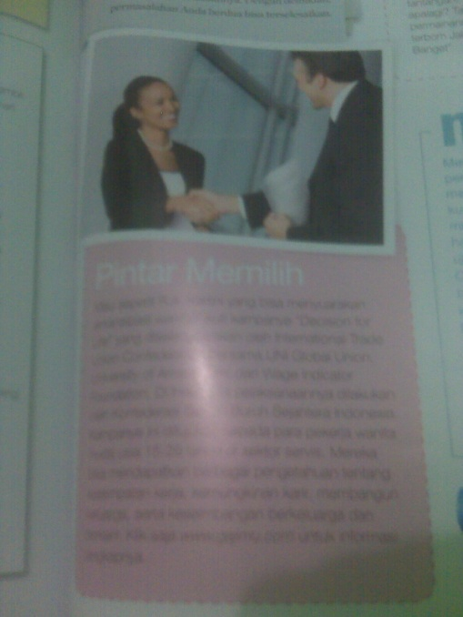
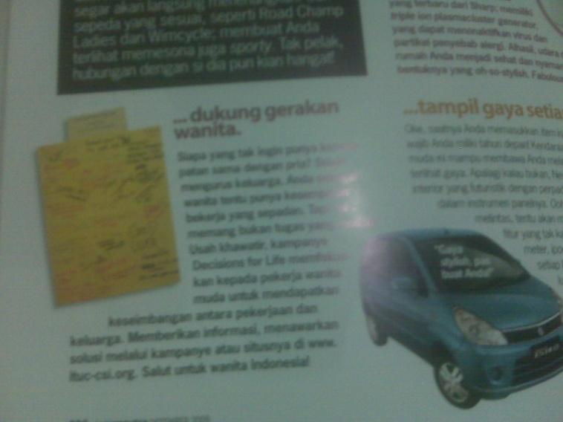
Media Publication

Slide 6
Other Campaign Materials

Slide 7
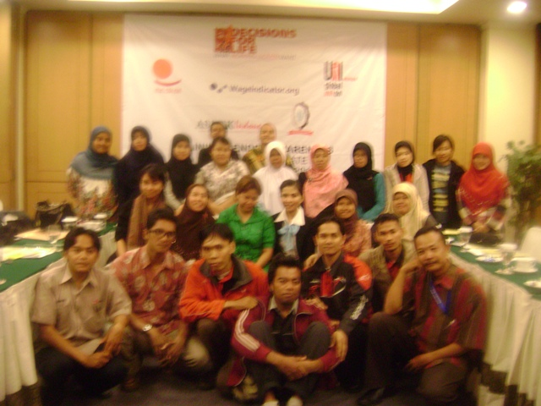
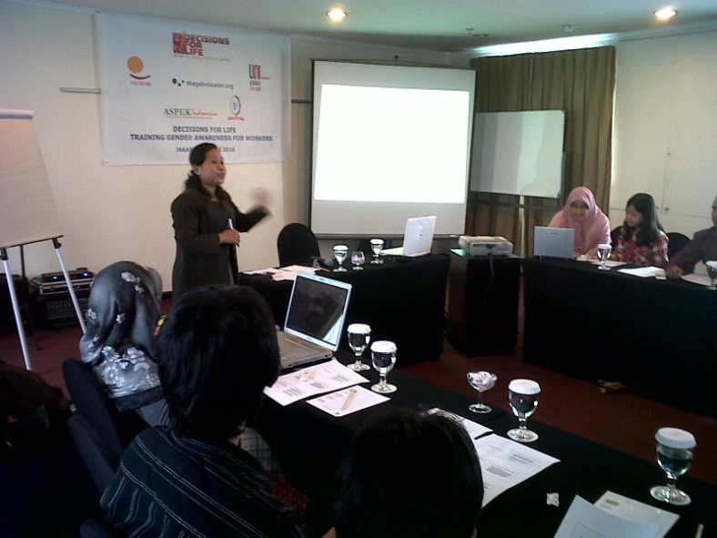
Educational Activities

Slide 8
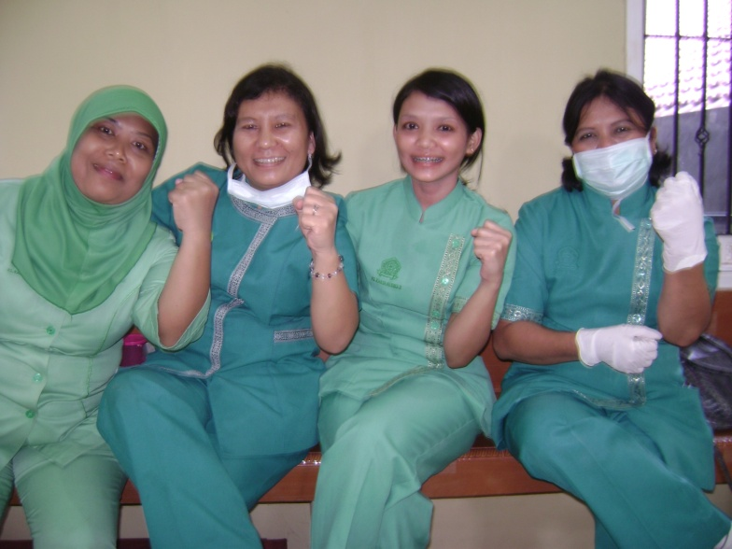
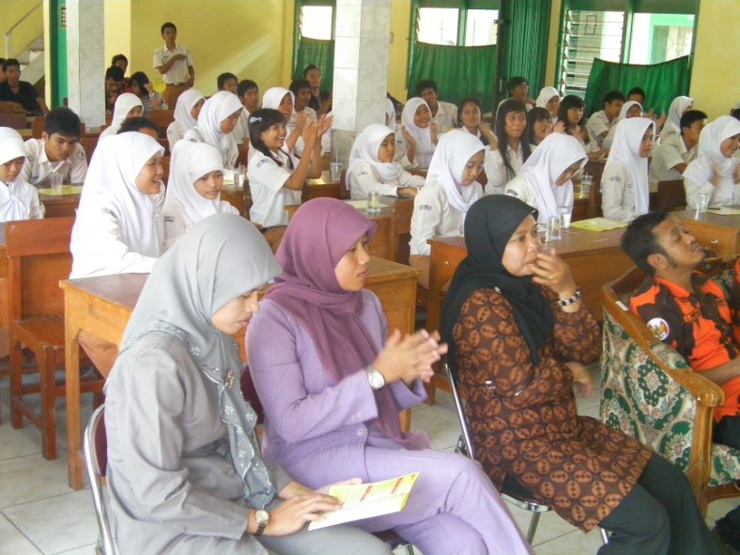
Other Activities

Slide 9
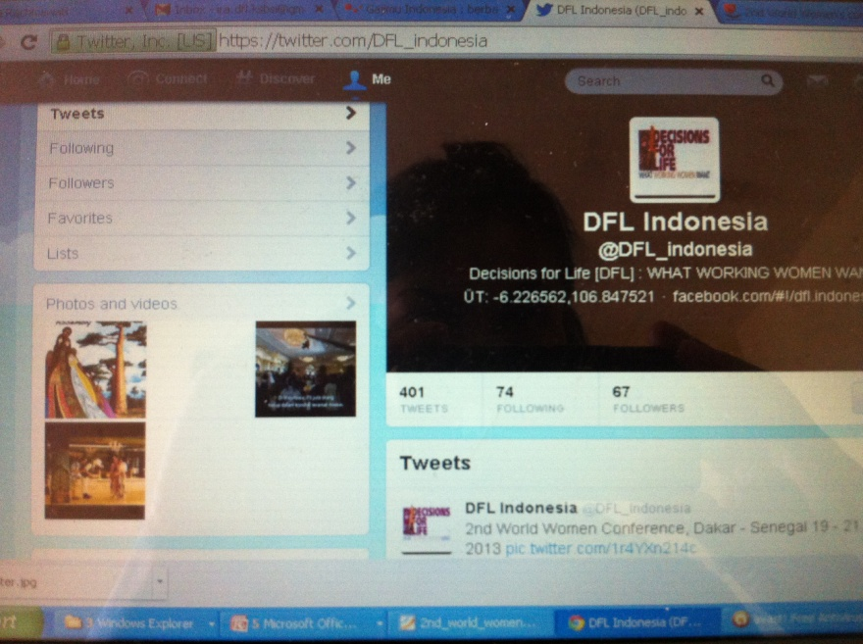
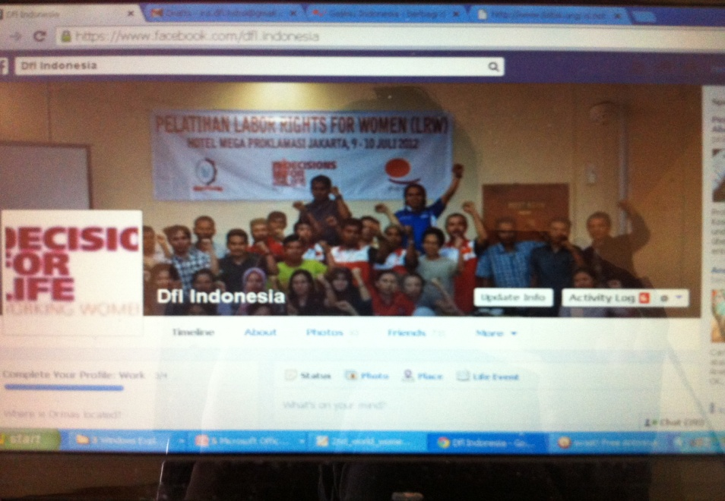
Social Media

Slide 10
Achievements

Slide 11
Action Points
To achieve in National Level:
Change in national law to benefit women workers namely the income tax, maternity benefits, social protection, and domestic worker bill.
Increased number of women in trade union
To achieve in global level:
Global network of young women
Youth Employment to become a strong global issue

