Slide 1
Achieving minimum living wages in Asia and beyond
Asia-Europe Labour Forum
Brussels, 15 October 2018
Evelyn Astor
Economic and Social Policy Department
International Trade Union Confederation
Evelyn.Astor@ITUC-CSI.org

Slide 2
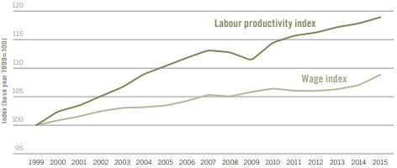
Global picture: Wages are stagnating compared to productivity
Source: ILO (2017)

Slide 3
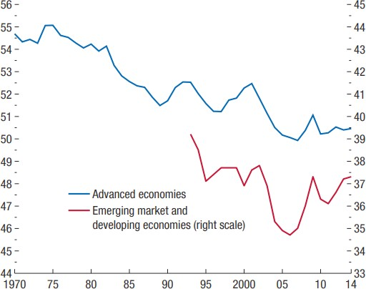
The labour income share is declining
Source: IMF (2017)

Slide 4
Workers are earning poverty wages
300 million workers in emerging and developing countries earn less than US$1.90 per day
A further 430 million workers in emerging and developing countries earn between US$1.90 and US$3.10 per day
83% of people believe that the minimum wage is not enough to live on

Slide 5
World needs a pay rise campaign

Slide 6
Living wages to be based on the cost of living
Food | Education expenses
Housing and basic furnishings | Household bills and utilities
Transport | Recreation
Clothing | Essential care costs (child care and elderly care)
Medical expenses | Contingency budget for emergencies

Slide 7
Minimum wages vs. union claims for living wages

Slide 8
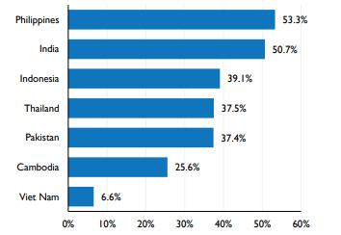
Strengthening compliance
Share of workers in the garment sector earning below the minimum wage (%)
Source: ILO (2017)

Slide 9
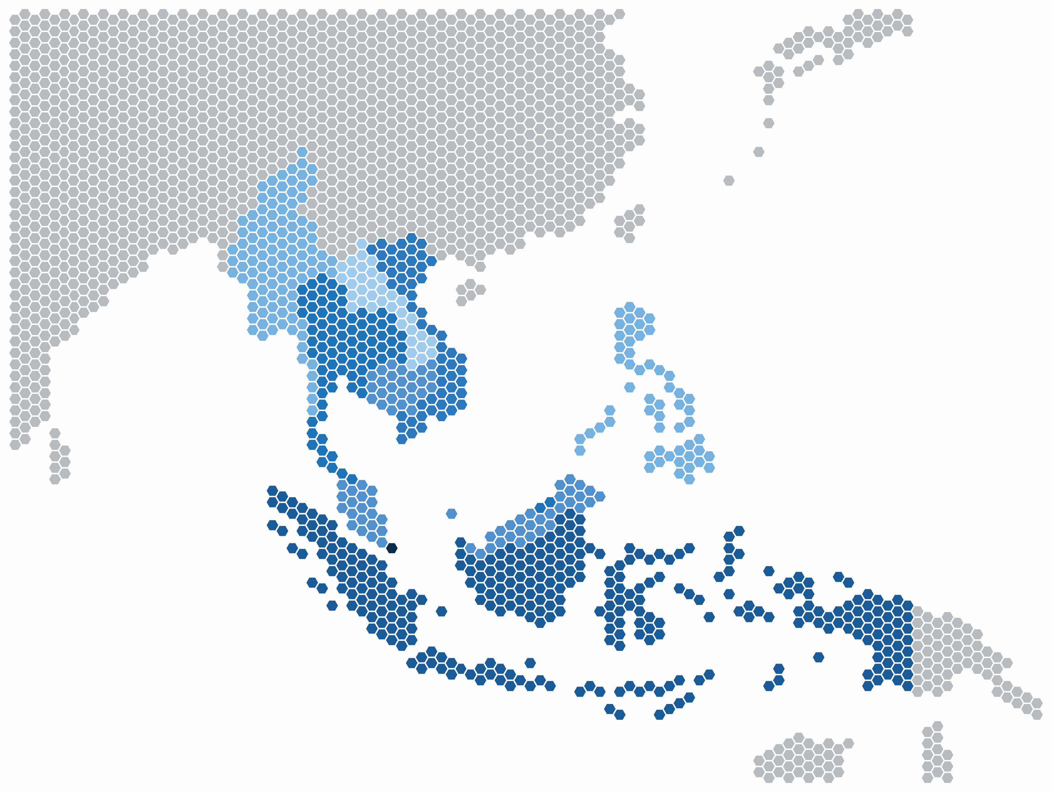
Asia +50: Regional coordination

Slide 10
Union demands internationally: L20 Declaration, September 2018
Ensure minimum living wages for all workers, based on the cost-of-living evidence set with social partners;
Promote collective bargaining on wages and working conditions, ensuring broad coverage of collective agreements, including through utilising extension mechanisms; and
Strengthen national social dialogue structures, if necessary, with the technical assistance of the ILO.

Slide 11
Further reading…
ITUC wages campaign website
L20 (2018) Statement to the G20 Labour and Employment Ministers Meeting
L20 (2018) The Case for Wage-Led Growth
ITUC lobby brief (2018) Supporting wage-led growth: the case for Asia +50

