Slide 1
Transition finance
OECD Development Co-operation Directorate
Financing for Sustainable Development
Policy Analysis and Strategy
April 2019
Jieun Kim, Cecilia Piemonte

Slide 2
Context
In its 2017 high level meeting (HLM) Communiqué, the DAC set an objective “to better understand the broad catalytic effect of official support and other resources by understanding the interlinkages among ODA, partner countries’ domestic resources, private investment, remittances, philanthropy, trade finance and export credits, and other sources of finance”, and to “continue to collaborate with other experts within the OECD and beyond in order to have a global overview and outlook on financing for development” (para 15).
Notes:
Responding to this call, and aligned within the Addis Ababa Action Agenda (AAAA) to mobilise all available resources – domestic and foreign, public and private – in support of the SDGs, the DCD developed a new work stream on transition finance to explore the evolution and interaction of public (Official Development Assistance and Other Official Flows) and private (Foreign Direct Investment and remittances) sources of finance across the development continuum.
--The ultimate objective of this work is to advise the DAC in preparing countries for transition (outlining the optimal financial mix and offering policy recommendations) and in building resilience.

Slide 3
Defining transition finance
As a whole, we call “transition” the journey towards the 2030 Agenda and the achievement of sustainable development, and transition finance is the financing of that journey.
As countries transition through the development continuum, they lose access to certain types of financing, but gain access to a broader variety of actors, tools and instruments.
Notes:
The analysis of transition finance carried out by the DCD attempts, from a DAC perspective, to analyse the substitution, interactions and trade-offs among all of the sources of finance, public and private, domestic and international, that evolve as countries transition.

Slide 4
Transition finance: methodology overview
As a country’s GNI per capita rises, financial inflows shift from official to private sources DAC, non-DAC OECD members and multilateral agencies’ outflows, 2012-16 net disbursements, 2016 prices | Tipping points: observing flows’ substitutions
 | First, a substitution of external with domestic resources. Second, a substitution of public with private resources.
Notes:
At any given point of DAC’s partner countries transition journey, the ultimate objective of transition finance is to optimise access to finance for sustainable development, ensuring a smooth deployment of financing -avoiding major financing gaps or socio-economic setbacks.
A number of conclusions can be drawn from the analysis of this figure, and two major substitution trends are observed (it is what we call in this methodology the tipping points, or when a flow is substituted by another):
First, a substitution of external with domestic resources. From the onset, domestic resources are the largest source of finance for the economy – with a 4 to 1 ratio of tax revenues/external flows. This ratio keeps increasing, however, with tax revenues representing more than 12 times the value of external flows as the country reaches high-income status. Domestic resource mobilisation is therefore a key component of financing sustainable development, and should remain a primary objective of ODA;
Second, a substitution of public with private resources. Highly dependent on public external support (mainly ODA) in early stages of transition, countries progressively move towards a private financing of their economy. Public financing itself evolves, with a progressive substitution of ODA with OOF, then private flows (foreign direct investments and remittances) take the leading financial role.

Slide 5
A close-up on social sectors Transition gaps or surpluses
Education | Health | Governance
transition gap
DAC, non-DAC OECD members and multilateral agencies’ outflows, 2013-17 net disbursements, 2017 prices
Notes:
The work stream has also a social focus.

Slide 6
The DAC has a major role to play in ensuring a smooth transition of countries
Better anticipation and preparation of substitutions – using ODA and OOF to support a sustainable transition finance path;
Better support to countries in transition through adequate capacity building (e.g. debt management support), investment in enablers (e.g. domestic resource mobilisation, trade and investment promotion) and in channels (e.g. financial system, business environment);
Better mitigation of the effects of ODA phasing-out and resilience building, as well as definition of new forms of co-operation less funding-focused.

Slide 7
Transition finance: an evidence based approach The ABC toolkit
A: Assessing
What is the transition context in the country?
What role are DAC members and partners playing in the transition context? How has access to financing for sustainable development (FSD) been impacted by the transition? What are the substitution effects between public/private/domestic/international resources as the country transitions?
B: Benchmarking
How does the substitution of FSD flows compare with country peers undergoing similar transitions? What lessons and best practices can be drawn from other country contexts?
C: Counselling
How can the DAC help the phasing out from ODA, securing the progressive growth of other sources of sustainable financing? How to design long-term support strategies that go beyond ODA? How can the DAC provide support to avoid setbacks when ODA is no longer an option? What kind of capacity building efforts, promotion of transfers of all kinds could be fostered by ODA to smooth the transition?

Slide 8
Country pilots
Cabo Verde (graduated from LDC category)
Zambia (having moved from LIC to LMIC category)
Uganda (LIC facing migration and financial challenges)
Lebanon (UMIC facing migration challenges)
Vietnam (Asian country)
Chile (having graduated from the DAC list of ODA recipients)
TBC: Bhutan, Solomon Islands, Uruguay
Notes:
Uganda and Lebanon has been carried out with colleagues in our Global Policies and Partnerships division.
Looking forward, the transition work is also exploring the possibility to collaborate with the OECD’s Centre for Tax Policy and Administration to further engage with domestic tax revenue issues, and IMF/WB on debt sustainability issues. During the second semester 2019, two reports will also be published; the first will present a ‘transition finance toolkit’, that is a ready-to-go manual to help donors and development partners to analyse transition finance issues in different contexts. The second report will present a ‘transition finance compendium’ compiling key messages, policy recommendations and lessons learnt from the full work stream carried out in 2018-19.

Slide 9
A. The Case of Cabo Verde : graduation from the LDC category
Cabo Verde is a Lower Middle-Income Country (LMIC)
Income status:
Cabo Verde graduated from the LDC category in 2007
2. Economic vulnerability:
small size (diseconomies of scale)
Cabo Verde was recently classified as high risk of debt distress
3. Environmental vulnerability:
Cabo Verde did not meet the EVI criteria to graduate from the LDC category and has stagnated for more than a decade (it scores 35 out of 100) mainly due to agricultural instability and natural disasters.
Notes:
Cabo Verde transitioned from the LDC category in 2007, which led to new challenges: the composition of financing shifted from grants to concessional loans and access to preferential trade agreements had to be renegotiated. Moreover, ODA was phased out rapidly in key social sectors (e.g. health and education) creating transition finance gaps. In parallel, tied aid rose significantly, increasing transaction costs and reducing local ownership. Cabo Verde also shares the unique vulnerabilities of other small island developing states (SIDS), compounding the challenges of its transition. LDC support provided to access climate finance funds and facilities (e.g. NAPA) was phased out, which places the country at risk of setbacks from persistent climate-related vulnerabilities.

Slide 10
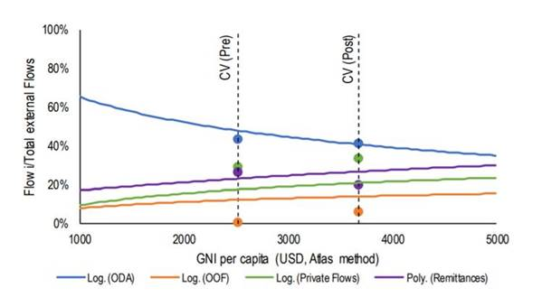
B. Comparing Cabo Verde’s financing mix to other countries
ODA represents 40% of total external resources
OOF remain below the overall trend after graduation
Private flows, in contrast, are well leveraged and at higher levels than in other low middle-income countries (LMICs)
Remittances face high transaction costs (9.1% in 2016)
Note: The pre- and post-LDC graduation lines indicated above are 5-year averages before and after the 2007 graduation
Notes:
Following graduation, Cabo Verde remains highly dependent on ODA, at 40% of total external resources
OOF remain below the overall trend after graduation mainly due to the small island exception that limits non-concessional financing by multilateral banks to SIDS
Private flows, in contrast, are well leveraged and at higher levels than in other low middle-income --representing 35% of the total external mix (directed mainly to the tourism sector), above the 15% average in the LMIC group
Remittances face high transaction costs (9.1% in 2016), even higher than other SIDS (8.8%)
A comparison of the financing mix in Cabo Verde and peer countries can help to identify success and failure in policies to leverage resources during transition. Seychelles is considered an “aspirational peer” because of its success in harnessing the Blue Economy through innovative financing instruments, including blue bonds and debt swaps for environmental protection. Maldives further presents a best practice in diversifying its economy beyond tourism, notably by upgrading fishery value chains, resulting in reduced ODA dependency.
Cabo Verde provides an example for others to strengthen domestic resource mobilisation crucial to fill the transition finance gaps. Cabo Verde’s national strategy will rely primarily on domestic resource mobilisation (89%). To promote coherent tax policies while attracting foreign investment (e.g. SEZ, off-shore banking), Cabo Verde recently accepted to join the OECD/G20 Inclusive Framework on Base Erosion and Profit Shifting (BEPS) Project.
More recently, Cabo Verde was classified at high risk of debt distress creating a new roadblock to financing and implementing its private sector-led national financing strategy. Local institutional and technical capacity building are needed to ensure that substantial investments from new actors (e.g. the People’s Republic of China (PRC) and the private sector) do not exacerbate debt distress and are aligned to contribute to long-term sustainable development. Private debt on commercial terms is the fastest growing source of external debt, increasing seven-fold since LDC graduation.
In 2016, Cabo Verde’s debt-to-GNI level reached 134% due to State Owned Enterprise (SOE) privatisation and non-concessional public lending.
Cabo Verde (2017-2021), Bases para o Plano Estratégico de Desenvolvimento Sustentável (PEDS), http://www.mf.gov.cv/index.php/legislacao-new/cat_view/55-documentos/128-direccao-nacional-do-planeamento-dnp.
Cabo Verde’s Doing Business ranking remains low (131/190 in 2018) and its competitiveness rank has fallen from 105 to 110 out of 135 countries (2017-18).

Slide 11
C. The need to combine co-operative and competitive strategies
Members must integrate financing criteria beyond income per capita, including economic and environmental vulnerabilities to help manage debt levels, build resilience and avoid socioeconomic setbacks, particularly in Cabo Verde (and SIDS).
A competitive strategy requires targeted investments to increase the competitiveness of productive and service sectors. A natural convergence can be achieved in sectors where markets exist for private sector investment (such as the banking, business, or infrastructure sectors).
Bridging the divide between these strategies calls for a renewed partnership.
Notes:
Although transition support groups helped to monitor LDC graduation in Cabo Verde, these lacked sufficient co-ordination among development partners. OECD DAC members must help to avoid a proliferation of actors which contribute to duplications between ad hoc assessments and “report fatigue”.
OECD DAC members must strive to reduce tied aid to ensure competitiveness of the local markets and to encourage local entrepreneurship. Infrastructure financing should be strengthened to ensure commercial viability (e.g. domestic travel, logistics, connectivity). The transition period in Cabo Verde was too short, and the necessary infrastructure is not yet in place to attract the private sector and to ensure a return on investment to repay growing debt.
A fusion of the co-operative and competitive strategies is needed. Greater harmonisation of support by development partners and other actors is needed to operationalise the mixed approach to transition finance. The participation of civil society and South-South and Triangular co-operation can help to build capacities, ensure local ownership of the SDGs and help to tackle growing inequalities. Operationalising the strategies will require better co-ordination in addition to the promotion of innovation through new instruments and enhanced transparency for debt sustainability.

Slide 12
A. The Case of Chile: HIC graduating from the DAC list of ODA recipients
Chile is a High Income Country
Income status:
USD 13 610 per capita
2. Economic vulnerability:
Copper production is 10% of its GDP (prices volatility effects/external economic cycles correlation - - 1/3 of total exports to China)
2. Ongoing challenges:
High inequalities (Gini index 46.6), regional income disparities; environmental vulnerabilities (natural disasters: earthquakes, wildfires, droughts)

Slide 13
B. The evolution of financing mix in Chile
ODA is almost negligible (as well as remittances)
OOF represent almost 10% in the period 2000-18
90% of external flows come from private sources
Tax revenues do not show major changes in the period -- reaching 17% of GNI in 2018
Note: External inflows and DRM to the Chilean economy

Slide 14
C. How can the DAC help recipient countries manage ODA graduation? (and avoid the middle income trap?)
Domestic government responsibilities should occupy a central place when facing MIC status. Peer to peer learning and DAC members’ exchanges of experiences in this sense can be highly useful for countries to better manage ODA graduation.
The DAC should consider minimising the use of ODA funds (mainly provision of concessional loans) to move to purely technical co-operation, focusing in particular on qualitative and sustainable investments as a core feature of such co-operation.
Incentives could be put in place to encourage private savings to be invested in sustainable/innovative projects to tackle major challenges (inequalities, low productivity and low R&D investments, diversification of the economy).
Notes:
The main message that emerged was that transition was not adequately addressed or planned by DAC members in the years prior to Chile’s graduation from the ODA recipients list. The report will also emphasize that in light of the current level of development of the Chilean economy, all interviewees emphatically called for technical assistance --instead of financial resources (as access to financial markets does not seem to be a concern for the country) to help the country rise to its challenges.

Slide 15
A. The Case of Zambia : A commodity-based LDC
Zambia is a Lower Middle-Income Country (LMIC) but also belongs to the group of Least Developed Countries (LDC) due to social and economic vulnerabilities
Income status:
Zambia has become an LMIC in 2011
2. Economic vulnerability:
80% of exports are in copper
70% of FDI in the mining sector
3. Social vulnerability:
60% live below the poverty line
5th hungriest country in the world
Notes:
After years of robust growth in the early 2000s, Zambia transitioned from the low-income to the lower middle-income (LMIC) category in 2011.
However, Zambia still belongs to the group of least developed countries with persistently high levels of economic and social vulnerabilities. More than half of the population lives below the poverty line, while the Global Hunger Index 2018 ranks Zambia as the fifth hungriest country in the world. Moreover, Zambia has a high reliance on one single commodity, with more than 70% of exports being in copper. This exposes the national economy to volatile commodity price movements.

Slide 16
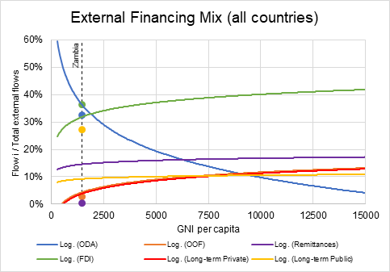
B. Comparing Zambia’s financing mix to others
Much higher share of non-ODF debt
Higher share of FDI
Low share of ODA
Low share of remittances
Notes:
Looking at how Zambia’’s financing mix compares to that of other countries, gives you this picture.
The pace of the increase in debt levels has been particularly pronounced.
Yellow dot is far above the yellow curve, indicating that Zambia has a much higher reliance on public debt than other countries at similar income level.
With the reclassification to LMIC status, Zambia gained access to a wider range of financing options including international debt capital markets. The Government issued a series of Eurobonds starting in 2012, which amounted to a total of around USD 3 billion or more than 40% of public external debt. At the same time, Chinese lending plays a growing role in the country’s financing landscape. In 2016, Chinese loans amounted to a quarter of Zambia’s total external debt stock. Conversely, the share of concessional finance from DAC providers has decreased. The light blue dot is below the curve.

Slide 17
High levels of debt decrease fiscal space to address vulnerabilities
Debt servicing made up about one third of domestic revenue in 2018.
Only 22% left for other expenditures.
Spending cuts on social protection by 24% and social cash transfers by 10% in 2019.
External borrowing exceeds the levels prior to the HIPC initiative
Source: IMF
Source: World Bank
Notes:
The shift towards non-concessional debt from non-DAC providers has profound implications.
After having been one of the major beneficiaries of the Heavily Indebted Poor Countries (HIPC) and Multilateral Debt Relief (MDRI) initiatives in the early 2000s, Zambia’s debt is rising again to potentially unsustainable levels. External debt rose to levels as high as 65% of GDP. Unlike in the 2000s, the majority of the debt is not held by Paris Club members, which can make a potential debt restructuring difficult.
Increasing costs of debt servicing reduce the fiscal space, crowing out spending on social sectors. In 2018, debt servicing made up about one third of domestic revenues. For the 2019 budget, the share is expected to rise to 42% (Figure 1.11).
The 2019 budget saw a decrease in spending on social protection by 24% and social cash transfers by 10%.

Slide 18
C. How can the DAC facilitate transition towards LMIC status?
Overcome the risk of debt distress: Develop Multilateral guidelines and best practices for sustainable lending. Provide technical assistance for debt management and negotiation. Increase support for governance reforms and effective public financial management.
Target social vulnerabilities: DAC providers still have an important gap to fill in targeting social sectors. Encourage the mobilisation of domestic resources and strengthen domestic systems for resilience in social sectors after eventual donor exit.
Promote private sector development: Develop local value chain development. Increase technical assistance related to mining sector regulation and policy-making.
Notes:
How can DaC facilitate transition in a country like Zambia?
One key message coming out of the study was that The debt problem faced by Zambia has to be seen in the wider context of transition finance challenges.
The OECD and DAC can accompany and help to smoothen this transition.
Multilateral guidelines and best practices for sustainable lending need to be developed in co-operation with other international organisations and within the context of international processes such as the G20. ensuring the participation of non-DAC and non-Paris Club creditors will be challenging but essential to the viability of these efforts.
DPs can provide targeted support for debt negotiation and restructuring as they access non-concessional and non-ODA sources of finance. This can help to ensure that countries learn to deal with a different set of lenders, who come with different conditions. In the meantime, scarce concessional sources should be focused on addressing social vulnerabilities.
DAC providers especially are encouraged to strengthen domestic systems and help domestic resources to build resilience in social sectora to prepare for eventual donor exit.

Slide 19
A. The Case of Viet Nam : A country at crossroads
Viet Nam has started a highly successful transition: from a centrally planned to a market-based economy, and from a low-income to a lower middle-income country
Income status:
Viet Nam has become an LMIC in 2010
2. Economic vulnerability:
Discrepancy between high-performing FDI sector and weak domestic private sector
Slow progress in SOE reforms
3. Social vulnerability:
Large informal sector → vulnerable employment
Fast aging puts demographic pressures on social protection system
Notes:
Now to Viet Nam.
So far, Viet Nam is a big success story. Ecoomic reforms in the 1980’s turned Viet Nam from one of the poorest countries to one of the fastest growing countries in the world.
The country achieved one of the highest growth rates in the world, averaging close to 7% in the period from 1990 to 2017.
Vietnam was re-categorised as a lower middle-income country in 2010. The per capita income levels increased more than ten-fold (from 210 USD in 1989 to 2,160 USD in 2017.) between 1990 and 2017.
Economic growth has been not only rapid but also stable and inclusive, and brought welfare gains for the vast majority of the population.
Poverty rates, as measured by the poverty headcount ratio at 1.9 USD per day, have dropped drastically from almost 38.6 in the early 2000’s to 2 in 2016,
The prevalence of undernourishment declined by more than half from 24.3% in 2000 to 10.8% in 2016.

Slide 20
B. Viet Nam’s financing mix compared to others
High reliance on private sources (FDI)
Low share of ODA
High reliance on remittances
Notes:
Looking at the financing mix, we can see that Viet Nam has a relatively high reliance on private sector resources. This can be explained by Viet Nam’s growth model, which was driven by international trade and foreign investments.
The reliance on ODA has consequently been relatively low.

Slide 21
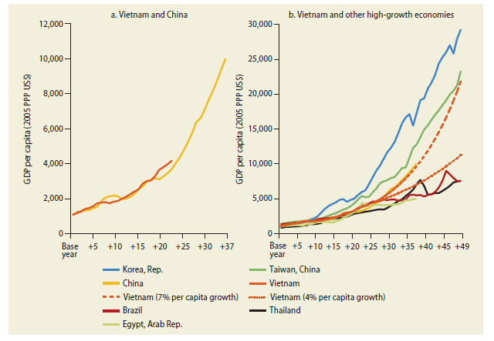
B. Overcoming the middle-income trap: Still a long way to go
Viet Nam needs to sustain high level of growth to continue on trajectory towards UMIC and HIC
Not many countries who have successfully continued transition from here
Source: World Bank
Notes:
But to overcome the middle-income trap and become a upper middle income and then high income country, Viet Nam still has a long way to go.
In the graph, you see how steep a growth rate Viet Nam has to maintain to follow China’s growth path.
This will not be easy. So far, Viet Nam has benefited from cheap labour and has attracted FDI in export-oriented sectors such as ICT and textile manufacturing. But for now, it often serves as the final assembly point of imported inputs, while the local value component is not so high. As the costs of labour is becoming more expensive and global trade opportunities are being reduced, the possibility to continue with this model of growth is more and more limited.
On the right hand side, you see that not many countries have been able to achieve to come out of the mit. Only Korea and Taiwan have been able to sustain high levels of growth to heave themselves out of the middle-income trap. Otehrs such as Brazil, Egypt, Thailand, have experienced a slow down in growth when they were at the stage Viet Nam is currently in.

Slide 22
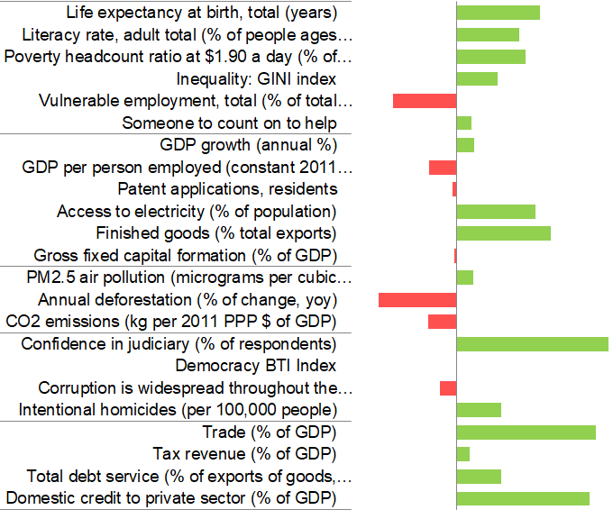
But quantity of investments does not guarantee quality
55.9% of the workforce in vulnerable employment
Social protection system not prepared to handle one of the world’s fastest population aging rates
Viet Nam likely to become one of the world’s major greenhouse gas emitters
Projections show a fourfold increase of the total net emissions between 2010 and 2030
Notes:
Also, looking closer reveals a number of socioeconomic and environmental challenges that the country needs to deal with.
This chart compares Viet Nam’s performance on socioeconomic indicators with other peer countries in the region. It shows that the availability of financing sources which come flowing into Viet Nam does not guarantee development impact.
Compared to peer countries, Viet Nam has high levels of deforestation and high levels of greenhouse gas emissions. At the current pace, Viet Nam is likely to become one of the world’s major GHG emitters in the world, as projections show a fourfold increase in net emissions between 2010 and 2030.
Socially, inequalities in Viet Nam are likely to increase. The economy is split into a burgeoning FDI sector and few highly successful domestic conglomerates on the one hand, and a huge informal sector consisting of small household businesses. A large part of the workforce is employed in the latter, and works under highly precarious conditions. Also, while Viet Nam’s society is ageing at one of the world’s highest rates, the social protection system is not comprehensive enough to handle these demographic pressures.
Viet Nam is at a criticial point in time, where policy-decision can influence which path the country will take. It can choose to stay on a more and more unsustainable path that based on cheap labor and low environmental standards Or it can choose a upgrade itself and move to a trajectory based on higher local value creation, that is socially inclusive and environmentally sustainable.

Slide 23
C. How can the DAC support countries to pursue a sustainable development path?
Strengthen enabling environment for private sector development: Support financial sector development. Facilitate local value addition through better linkages between SMEs and multinationals.
Shift from development towards economic diplomacy: New-generation FTAs (CPTTP and EU FTA) have potential to raise social and environmental standards. However, effective enforcement is a big challenge due to low level of capacities.
➔ The role of development partners: to accompany transition in a way that ensures social inclusiveness and environmental sustainability.
Notes:
What can the DAC do to support Viet Nam? What leverage does the DAC have in a context with massive FDI and trade flows?
The focus of relations between Viet Nam and partner countries is shifting from development towards economic diplomacy. But development partners can still help to steer the country towards a path for inclusive growth and sustainable development.
One example are trade relations. Viet Nam is signatory to a number of new-generation FTAs such as the CPTTP and the EU FTA, which come with social and environmental chapters and requirements. So, these FTAs have great potential to enhance development quality. But though laws are being made to comply with these obligation, effective enforcement of these standards is very challenging because of the low level of capacities.
The role of development partners is to help bridge this implementation gap. DAC providers can focus their resources and efforts to provide targeted technical assistance in meeting the new obligations that arise under the new FTAs, and help the country set up a sound governance framework to mobilise channel and regulate private resources.
Development partners can provide support for the creation of an enabling legal and regulatory framework for private sector development. This includes giving support for financial sector development, and providing opportunities for local value creation through helping to build linkages between domestic SMEs and MNEs.
Commitments to implement International Labour Organization core standards - (i) freedom of association and collective bargaining; (ii) elimination of forced labor; (iii) abolition of child labor; and (iv) elimination of employment discrimination.
Commitments to implement UN conventions on combatting climate change and protecting biodiversity

Slide 24
Thank you jieun.kim@oecd.org; cecilia.piemonte@gmail.com

Slide 25
A. The case of Lebanon: a UMIC in a fragile context
Despite being a UMIC, Lebanon has struggled with widespread poverty and inequality, exacerbated by instability in the region.
Income status:
Lebanon has been an UMIC since 1997
2. Economic vulnerability:
Multibillion post-war reconstruction led to massive debt accumulation – one third of public spending is on debt servicing
3. Social vulnerability:
Wide-spread poverty and unequal income distribution
Challenges compounded by Syrian war and instabilities in the MENA region (3.3 million people in need of assistance in the country, including 1.5 million vulnerable Lebanese, 1.5 million refugees and 300,000 Palestinian refugees )
Notes:
According to the 2007 national survey, which is the most commonly used for a pre-Syria crisis poverty profile, in 2005, 28% of the population were considered poor and 8% extremely poor. The bottom 20% of the population accounted for 7% of all consumption while the richest 20% accounted for 43%, over six times higher, however comparable to other middle-income countries as well as to the average of MENA countries. (MOSA and UNDP, 2007_{[8]}) (UNDP, 2008_{[9]}) (Oxfam, 2017_{[10]}) The Syria crisis has exacerbated the existing situation and it is estimated that the Syria crisis pushed about 200,000 Lebanese into poverty, with 40% of Lebanese being now vulnerable and in need of social assistance (World Bank, 2013_{[11]}); (United Nations, 2018_{[12]}).
One out of four people in Lebanon is a Syrian refugee, the highest per capita rate of refugees and the fourth largest refugee population in the world. The Government of Lebanon estimates that the country hosts 1.5 million of the 6.3 million Syrians who have fled the country since 2011

Slide 26
B. Lebanon receives relatively large amounts of official development finance

Slide 27
But ODF cannot replace Government’s role
ODF flows by sector, 2014-2017
ODF flows by channel, 2015-2017

Slide 28
C. Donors can donors can help the country make policy frameworks more inclusive
Lebanon in Oxfam’s Commitment to Reducing Inequality Index (2018)

