Slide 1
Democracies for People: Government accountability by moving beyond GDP

Slide 2
GDP: an incomplete measure of economic progress
Does not capture how growth is distributed
Assumes growth translates to higher living standards…. often not the case
Neglects environmental sustainability
Presents a gender-biased understanding of production

Slide 3
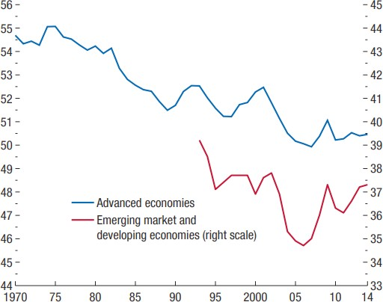
GDP growth has not been shared with workers
Evolution of the labour income share
Source: IMF (2017)

Slide 4
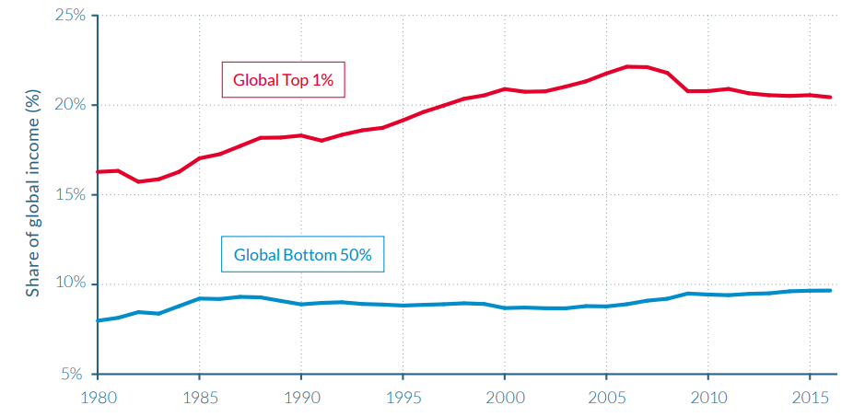
Top earners are capturing global income
The rise in the top 1% versus the stagnation of the global bottom 50%, 1980-2016
Source: World Inequality Report (2018)

Slide 5
Rapid global growth is not translating into improved livelihoods and well-being
Global GDP (current USD, in trillions) and % of the global population undernourished (2000-2018)
Source: ITUC calculations based on World Bank data (GDP) and FAO data (undernourishment).
Note: 2018 undernourishment data are FAO projections.

Slide 6
Growth is not translating into greater economic security
Percentage of the world’s population covered by social protection
Source: ILO World Social Protection Report 2017-2019

Slide 7
Some countries are starting to move beyond GDP

Slide 8
Possible indicators to inform policy and regain trust
Economy: e.g., income inequality levels, net job growth/full employment, gender inequality in the labour market (in addition to GDP/GDP per capita)
Living Standards: e.g., cost of living, average wages, wage growth, minimum wages, national poverty benchmarks
Tax, social protection and public services: e.g., progressivity of tax; social protection coverage; access to health, education and care services
Environment: e.g., progress towards net zero emissions, agreed just transition measures, pollution levels, workplace health and safety
Democratic rights and freedoms: e.g., human rights, labour rights, workplace democracy
Engagement of People: e.g., policy consultation, voting rights, tripartite institutions and processes, anticorruption measures

