Slide 1

Trade Union Development
Effectiveness Profile a practical tool for improving the quality of development cooperation

Slide 2
TUDEP BASIS
TUDCN ‘product’ linked to the work on TUs Principles & Guidelines and more widely to the engagement in development effectiveness processes
Policy Priorities of TUDCN: strengthen coherence among TUs strategies and support shared ownership of development cooperation initiatives

Slide 3
TUs Principles and guidelines on development effectiveness
Values and vision of TUs in development cooperation on:
the quality of partnerships
capacity development
Common and shared reference to:
strengthen working modalities enchasing the impact of trade union development initiatives
serve as a tool to spread awareness about the role of trade unions and their dynamics vis-à-vis external donors
- Supported by a consultation process

Slide 4
TUs Principles and guidelines on development effectiveness…in details
Democratic ownership
2. Autonomy
3. Partnership
4. Transparency
5. Accountability
6. Coherence
7. Inclusiveness and Equality
8. Sustainability
• Democratic sustainability
• Political sustainability
• Organisational sustainability
• Financial sustainability
• Environmental sustainability

Slide 5
TUDEP’s Objectives
Operational follow up to the Principles and guidelines, facilitating their monitoring and evaluation
Help partners to reflect about their working practices improving the quality of partnerships, as well as, organisational capacity
How does it work?
...........2 steps: analysis and comparison

Slide 6
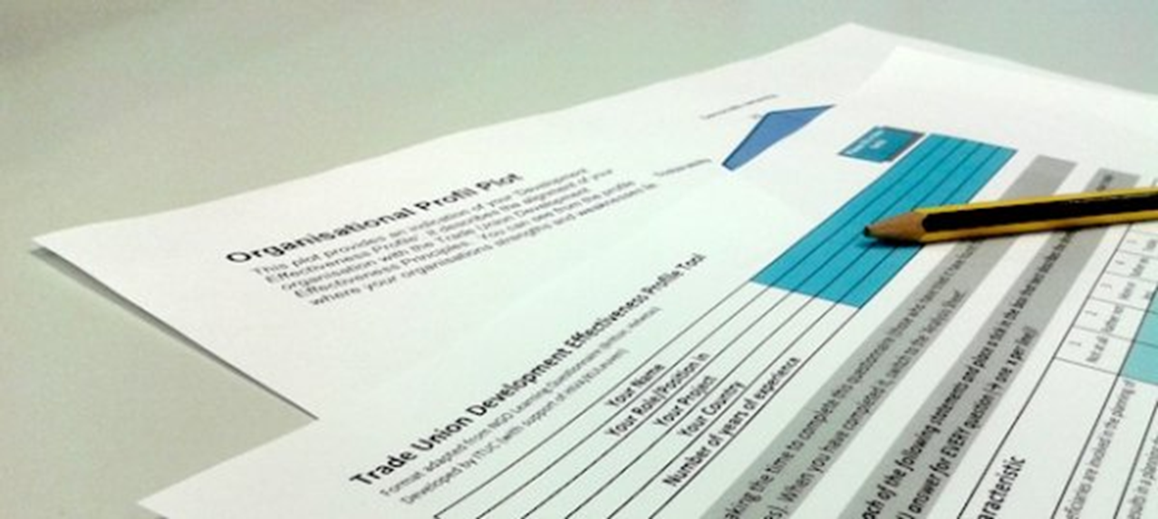
TUDEP’s STRUCTURE: questionnaire

Slide 7
TUDEP’s STRUCTURE: scoring

Slide 8
TUDEP’s STRUCTURE: organisational profile

Slide 9
TUDEP’s STRUCTURE: profiles comparison

Slide 10
TUDEP’s STRUCTURE: further support…Explanation Sheet

Slide 11
TUDEP’s STRUCTURE: detailed chart…comparison on individual questions

Slide 12
TUDEP FEATURES
- dialogue between partner organizations
…….it is to be used in conducive contexts i.e. workshops
learning oriented tool
……it can support organizational change (capacity development)
…….it can be used for planning, monitoring and final assessment

