Slide 1
SEMINAR ON ORGANISATIONAL CAPACITY ASSESSMENT Day 1 -Session on organising & capacity development: introduction
Brussels, 19th and 20th of March 2015

Slide 2
Why are we talking about capacity & capacity development?
In pairs – 15 mins
Share a personal experience/observation of a capacity development process in a trade union that was really effective
What did it look like?
How did you see that it
was successful?

Slide 3
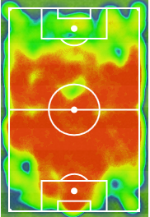
From capacity to performance..
Capacity
“Emergent combination of individual competencies/skills, collective capacities (capabilities), assets and relationships that enables a human system to create value”
(Baser & Morgan, 2008)
Individual skills & competencies
Capacity
development
Collective capacities
$
$
$
Capacity of a team (potential)
Capacity development
“process of enhancing, improving and unleashing capacity”
(Baser & Morgan, 2008)
OCA TCA
Context !
Performance!

Slide 4
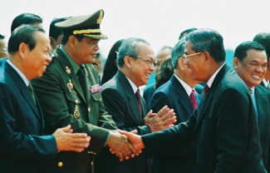
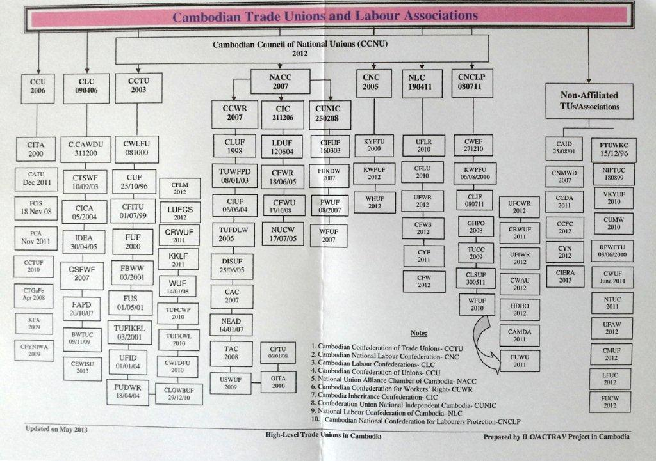
Context…
government
In a trade union setting..
companies
Confederation

Slide 5
What should we consider?
Capacity develops from within (endogenous)
Non-linear and iterative process
Influence of internal and external factors
Moving goal posts
Changing the rules of the game
implicit policies and practice on capacity development

Slide 6
SEMINAR ON ORGANISATIONAL CAPACITY ASSESSMENT Day 1 - Session on OCAs: introduction
Brussels, 19th and 20th of March 2015

Slide 7
Notes:
Start with a health warning!

Slide 8
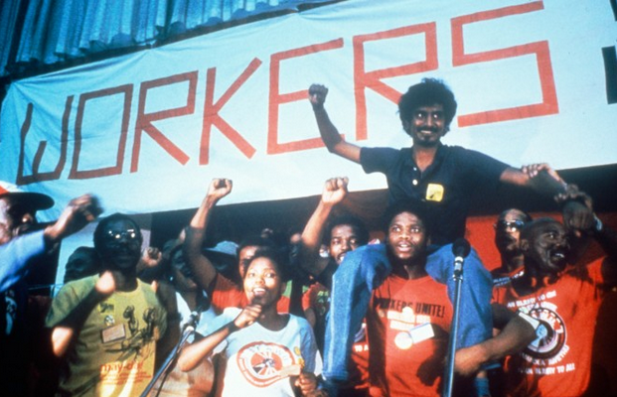
COSATU in Apartheid years: in need of an OCA?
Notes:
Capacity development through exchanges with unions in the region & in Europe.. Did someone do an OCA?
Nothing much stronger than a critical dialogue & collective reflection
Have to be carefull not to get caried away by the shiny instruments & tools.

Slide 9
Why so much attention for organisational capacity assessment (OCA)?
Arguments:
Making unions stronger requires insights into strengths & weaknesses
Failure of capacity development? => Need to know what works (and what not)
Funding agencies want to see results of capacity development
Doing OCAs can form the basis of differentiated cooperation approach between partners

Slide 10
Impact
Development Goal
3rd generation OCA
Adaptability
Sustainability
Adaptability
adaptability
Outcome
ownership
2nd generation OCA
Ownership
Performance
Performance
3rd generation OCA
2nd generation OCA
‘soft’ capacities
‘hard’ capacities
Output
1st generation OCA
…
Leadership
Structure & procedures
…
…
…
Skills devel
Input
Resources & other inputs

Slide 11
OCA: differences in methodology
On a continuum….
External assessment | Self-assessment
Quantitative scores | Qualitative scores
Generic capacities | Thematic capacities
Generic scales | Context-specific scales
Gap-based | Strengths-based
Individual process | Collective process
Learning / planning | Accountability – proving
Integrated in logframes | separate

Slide 12
TUDCN-manual on M&E (2013): 7 principles
7 principles for M&E
2. Local M&E practices and processes
3. Actor-based M&E system
4. Joint learning
5. Minimum M&E standards
6. Transparency and feedback
7. Keeping it simple
1. Democratic ownership

Slide 13
Question & answers?

Slide 14
SEMINAR ON ORGANISATIONAL CAPACITY ASSESSMENT Day 2 – OCAs by TUs: The Bigger picture
Brussels, 19th and 20th of March 2015

Slide 15
Impact
Development Goal
Adaptability
Sustainability
Adaptability
adaptability
Outcome
ownership
Ownership
Performance
Performance
5C OCA tools (FNV, CNV, ACLVB)
Solidarity Centre
LO-TCO
‘soft’ capacities
‘hard’ capacities
Output
…
Leadership
Structure & procedures
…
…
…
Skills devel
ACV-CSC
Input
Resources & other inputs

Slide 16
Current OCA introduced after donor or evaluation recommendation
 | Yes | No
ACV-IIWE |  | X
CGSLB | X
CNV-International | X
FNV Mondiaal | X
ISCOD
LO-TCO | X
Solidarity Centre | X
TRUDI |  | X
A number of SSOs are not using OCA tools by own choice:
not tolerated by own movement
autonomy of partner organisations
Want to avoid too much steering

Slide 17
Prescriptive versus open OCA
 | Comprehensive framework with detailled components | Open framework, contextualised
Strong points | Considering organisation as a whole Comparability between orgs | Building it up with partner Focus on issues that matter
Weak points/risks | Key issues lost in analysis? Risk for box ticking | SSO & back-donor flexibility required

Slide 18
Measuring hard & soft capacities?
 | Only ‘hard’-capacities | Both ‘hard’ and ‘soft’ capacities
Strong points | Simplicity of analysis Closer to logframe | Avoiding iceberg situation Comprehensive
Weak points/risks | Risk for over-focus on performance-related issues | Is partnership compatible Risk for steering Complexity of analysis

Slide 19
One OCA tool per partner?
 | Same tool for all partners of one SSO | Same tool for one partner
Strong points | Manageable for SSO & donor Comparing across partners | Less admin burden on partner More chance for use
Weak points/risks | Burden on partner Real use? | Making a stance against back-donors (& internal bureaucracy)

Slide 20
How can we limit administrative burden?
Confederation

Slide 21
Self-assessment versus external assessment (or combination?)
 | Self-assessment | External assessment (non-disclosure)
Strong points | Buy-in of partner Collective reflection | Avoiding lack of critical analysis Less burden on partner
Weak points/risks | Collective = secretary-general? Possibility to be self-critical? Fear for funding consequences | Transparancy of analysis Indirect steering

Slide 22
Quantitative scores or not?
 | Quantitative scores | Qualitative analysis
Strong points | Possibility to visualise & compare results Easy to manage | Less risk for simplification More focus on process aspects
Weak points/risks | Pressure to improve scores Fixation on scores Risk for being simplistic | More difficult to visualise Comparing is difficult

Slide 23
Hands-on versus hands-off
 | Hands-on | Hands-off
Strong points | Going beyond instrumental relationship | Respecting autonomy Ownership
Weak points/risks | Imposing agenda’s Steering in complex organisational challenges | Added value of partnership

Slide 24
Using OCA in which phase?
2. Planning
3. Implemen-tation
4. Monitoring
5. Evaluation
1. Analysis

Slide 25
Do’s & don’ts?
Do | Don’ts
If you want to check accountability or project management quality: use an existing audit tool … | Maximum one OCA for one partner! Don’t do to others what you would not accept yourself ..

Slide 26
Major challenges/dillemma’s
Contribution to important conversations in organisations?
Partners using multiple OCA and M&E instruments
Hands-on versus hands-off approach
Not all partnerships are OCA ready
Keeping it simple without being simplistic
Generic relevancy for different types of union structures(union, federation, confederation, networks)
Balance between self-assessment & external review
Moving from diagnosis to change management
Avoiding dominance of leadership

