Slide 1
ILO strategic objectives, actions and initiatives on social protection
ILO Brussels in cooperation with ILO social security department
Brussels, ITUC, 25 January 2012

Slide 2
Structure
  Point One: The UN Social Protection Floor Initiative
  Point Two: The 100th ILC and the emergence of a new policy paradigm
  Point Three : Next steps: The 101th ILC in June 2012 Recommendation on social protection floors and beyond; Cooperation with EU

Slide 3
One. The UN Social Protection Floor Initiative

Slide 4
What is the Social Protection Floor (SPF)–Initiative? ..
In April 2009, the UN Chief Executives Board (UN CEB)
agreed on nine joint initiatives to confront the crisis,
among them the Social Protection Floor Initiative
The SPF Initiative aims at joint global and local UN action lead by ILO+WHO to promote access to essential services and social transfers for the poor and vulnerable. It includes:
  A basic set of essential social rights and transfers, in cash and in kind, to provide a minimum income and livelihood security
  Geographical and financial access to essential public services, such as health, water and sanitation, education, social work

Slide 5
What as been done so far? Three Things…
One: Advocacy at global, regional, national levels => e.g. UNCSocD Resolution 2010, UN Millennium Summit, G8, G20, Yaounde Triparite Declaration, South-South Dialogue, the Conclusion of the 100th ILC, the Conclusions of the G20 Labour Ministers and Development Group
Two: Country operations in Cambodia, Burkina Faso, Mozambique, Nepal, Togo, Benin, Vietnam... with other agencies and IMF on basis of a joint UN manual (total number of country activities: 25)
Three: High-level Social Protection Floor Advisory Group established under chairpersonship of Ms. Michelle Bachelet ; report launched at the UN ON 27 October 2011
Notes:
4

Slide 6
The Bachelet report…makes the case for he SPF :
The SPF is a tool to
  Realizing Human Rights and social justice
  Combat poverty and inequality
  Accelerate progress towards achieving
  the MDGs
  Ensure adequate opportunities for Decent Work
  Address the social and economic impact of
  the crisis
  Help redressing global imbalances
  To support gender empowerment
  Support nation building
  Facilitate social transformations and is
  ...affordable even in low income countries...
Notes:
5

Slide 7
… and recommends…:
The implementation of nationally defined social security extension policies based on a SPF everywhere as an indispensable contribution to social and economic development
A number of principles for the implementation of the SPF close to the ones identified by the ILC
National monitoring mechanisms, that map progress on coverage and quality of social security
Co-ordination and co-operation of international agencies in implementing social protection and the SPF
Linking the SPF to the MDGs and MDGs beyond 2015
International standard setting on the SPF, notably the ILO recommendation
Greater focus of international development aid on the SPF
Notes:
6

Slide 8
Two. The 100th ILC and the emergence of a new policy paradigm

Slide 9
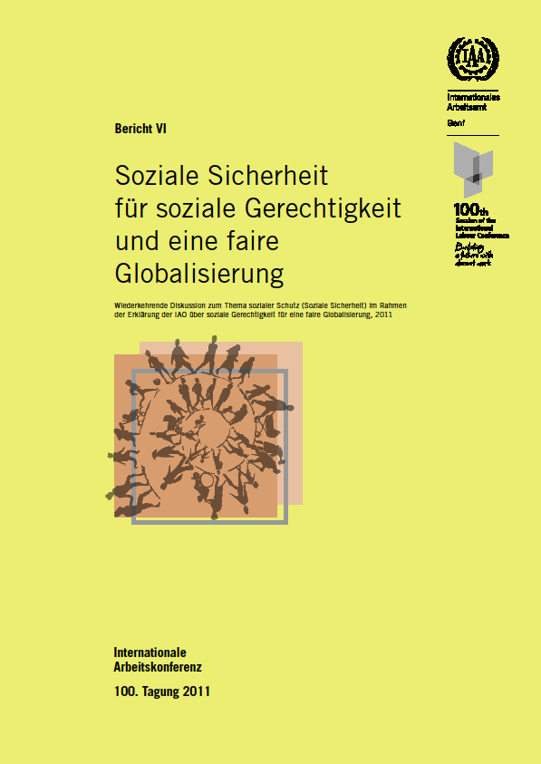
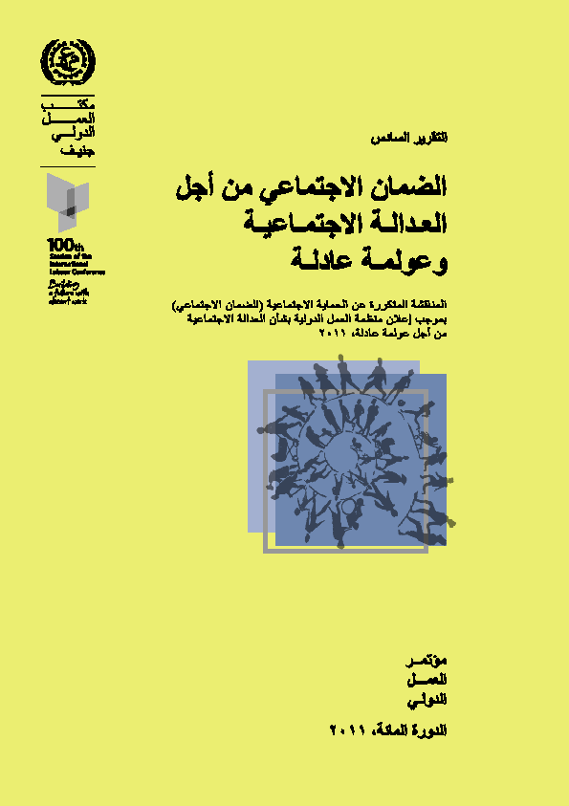
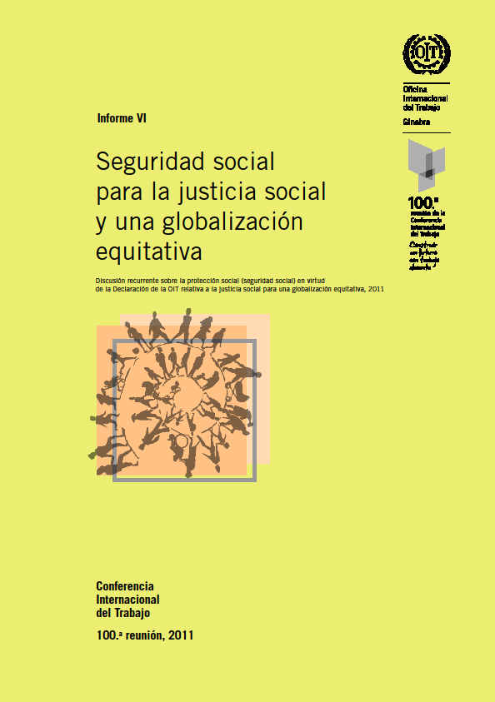
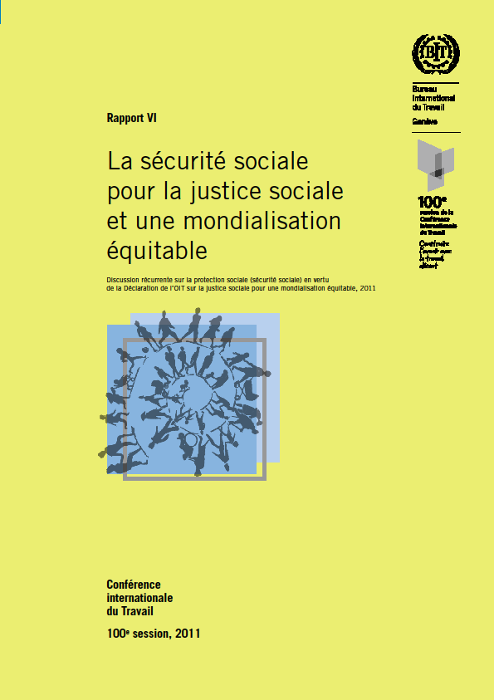
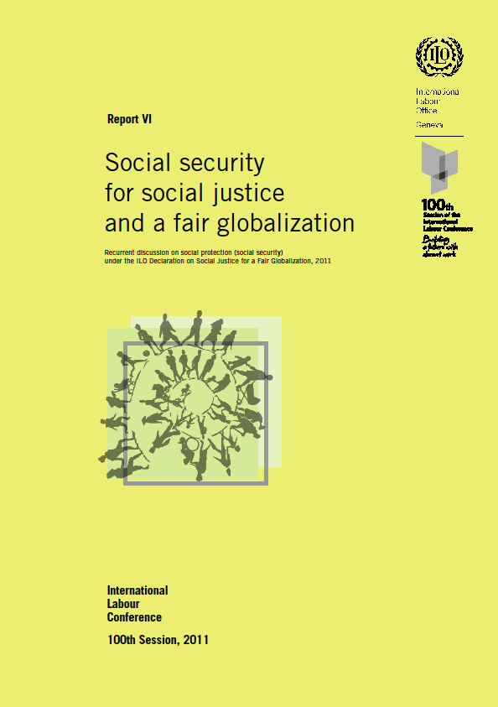
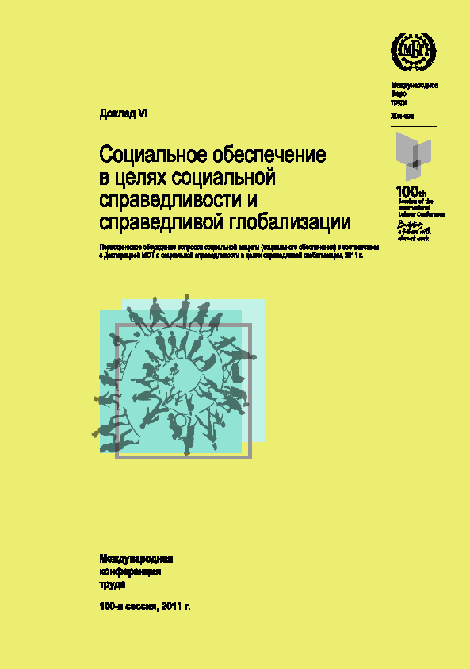
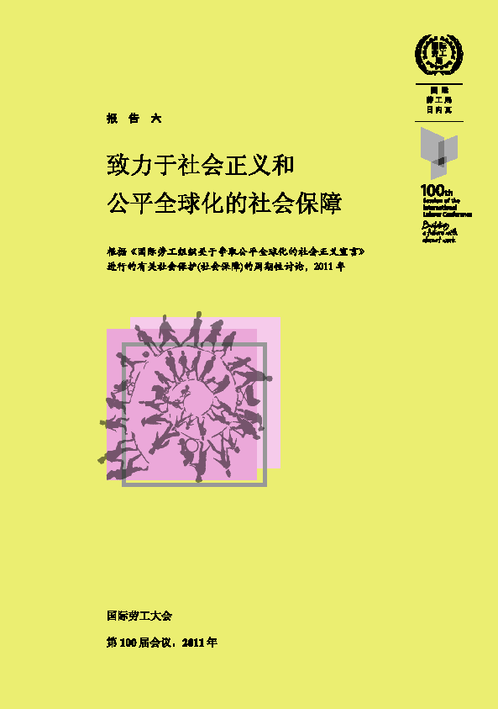
Input: The Office report
Report VI:
Social security for social justice and a fair globalization
Report available on ILC website in English, French, Spanish, Arabic, Chinese, German
and Russian
http://www.ilo.org/ilc/ILCSessions/100thSession/reports/lang--en/index.htm

Slide 10
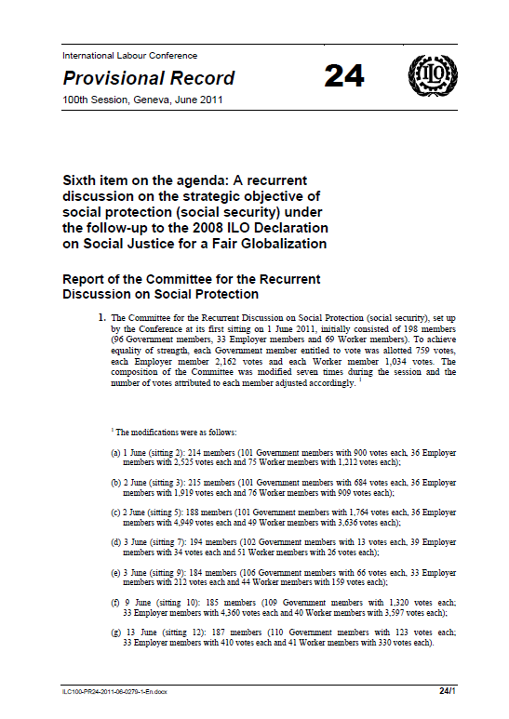
Outcome of the Recurrent Discussion on social protection (social security), ILC 2011
Resolution concerning the recurrent discussion on social protection (social security):
“

Slide 11
Outcome: Summary of results of the ILC 2011 and follow-up
Resolution and Conclusions on social protection (social security), adopted by the tripartite delegations represented at International Labour Conference (183 member States)
Endorsement of ILO two-dimensional strategy for the extension of social security coverage
Discussion on a possible Recommendation on Social Protection Floors at ILC 2012
Reaffirmed mandate for ILO to assist member States in the extension of social security coverage and building social security systems, including
  Technical assistance to support design and implementation of
  two-dimensional extension strategy, including Social Protection Floor
  Assistance in promotion and implementation of ILO social security standards (notably C. 102)
  Facilitation of exchange of experiences and good practices, including development of a good practices guide

Slide 12
Mains elements of the “Geneva consensus”
  Sustainable social security systems are a key element in promoting productive economic growth with equity
  Social security and other pillars of the Decent Work Agenda (productive employment, rights at work and social dialogue) are inseparable, interrelated and mutually supportive in reaching the objective of social justice and fair globalization
  Provision of social security should be based on entitlements defined within a national legal framework
  Tripartism and social dialogue based on freedom of association and the effective recognition of the right to collective bargaining are key elements contributing to sustainability of social security systems in which non-contributory and contributory schemes complement each other
  Social security is not only human right but also economic and social necessity

Slide 13
On strategies to extend coverage
  Closing coverage gaps is of highest priority for equitable economic growth, social cohesion and decent work for all women and men
  National strategies, in line with country priorities, administrative feasibility and affordability, should aim at achieving universal coverage of the population with at least minimum levels of protection (horizontal dimension) and progressively ensuring higher levels of protection guided by up-to-date ILO social security standards (vertical dimension)
  The two dimensions of the extension of coverage are consistent with moving towards compliance with the requirements of the Social Security (Minimum Standards) Convention, 1952 (No. 102) and are of equal importance and should be pursued simultaneously where possible

Slide 14
The ILO‘s two-dimensional strategy for the extension of social security coverage endorsed:
The progressiveness of protection
high
Higher levels min. c102
Voluntary insurance
under government regulation
  Vertical dimension: progressively ensuring
  higher levels of protection
  guided by C.102 and higher-level standards
Level of protection
social security benefits
of guaranteed levels
Floor level
Access to essential health care
and minimum income security for all
low
low
individual/household income
high
  Horizontal dimension:
  Guaranteeing access to essential health care
  and minimum income security for all

Slide 15
Minimum income security and access to essential health care can be achieved by different delivery systems
national choice
social assistance
social insurance
universal systems
combination of these+others
nationally guaranteed outcomes

Slide 16
The Social Protection Floor: we see four nationally-defined guarantees
TRANSFERS in cash or in kind
all residents
have access to a nationally defined set of essential health care services
all children
should enjoy minimum income security through transfers in cash or kind aiming at facilitating access to essential goods and services, such as nutrition, education and care
active age groups unable to earn sufficient income in the labour market
should enjoy minimum income security through social assistance transfers aiming to achieve access to essential goods and services
all residents
in old age and
with disabilities
should enjoy minimum income security through pensions/transfers in kind that guarantee access to essential goods and services
Outcome-oriented approach taking account of national conditions, priorities and institutions
Transfers in cash and in kind should guarantee geographical and financial access to essential services such as water and sanitation, health, and education

Slide 17
Principles for the extension of social security coverage
Universal coverage
Fiscal, financial and economic sustainability
Rights-based approach
Adequacy and focus on outcomes
Progressiveness
Universal coverage of all residents
if necessary gradual implementation based on rational priority-setting in a social dialogue process
Sustainability
Scope of basic guarantees commensurate with available fiscal space
Adequacy of guarantee levels with clear focus on outcomes
Flexibility as to institutional arrangements (pluralism)
Encouraging progress towards C102 and higher-level ILO standards
Benefit provision as a legal entitlement
Coherence and efficiency of overall social security system

Slide 18
Three. ILC June 2012, Next steps, cooperation with EU

Slide 19
...AND THE NEXT MILESTONES in the Global Policy agenda ?:
ILC 2012 with a new recommendation
G20 endorsed the SPF as a means to create a concrete social dimension of globalisation... with the Bachelet report to feed into the discussion
Building a joint global knowledge base
Country level implementation projects, capacity building (with ILO Turin training centre)
Monitoring of progress of SPF and cooperation with UN system and IFIs

Slide 20
And cooperation with EU, EU Member states and social partners
EU supported social protection extension strategy and SPF at ILC, in G20, ASEM summit, EU-Africa meetings and UN; support EP
EU development report 2010 on social protection (ILO contributed)
Social protection schemes and floors included in EU agenda for change (future development cooperation) - future communication
UN (reply complemented by a specific ILO Office one)to EC consultation
EU joint informal meeting of SPC and EMCO in April 2012 on SPF and ILC 2012
Likely an EU prep. meeting in Brussels on ILC (with consultation social partners)
Future development programming EU MS and EU: decent work including social protection ? what about specific role of social partners and social dialogue ? what about labour rights and linkage between policy dialogue, trade and programming of TC ?
EU support to global technical cooperation efforts ? support for a global facility ? See Bachelet report and support G20

