Slide 1
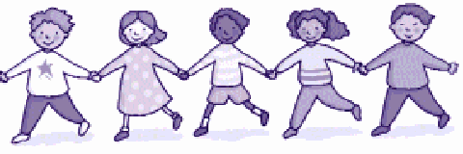
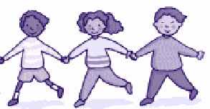
“ “My school and the world” AWARENESS CAMPAIGN FOR SCHOOLS AND TEACHERS

Slide 2
Origin
The new social composition in Spain in 2004 and earlier by the arrival of immigrants and the derivation in public school
It is necessary to work on the prevention of xenophobic behavior models integrated in public schools because many students from other cultures in a short time, some of them arrive with language difficulties
* The parents see this as a threat for the quality of teaching
* The teachers have no preparation for the change on the composition of the class.

Slide 3
INTERVENING AGENTS INVOLVED:
Instituto Sindical de Cooperación al Desarrollo
The project falls within the framework of actions ISCOD on trade union development cooperation, as an extension of social inequality, workers' rights, values ​​education and intercultural harmony.

Slide 4
Federación Estatal de Trabajadores de la Enseñanza, FETE- UGT,
Provides to the project activities aimed to the improvement of educational community, because of its importance as an agent of socialization.
FETE offers training to teachers on the principles of education for equality.

Slide 5
These two institutions design an intervention that provides
Values ​​education for the solidarity, the participation and an intercultural coexistence

Slide 6
Specific Objectives
Design and make teaching materials in print and digital format to bring to the school the social and ​​Education values and intercultural harmony
Design and develop a training plan for teachers with an active methodology, for mainstreaming of the perspective of values ​​education in school curricula

Slide 7
Strategic Objectives
Working with teachers and children in a transversal manner
Education for Development
Peace Education
environmental Education
Education for Participation
Education for equality between men and women

Slide 8
Parts of the project
Materials for teachers
Materials for students
Teachers training plans
A web site where the materials could be downloaded and the users could participate on line
Workshops for basic school students
Integrate schools in a solidarity network for the dissemination of materials, sharing knowledge and experience and promote joint projects.

Slide 9
Characteristics of the materials
Respect for all groups of people and their cultures.
Tolerance of ideas that are not contrary to human rights.
Critical capacity against unjust laws and situations that violate human rights.

Slide 10
Characteristics of the materials
Active fight against racial discrimination.
Interpersonal acceptance.
Overcoming ethnocentrism.
Communication and exchange between people and various ethnic groups.
Positive acceptance of different cultures.

Slide 11
Characteristics of the materials
Active cooperation in social construction.
Social responsibility.
Conservation of the natural and social environment.

Slide 12
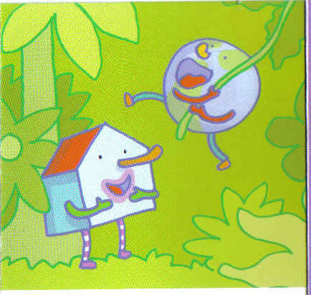
Methodology
Participative vision with the construction of two characters
the school
the world
Whit that bring to the school the real world

Slide 13
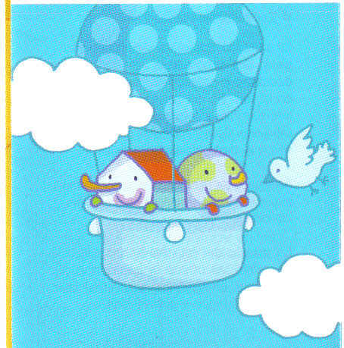
It creates a story in which the school makes a trip across the five continents where children are placed in an individual and collective form

Slide 14
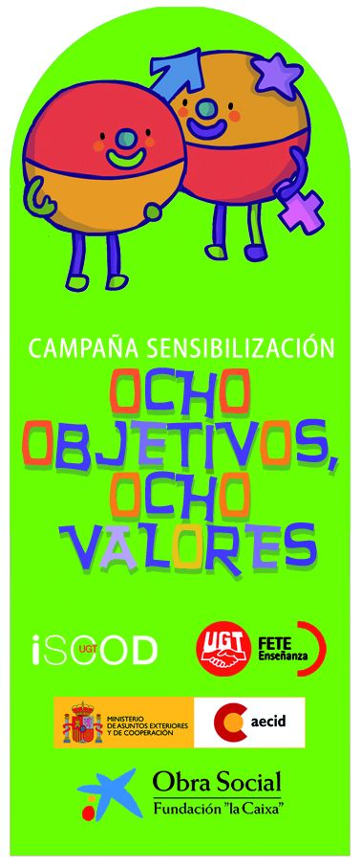
Evolution
School campaign for secondary:
eight targets,
eight values ​​based in the Millennium Development Goals.

Slide 15
Networking
http://www.aulaintercultural.org/
http://www.educacionenvalores.org/

Slide 16
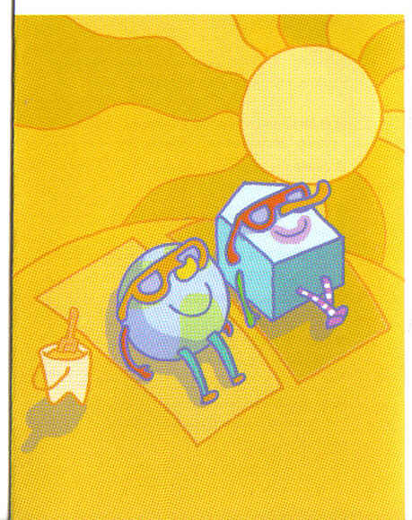
Gracias= Thank you
To share our progress and our setbacks in building up a more just world
In this occupation
we can not rest

