Slide 1
AFL-CIO ORGANIZING WOMEN WITH STRATEGIC APPROACHES
2ND WORLD WOMEN’S CONFERENCE
Dakar, Senegal 19-21 November 2013

Slide 2
Notes:
Hello Sisters! I have been so inspired by the amazing work I’ve heard so many of you talk about in the last day and I only hope what I have to share is of some use to all of you… I thank you for the opportunity to share some experiences from the U.S.
The labor movement in the U.S. has been in a steady decline the past 30 years, and has not done a good enough job of adapting its institutions or approaches to organizing as the economy and structure of employment in the U.S. has changed. Our labor movement and its institutions largely represent the interests of workers in the formal economy—people with permanent employment and generally speaking, high skills. While in the U.S. the informal economy is relatively small compared to many places, it is significant, and much of the formal economy is now characterized by highly precarious, low-wage work in the service sector. We have a large and growing immigrant workforce, many without citizenship, and employers like Walmart that are big enough and powerful enough to lower standards for workers from their stores and throughout the U.S. economy as well as all the way through a global supply chain.
But the 2013 AFL-CIO National Convention marked a historic opening in the U.S. labor movement and signaled a new commitment to openness, inclusion, new ideas, and most fundamentally, organizing. As sister Sharan Burrow, General Secty of the ITUC said yesterday, the best way to build power for workers is to Organize! Organize! Organize!
A series of resolutions were passed that commit the AFL-CIO and its unions to focus on organizing in bigger and more effective ways… NEXT SLIDE

Slide 3
Help All Workers to Organize Support Immigrant Workers’ Rights Create a Broad & Inclusive Labor Movement Global Organizing
Notes:
To summarize the commitments most relevant to the issues related to building power for women workers, US unions and the AFL-CIO will:
Pursue efforts to help all workers organize--
For example, worker centers—local organizations fighting for immigrant workers rights, can now affiliate into local labor councils,
National affiliates are now required to submit organizing plans to the federation each year and the focus is on identifying large targets and encouraging multi-union campaigns
And the AFL-CIO and its affiliate unions must commit resources to research and strategic campaign planning—I am a researcher, so I am biased, but I always say: good facts and analysis drive good strategy and a sound strategy drives effective tactics. We are committed to this approach and designating resources to back it up.
Support Immigrant Workers’ Rights
We will promote organizing of immigrant workers
We will work with affiliate unions to recruit and train organizers from the immigrant community
Create a Broad and Inclusive Labor Movement
We will expand existing forms of worker representation through ideas like associate member programs that establish a membership ladder and make joining the union easier. We are also creating new forms of membership available to any worker, for example through our affiliated non-profit organization, Working America
Global Organizing
Develop a shared analysis of global supply chains and multi-national employers--, USW partnership with Africa FAWUL .Solidarity Center also supporting this work and it is a great example of leveraging supply chain relationships to organize precarious workers and improve egregious worker rights violations.
We will also expand work with the global labor movement to develop global bargaining strategies and new forms of cross-border representation--The work of CUT of Brazil with some of our affiliates is a good example here.
While these are general commitments and not specific to women, they represent a big shift in focus for us and set the stage for innovative campaigns to organize the most vulnerable women workers in the precarious workforce and the informal economy.
Now I will briefly describe two examples of innovative campaigns targeting a majority female and low wage workforce…

Slide 4
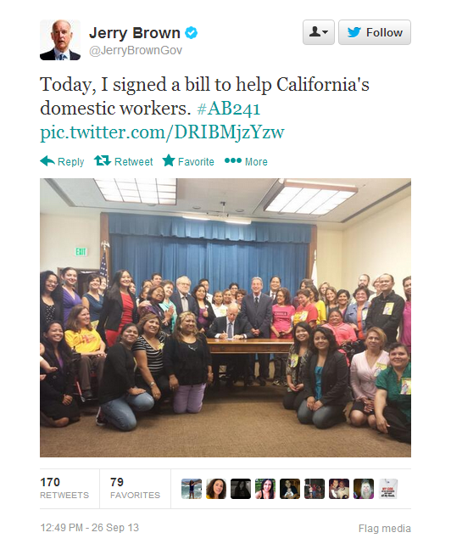
Notes:
The first campaign I want to talk about is the work of the NDWA.
Founded in 2007, NDWA works for the respect, recognition, and inclusion in labor protections for domestic workers—mostly women. The national alliance is powered by 45 affiliate organizations of over 10,000 nannies, housekeepers, and caregivers for the elderly.
Organizing efforts recently paid off when on September 17, the Obama administration announced new rules creating protection under existing labor law for the 800,000 to 2 million home health workers—who help the elderly and others with self-care tasks like taking medications, bathing, and shopping.
For the first time ever, these employees, mostly women, will be guaranteed the federal minimum wage and will earn overtime pay.
And, importantly, their victories have implications for a much larger portion of the workforce, including independent contractors, nontraditional employees, and those on temporary assignments. The domestic employees' wins are helping to chart a path forward for the growing number of employees who work outside conventional employment relationships.

Slide 5
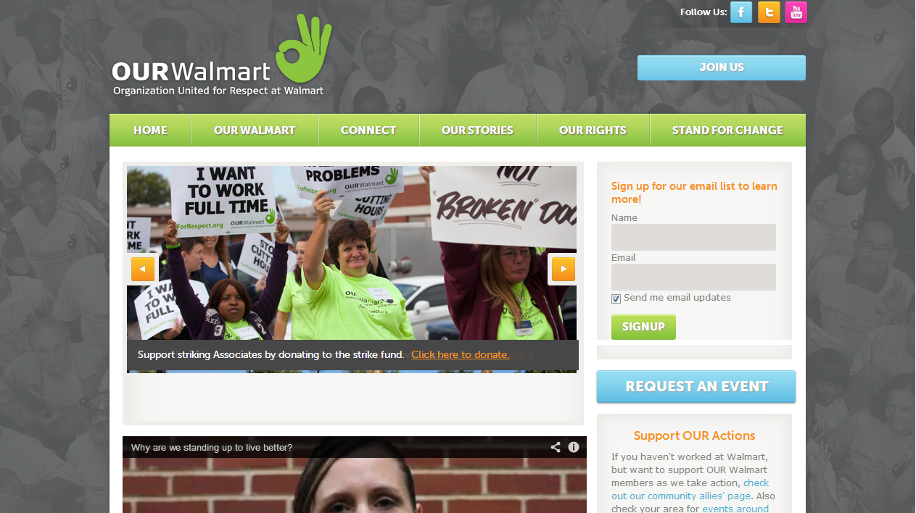
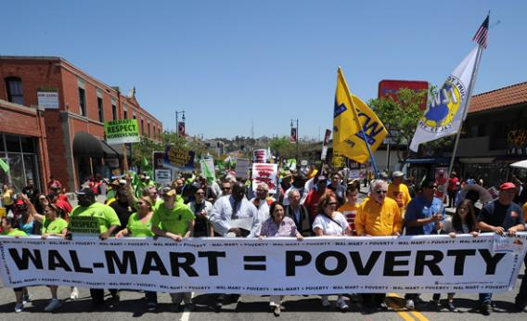
Notes:
The second campaign I want to mention is the Our Walmart campaign—a worker driven, bottom up, national organizing campaign supported by the United Food and Commercial Workers union.
Walmart is the largest retailer and the largest private employer in the world—as I mentioned in my opening, what Walmart does can impact the entire U.S. economy as well as create tremors through its supply chains around the world.
Walmart workers earn poverty wages and face discrimination, abuse by managers and retaliation for organizing. Women, who make up more than half of the workforce at Walmart have it even worse…
Walmart spent years defending against the biggest class action gender discrimination lawsuit in history
While women make up 57% of Walmart’s workforce, the majority of managers are men, leaving women in the lowest paying positions
Walmart pays women $5,200 less per year on average than men
Irregular schedules and insufficient sick days make Walmart a particularly difficult place for mothers to work.
Walmart workers have a very flat organizing structure and they rely heavily on social media both to communicate and also to do what is traditionally done one-on-one to develop campaign leaders. The campaign Facebook page is a real hub, where a full time on-line organizer interacts with workers across the country who respond to prompts put out by the campaign. If someone likes something they are encouraged to comment, if they comment, they are encouraged to post something about their store and to reach out to their co workers, if they continue to respond, the organizer will contact them directly and encourage them to organize co workers and plan an event. There are “affinity” groups who form relationships and take action around issues they have in common—this has been very powerful for women Walmart workers who have connected around health, child care issues, and unequal treatment.
There are now thousands of stores with active workers participating in the campaign at different levels, and with very few paid union staff working in support.
Walmart workers from three separate stores in the Chicago area went on strike last week. The walkouts are the latest in a series of worker demonstrations in protest of the retailer's low wages, unpredictable hours and unjust retaliation against workers. These protests come one day after two hundred community members and workers staged a similar one-day strike in the Seattle area. The previous week, Walmart protests in California led to the arrest of more than 50 Walmart workers and supporters in downtown Los Angeles, the largest civil disobedience case in the company's history.
And last year on “Black Friday”---the day after our Thanksgiving holiday, traditionally a huge shopping day and the day when most U.S. retailers make a huge proportion of their profits for the year-- workers joined strikes and actions at over 1000 stores across the country. The activities of the last few weeks will lead up to what the campaign hopes will be even more workers walking out on Black Friday next week.
This campaign has a global component too…
Through UNI Global Union there is a global network of Walmart workers unions, with leadership from young women workers who are organizing at the workplace and have joined together to hold workplace actions and common worker demands across several countries including Brazil, Chile, US, and others.
There is also work with community and labor allies around the world to put pressure on Walmart’s vicious expansion strategy. By teaming up with environmental, transparency, community and other groups concerned about the impact of new super Walmarts in their community, the network has challenged the company’s unfettered expansion. (examples are Walmart in South Africa and El Salvador
To wrap this up, I just want to go back to the idea I shared earlier about the progression from research to strategy and strategy to tactics. In the face of an employer as big and powerful as Walmart and with a disenfranchised workforce spread out all over the U.S., the idea of building sufficient worker power to win is daunting and seemingly impossible.
But deep research and analysis has enabled these workers and the union supporting them to design a smart, innovative campaign structure and to layer in a variety of strategies--from reaching out to Walmart shareholders to focusing major actions at times when the company is vulnerable, to a sophisticated communications campaign that highlights issues that resonate with all low wage workers and appeal to consumers as well This comprehensive, strategic approach is proving effective at chinking away at Walmart’s power and public image while the workers continue to build a union whether Walmart says they can or not.

Slide 6
Applying basic organizing principles to informal/precarious work:
Research and analysis to identify: ” who has the power to improve conditions?
Finding workers on their home turf to have one-on-one conversations
Identifying their issues
Building leaders, creating a committee
Taking action--escalation
Notes:
Skip this slide if out of time
In conclusion, I want to leave you with the best practices that run through both of these campaign examples:
Research and analysis to identify: ” who has the power to improve conditions?
Finding workers on their home turf to have one-on-one conversations
Identifying their issues
Building leaders, creating a committee
Taking action--escalation
Thank you…

