Slide 1
International Trade Union Confederation
2017 Global Poll

Slide 2
Methodology
The 2017 International Trade Union Confederation Global Poll
16 COUNTRIES
3.9 BILLION PEOPLE
53% OF THE WORLD’S POPULATION

Slide 3
1.0
Executive Summary Globalisation is Failing People

Slide 4
1. A global jobs crisis
Not enough jobs
Seventy-three percent of respondents to the ITUC Global Poll worry about people losing their jobs. Over the past two years, almost 4 in 10 have directly experienced unemployment or the reduction of working hours – either in their own job or that of a family member.

Slide 5
1. A global jobs crisis (Continued)
Not enough jobs for the next generation
Nearly half of all respondents do not expect the next generation to find a decent job. Hope that the next generation will find a decent job is a key driver of cohesive societies.
Working conditions
61 percent are concerned about weakening or dismantling of labour laws.

Slide 6
2. Wage despair
Worries about rising inequality
Across the world, almost three in four people (74 percent) are worried about rising inequality between the richest 1% and the rest of the population. 56 percent are worried aboutunfair competition from lower paid foreign workers.
Family incomes in crisis
Many workers are facing serious financial pressure, 80 percent of people are just getting by. Close to half of the respondents (45 percent) say their family income has fallen behind the cost of living in the past two years. Only one-third of the respondents (35 percent) say their family income has stayed even with the cost of living in the past two years. And nine percent of the respondents now lack the money for basic essentials like housing, food and electricity.

Slide 7
2. Wage despair (Continued)
Minimum wage is insufficient to lead a decent life
An overwhelming majority of 80 percent of respondents globally say the minimum wage in their country is insufficient to enable workers to lead a decent life.

Slide 8
3. Fear of climate change and cyber-attacks
Outside of the workplace, 66 percent of people worry about climate change, and 63 percent worry about cyber-attacks on banks, government or other services.

Slide 9
4. Failure of governments
Global companies hold the power
Governments are failing to act in the interests of people. Many people feel confronted with an economic system that favours the wealthy – and which is not fair to most people. More than seven out of ten respondents (71 percent) believe working people do not have enough influence on how rules in the global economy are set and 53 percent are concerned that national governments do not have enough power. 71 percent believe the richest 1% of people have too much influence and 61 percent say that ‘corporate interests’ have too much power when it comes to setting the rules for the global economy.

Slide 10
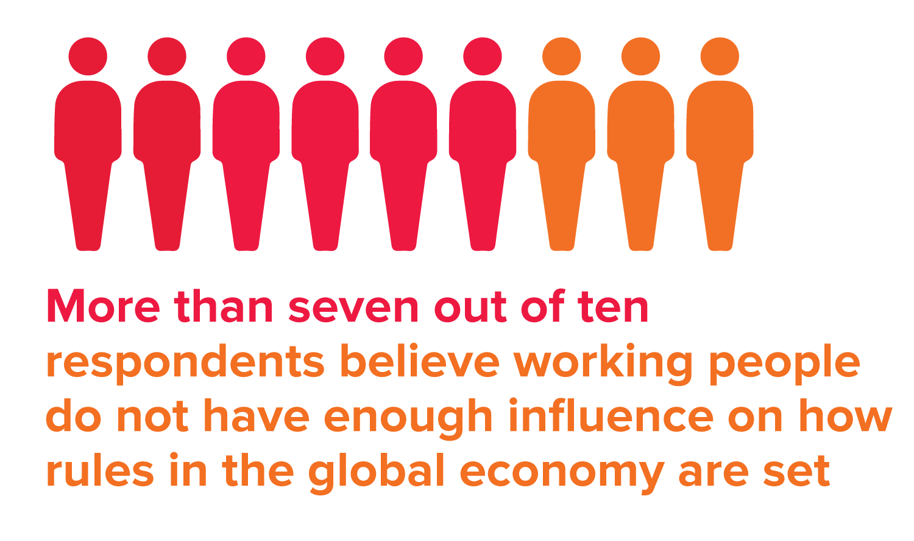
4. Failure of governments (Continued)
The 1% set the rules of the economy
80 percent of all respondents believe the economic system favours the wealthy, rather than being fair to most people. There is not a single country in the ITUC Global Poll where a majority of the respondents says the economic system is fair to most people.
Frustration with performance of national governments
People are disappointed with the performance of their governments when it comes to decent retirement incomes, unemployment benefits, and on providing affordable access to health care and education.

Slide 11
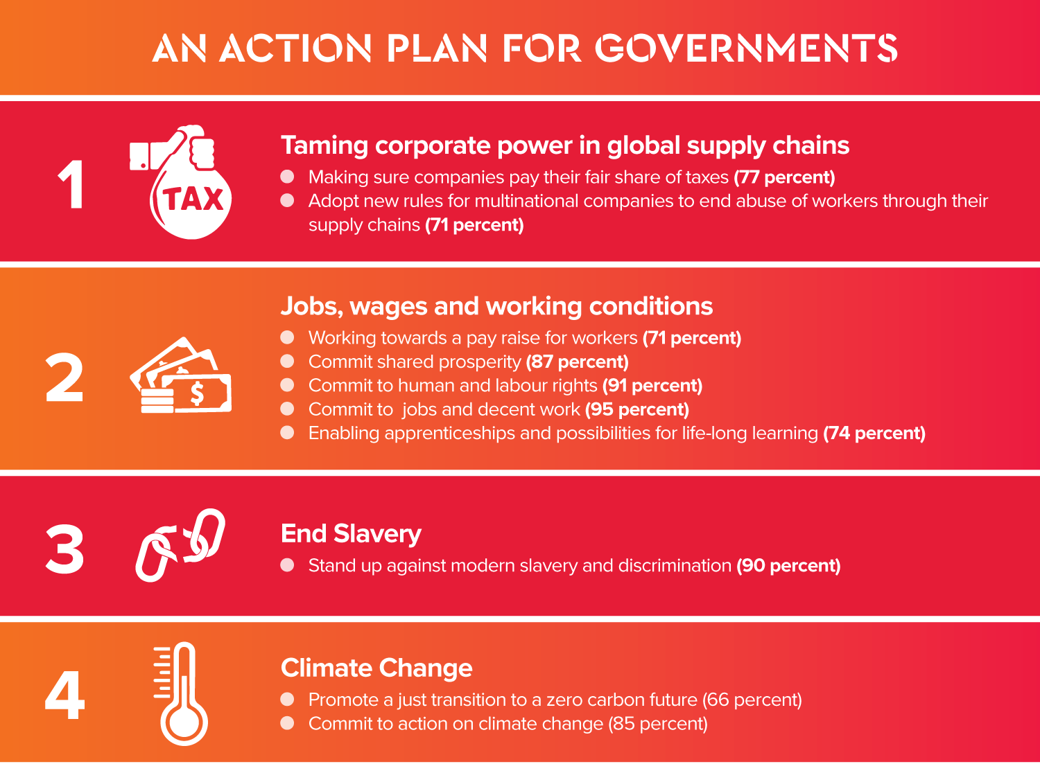

Slide 12
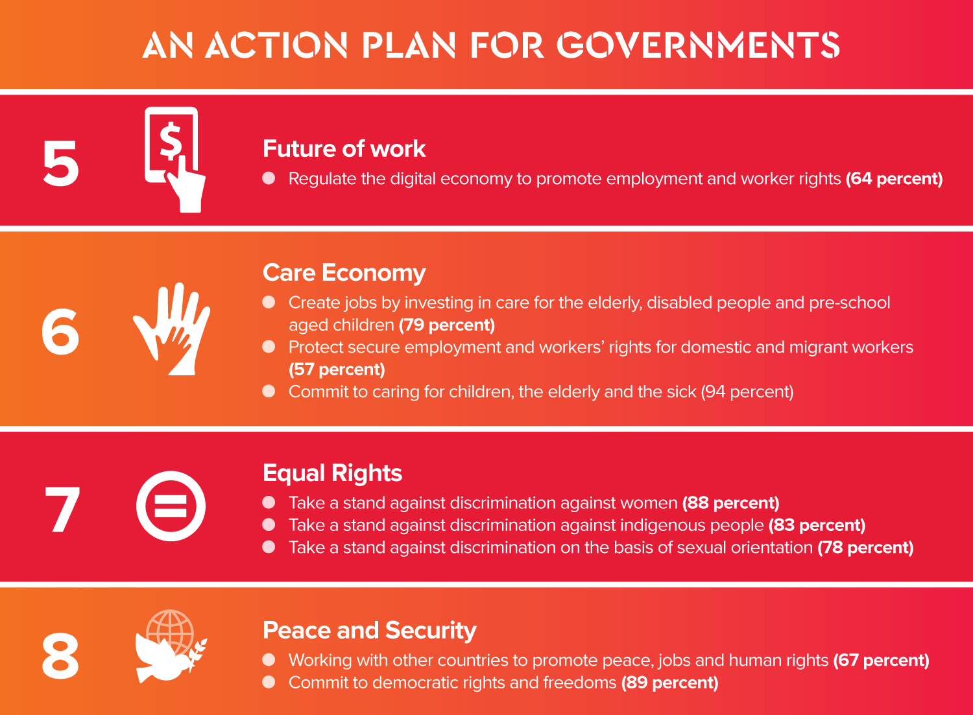

Slide 13
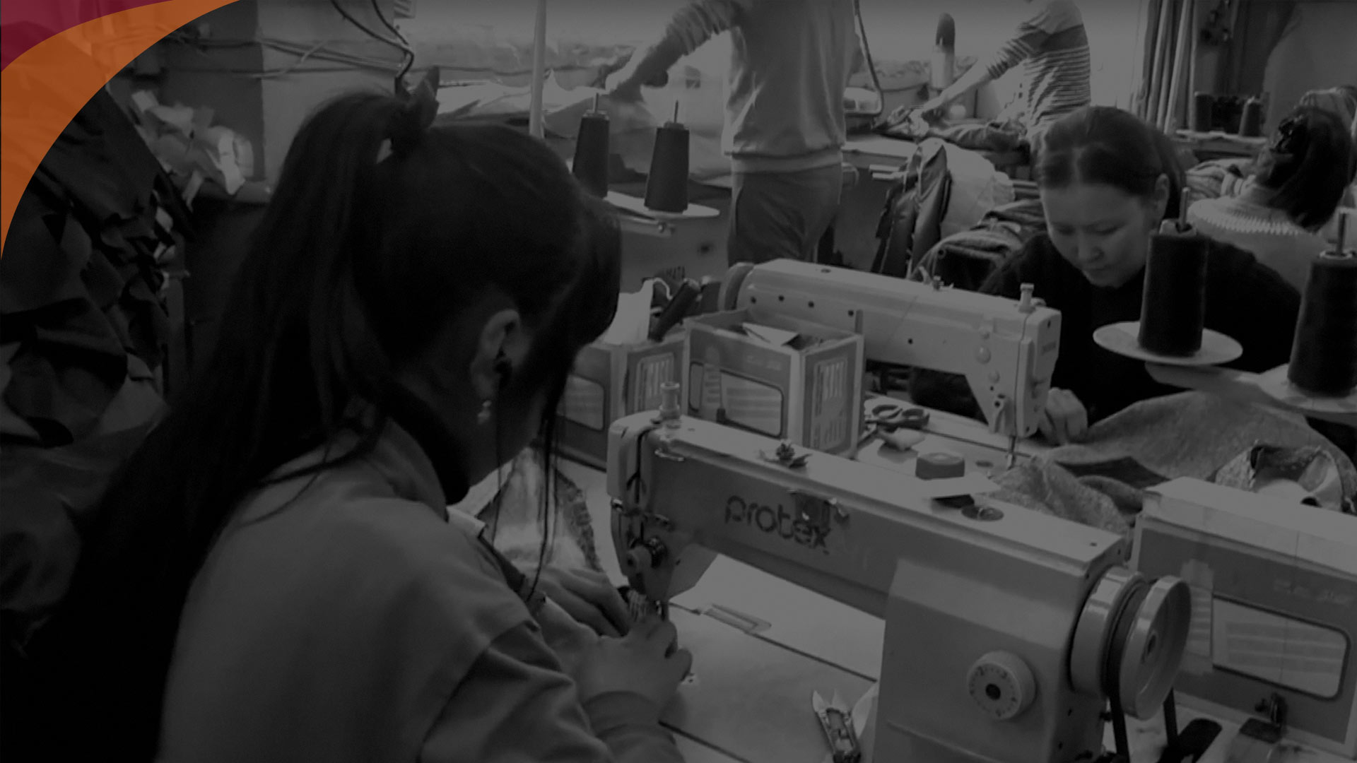
2.0
Key Findings Globalisation Anxiety about the World and Work

Slide 14
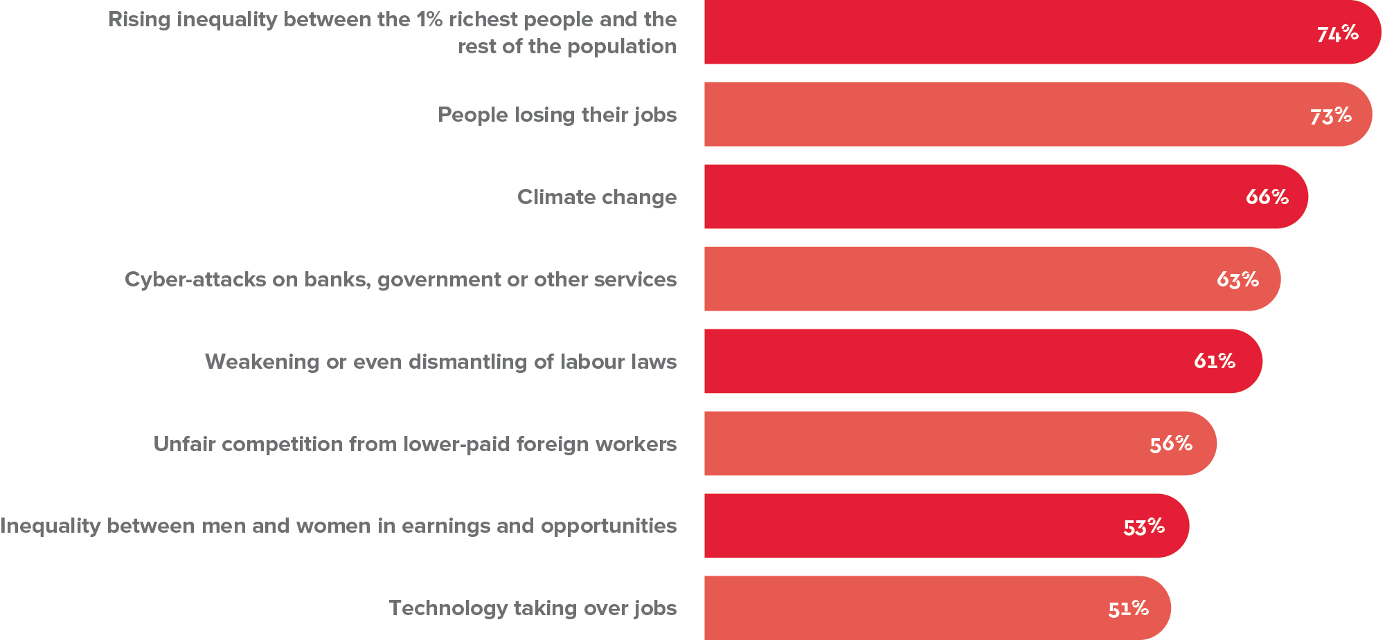
People are worried
What worries you?

Slide 15
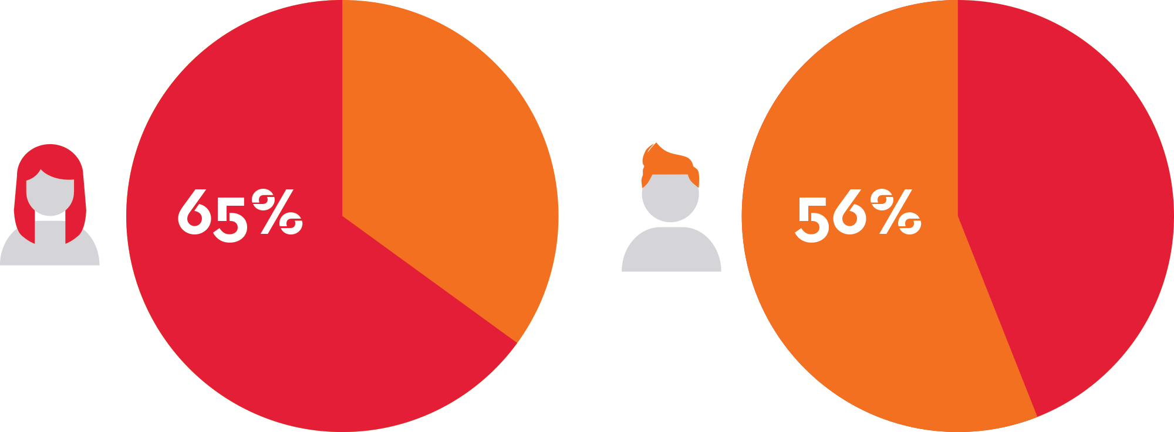
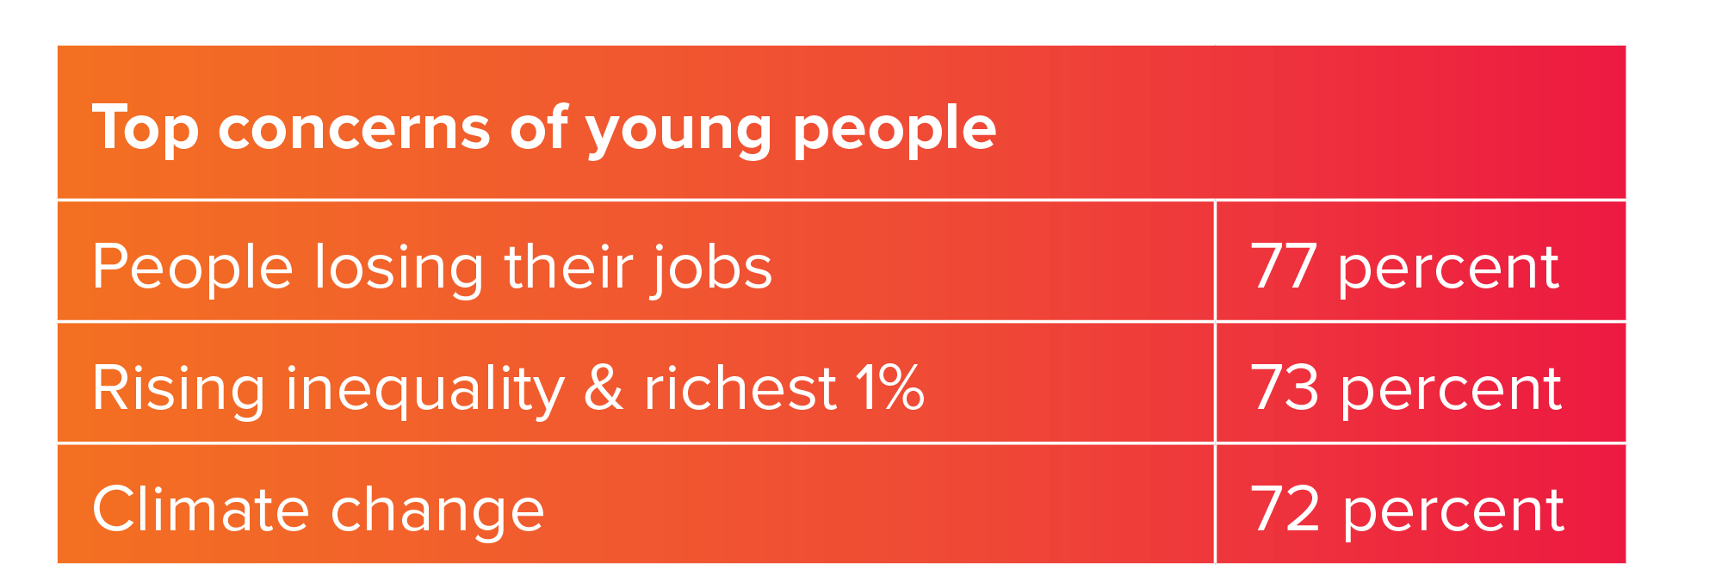
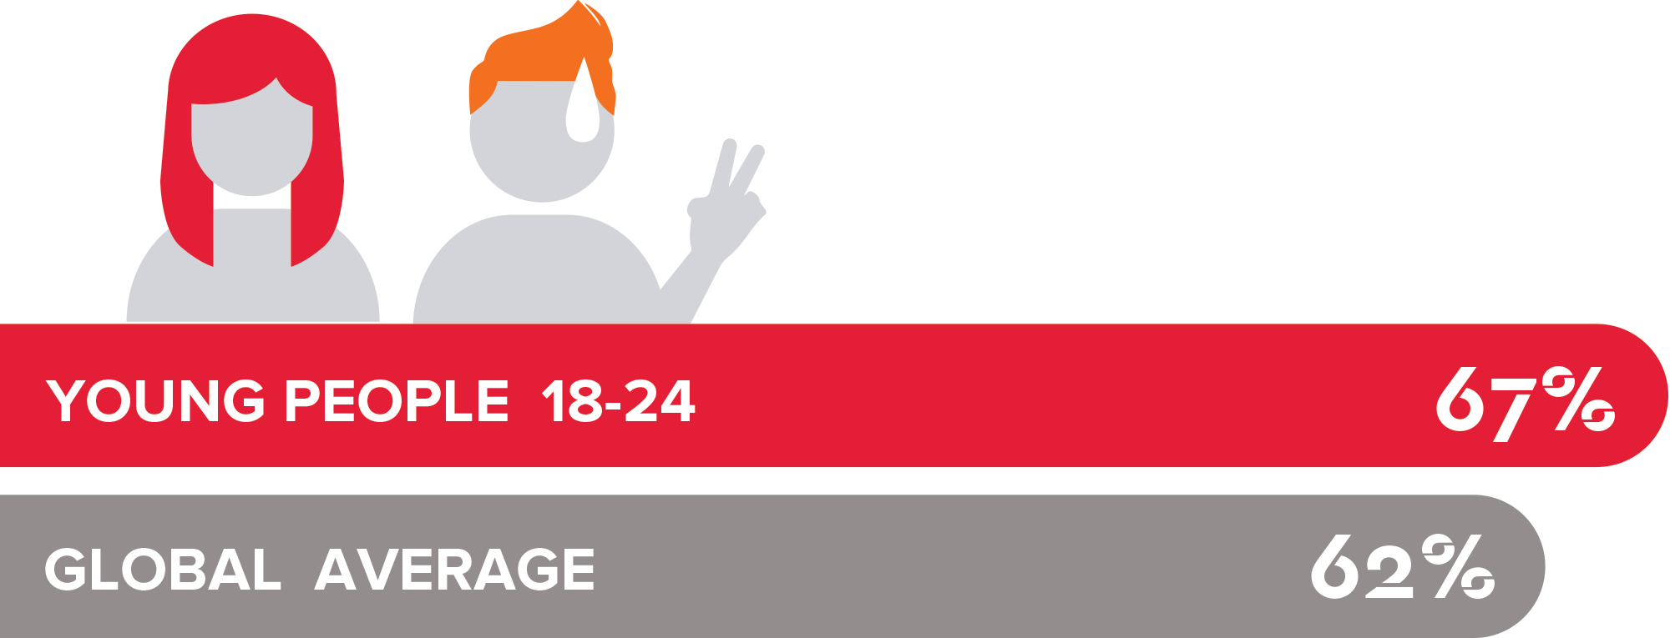
Women and Young People Worry More
Women worry more than men
Young people worry more

Slide 16
Global Companies hold the power
Who has the power to set economic rules

Slide 17
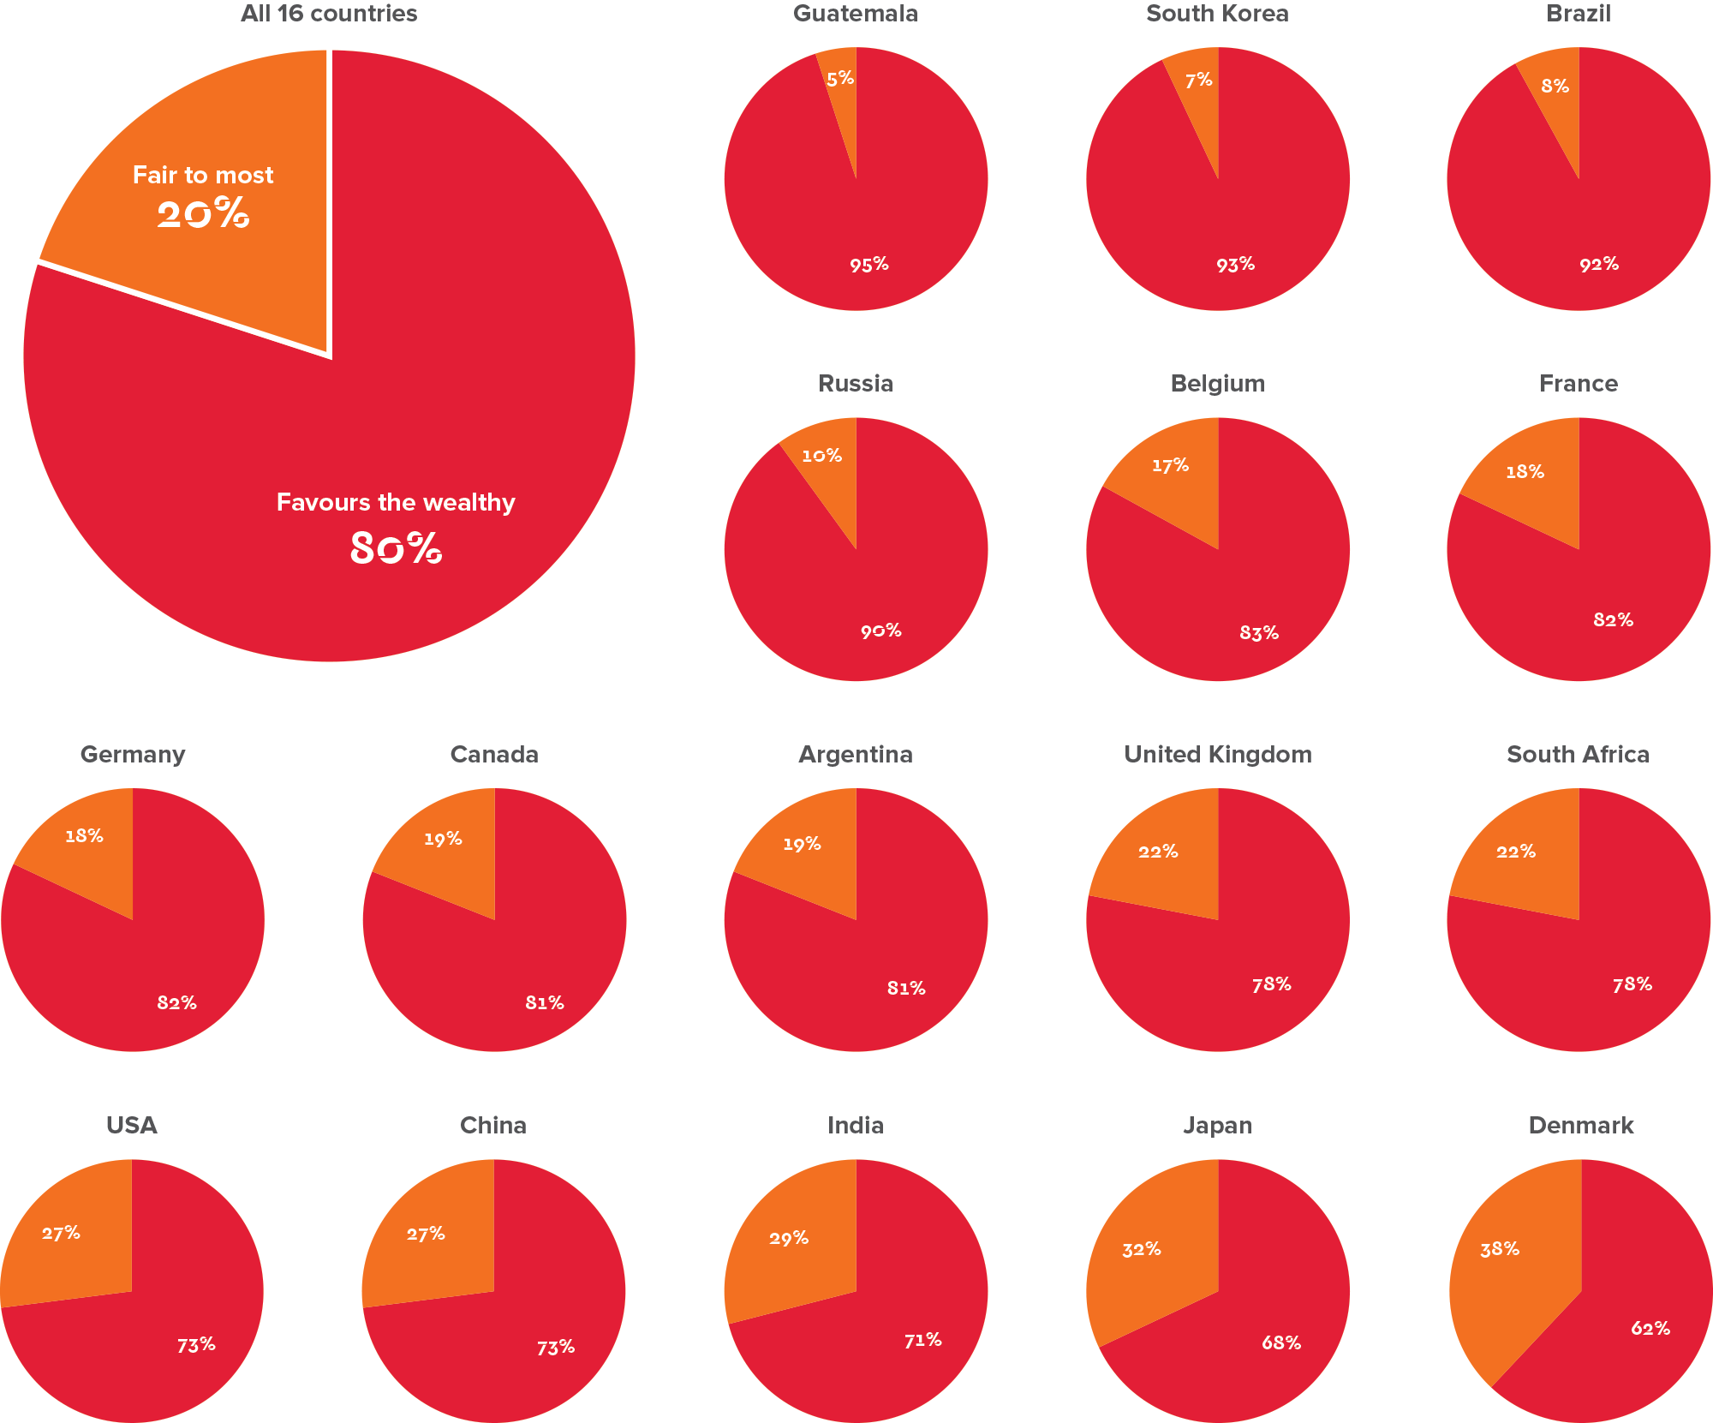
The 1% set the rules of the economy
Is the economic system fair to most people?

Slide 18
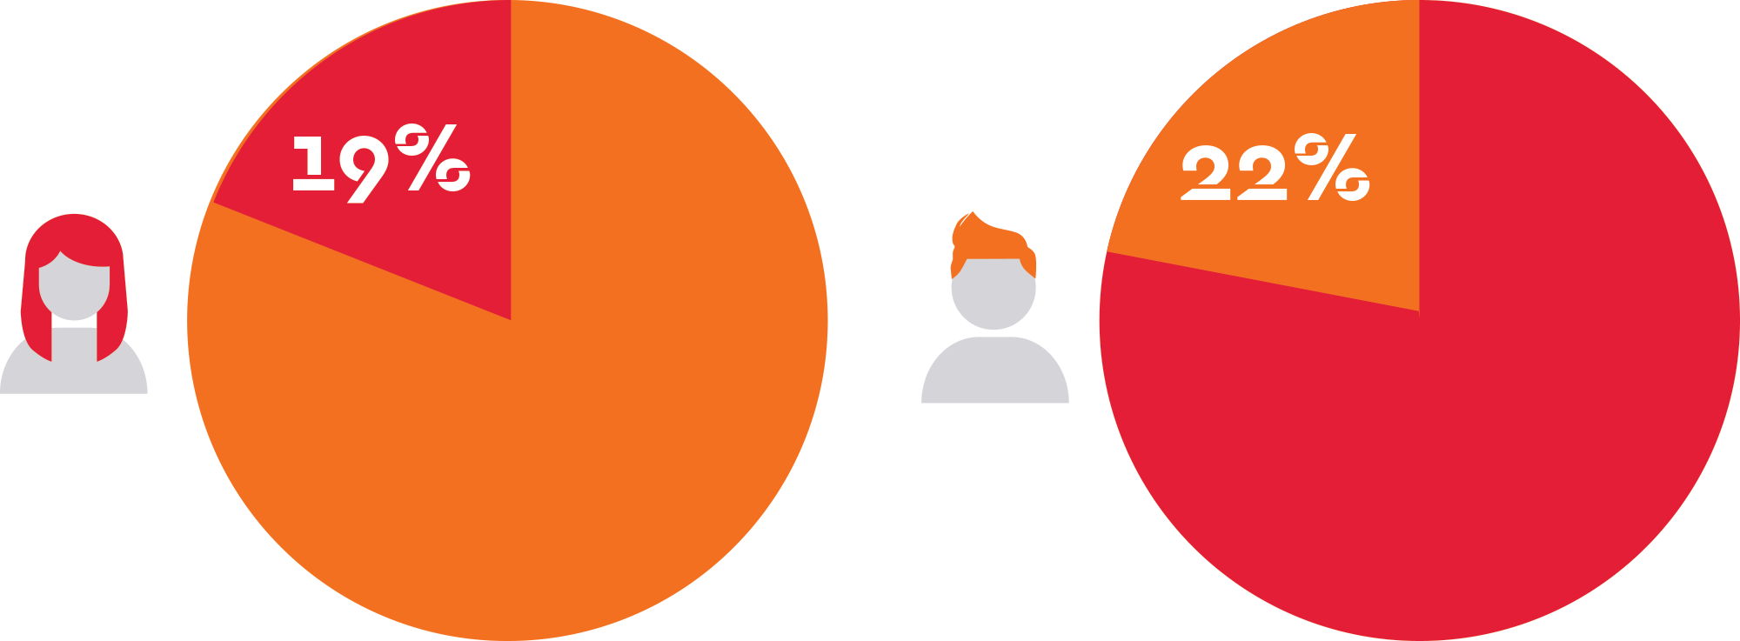
Women and economic fairness

Slide 19
4.0
Key Findings The World needs a Pay Rise

Slide 20
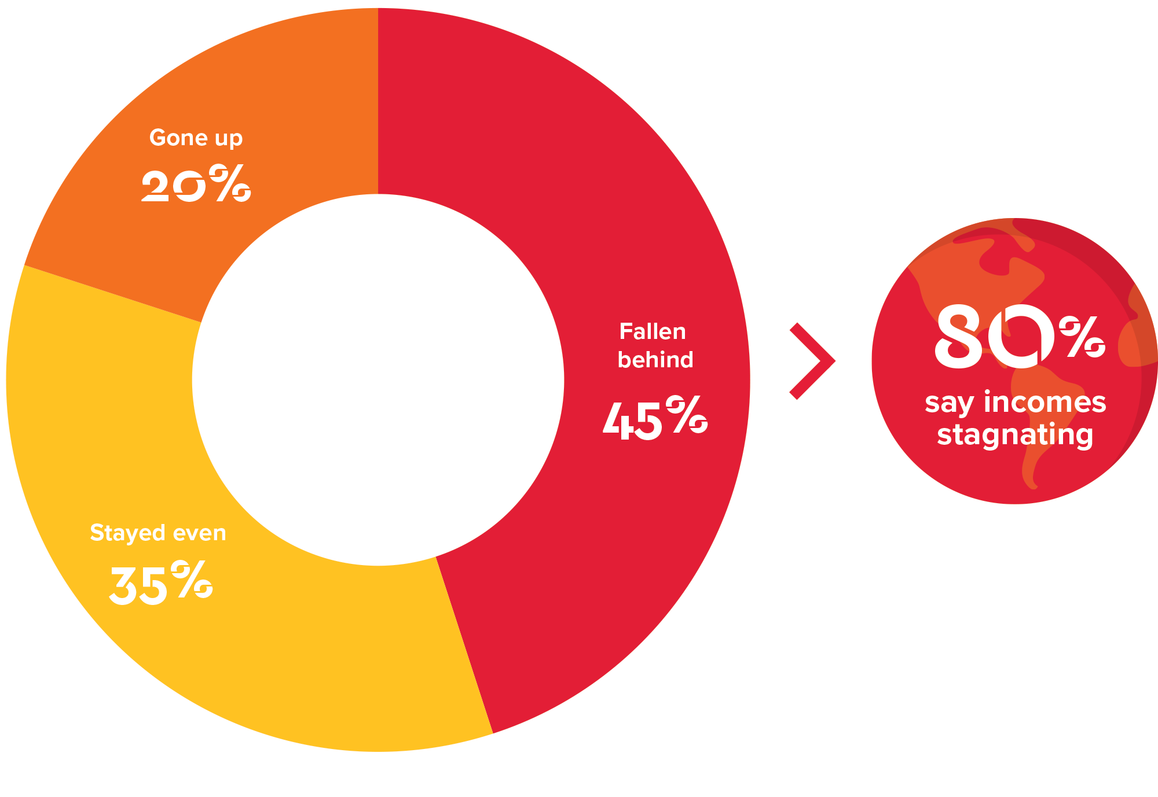
Family incomes in crisis
Has your household income fallen behind the cost of living?
Target findings

Slide 21
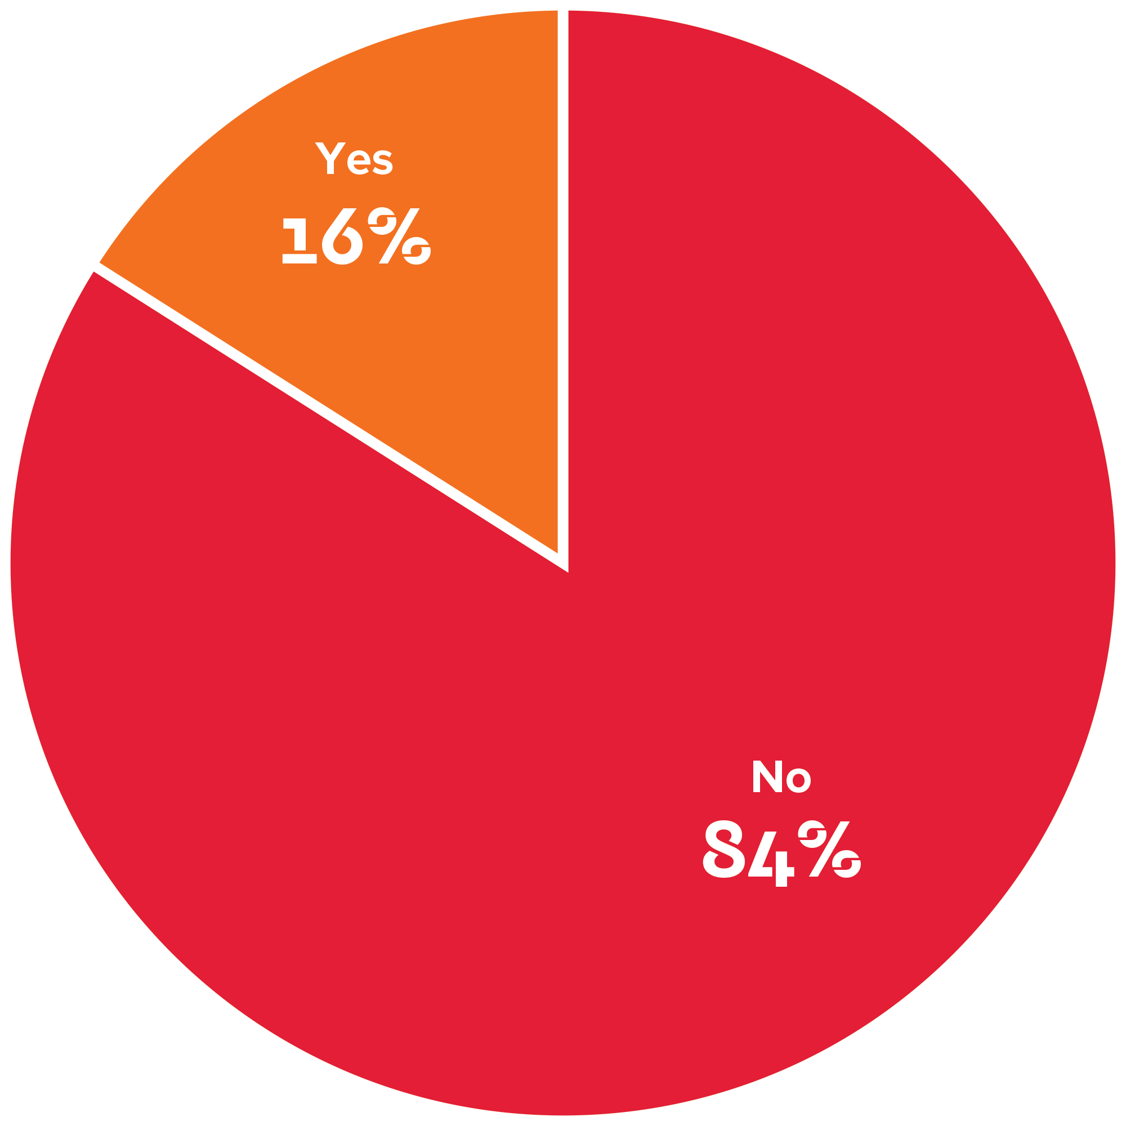
Wage despair
Is the minimum wage enough to live a decent life?

Slide 22
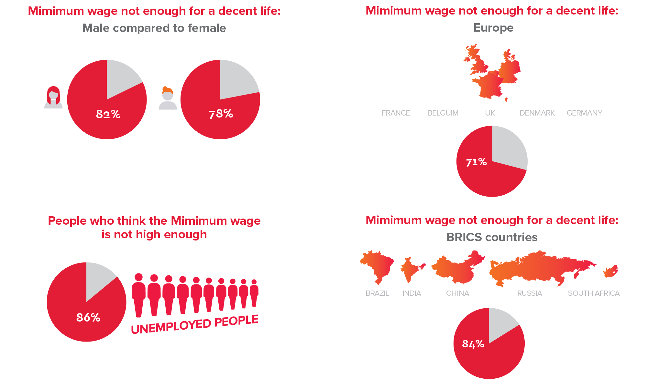
Wage despair

Slide 23
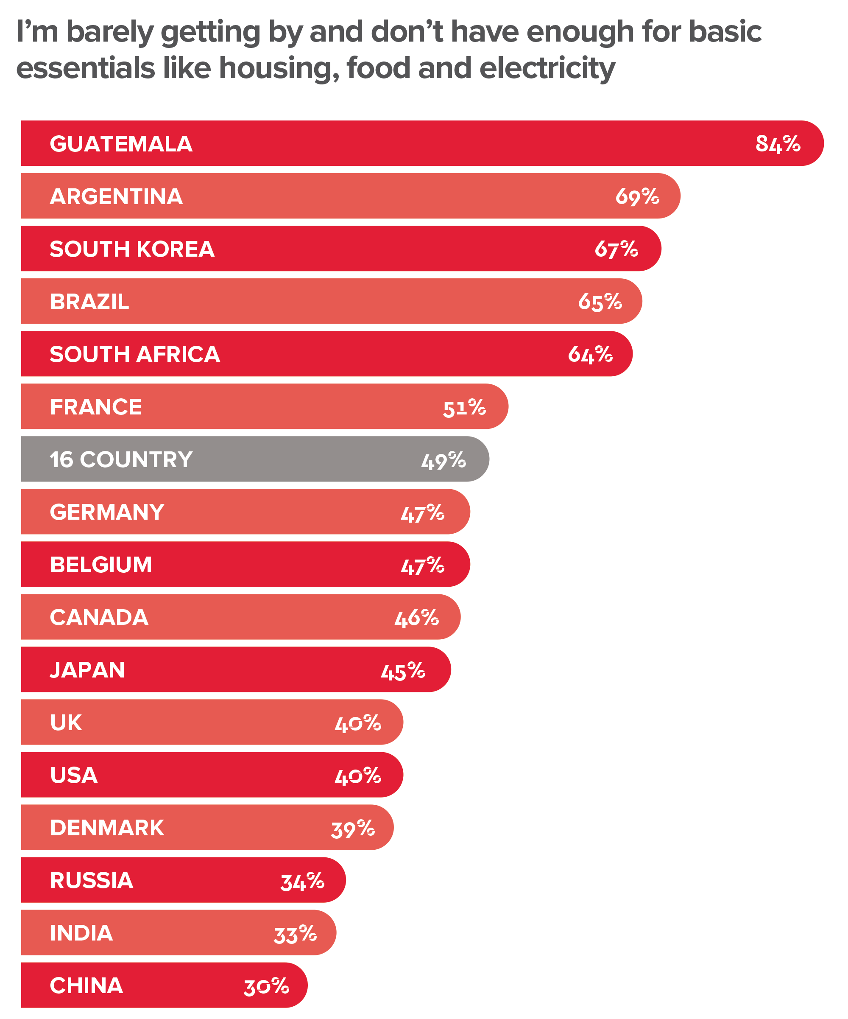
Working people are struggling
Are you getting by – how would you describe your financial situation?

Slide 24
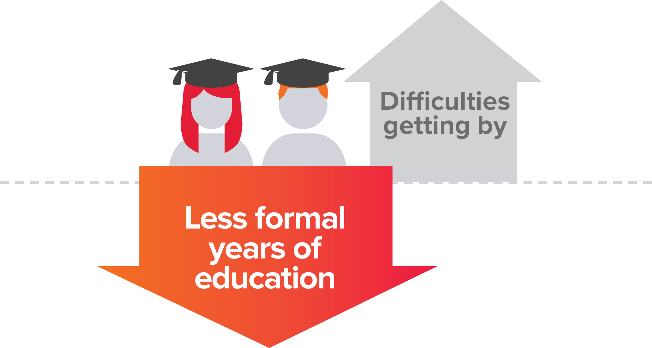
Trouble getting by

Slide 25
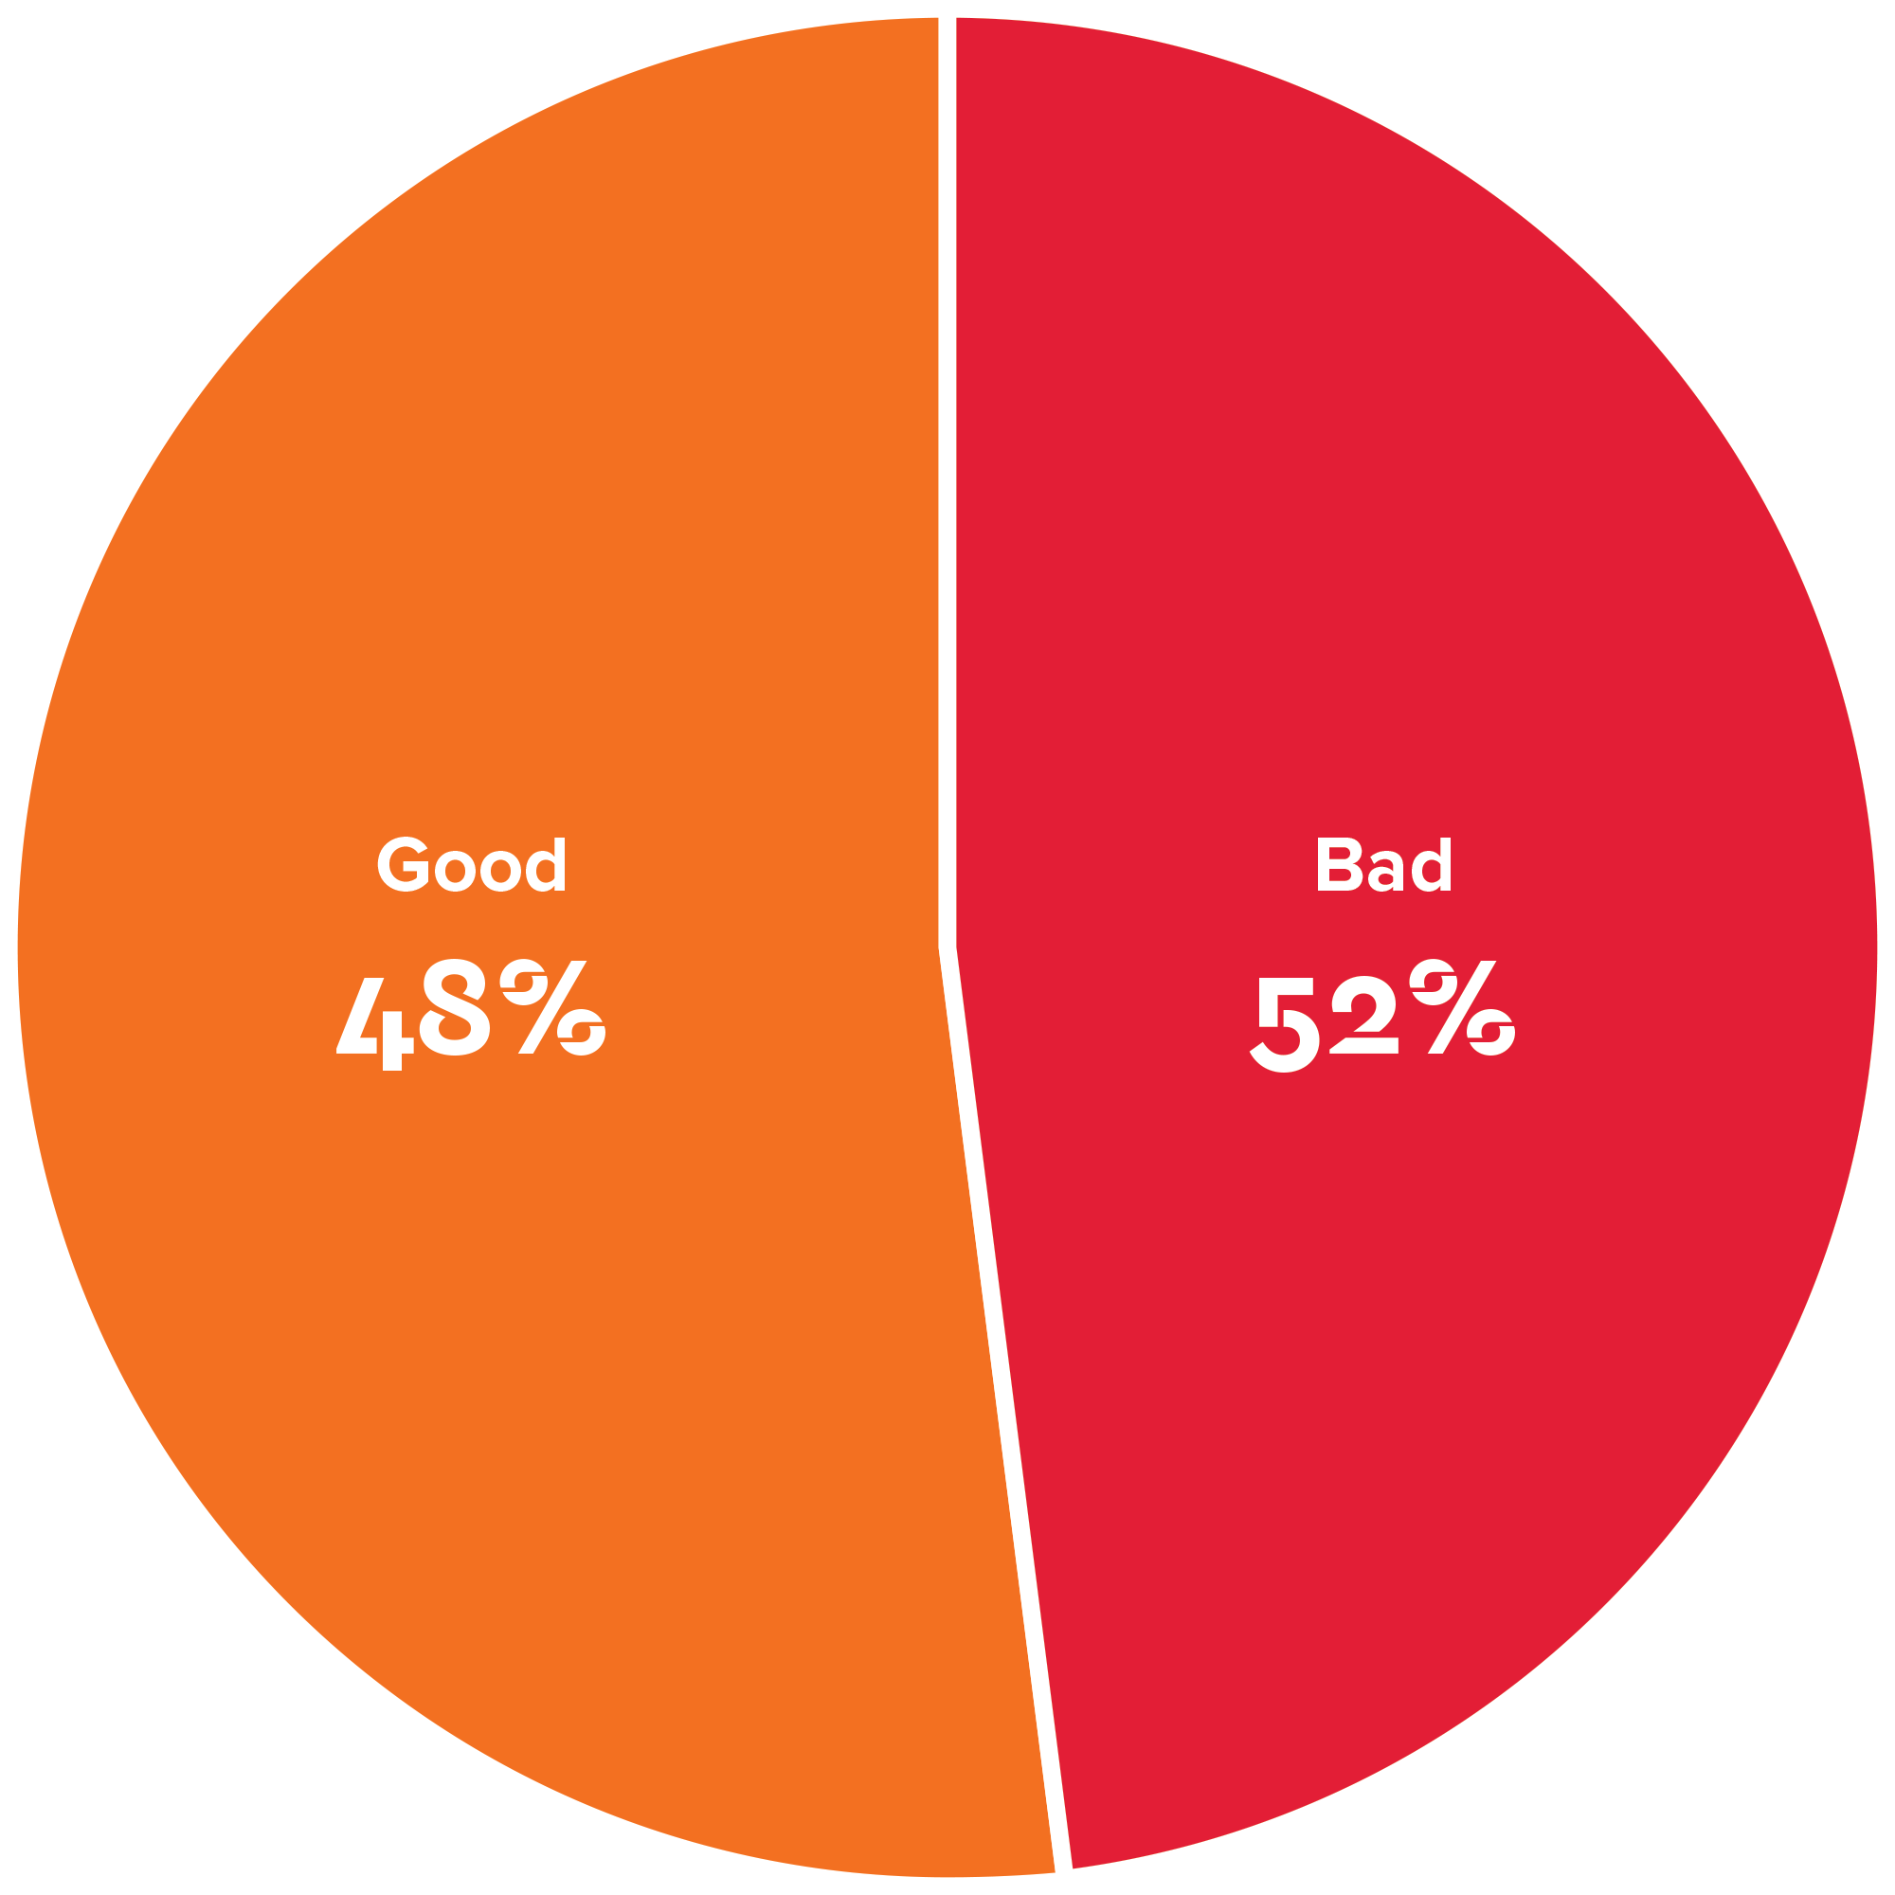
Globalisation under challenge
Is the economic situation good or bad?
Target findings

Slide 26
5.0
Key Findings The Jobs Crisis

Slide 27
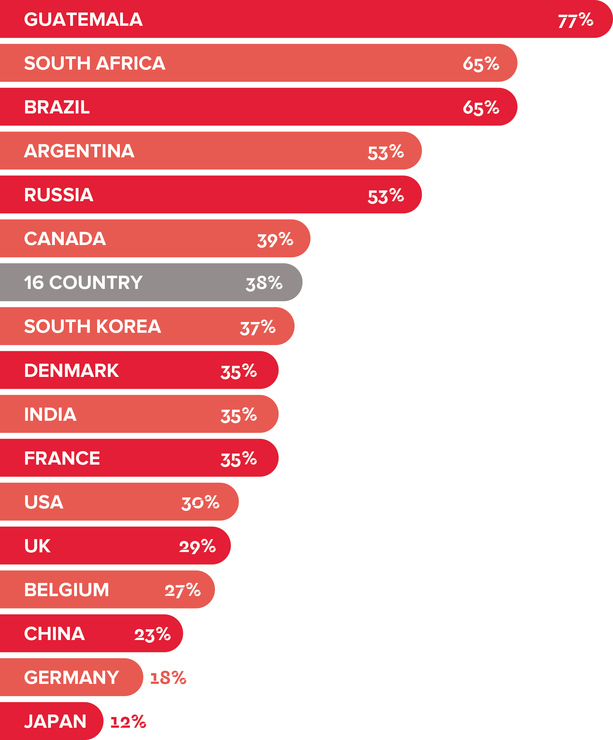
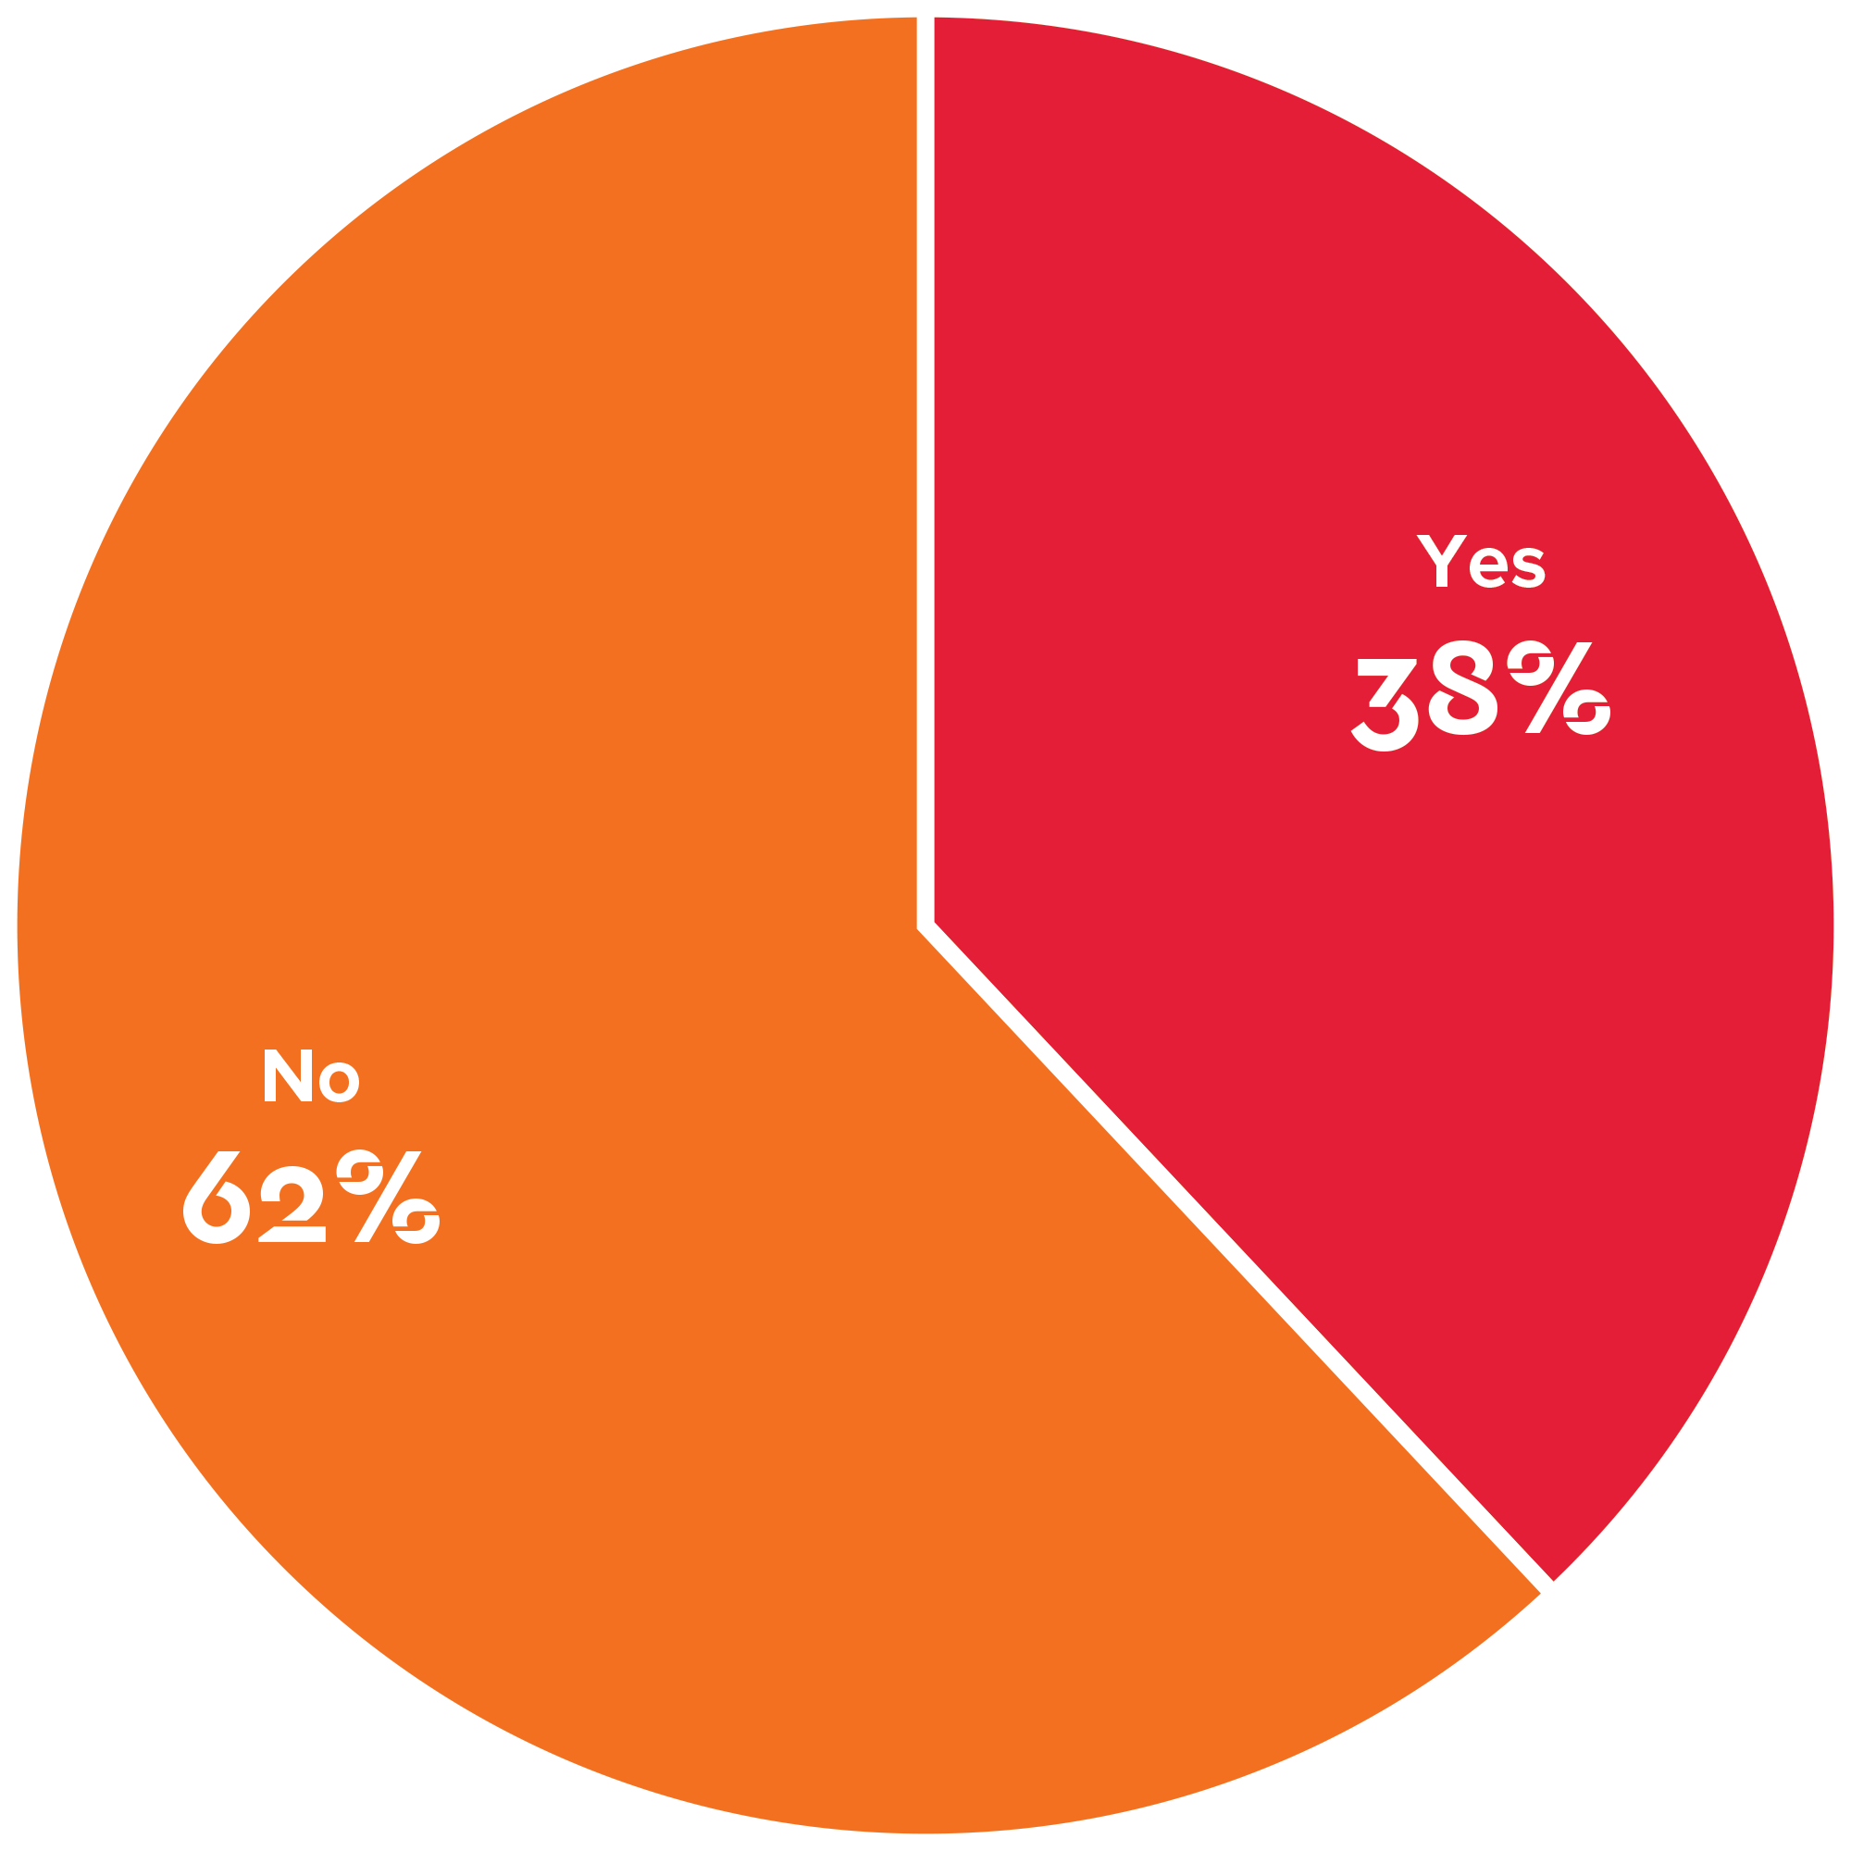
Not enough jobs
Have you or a family member been unemployed?

Slide 28
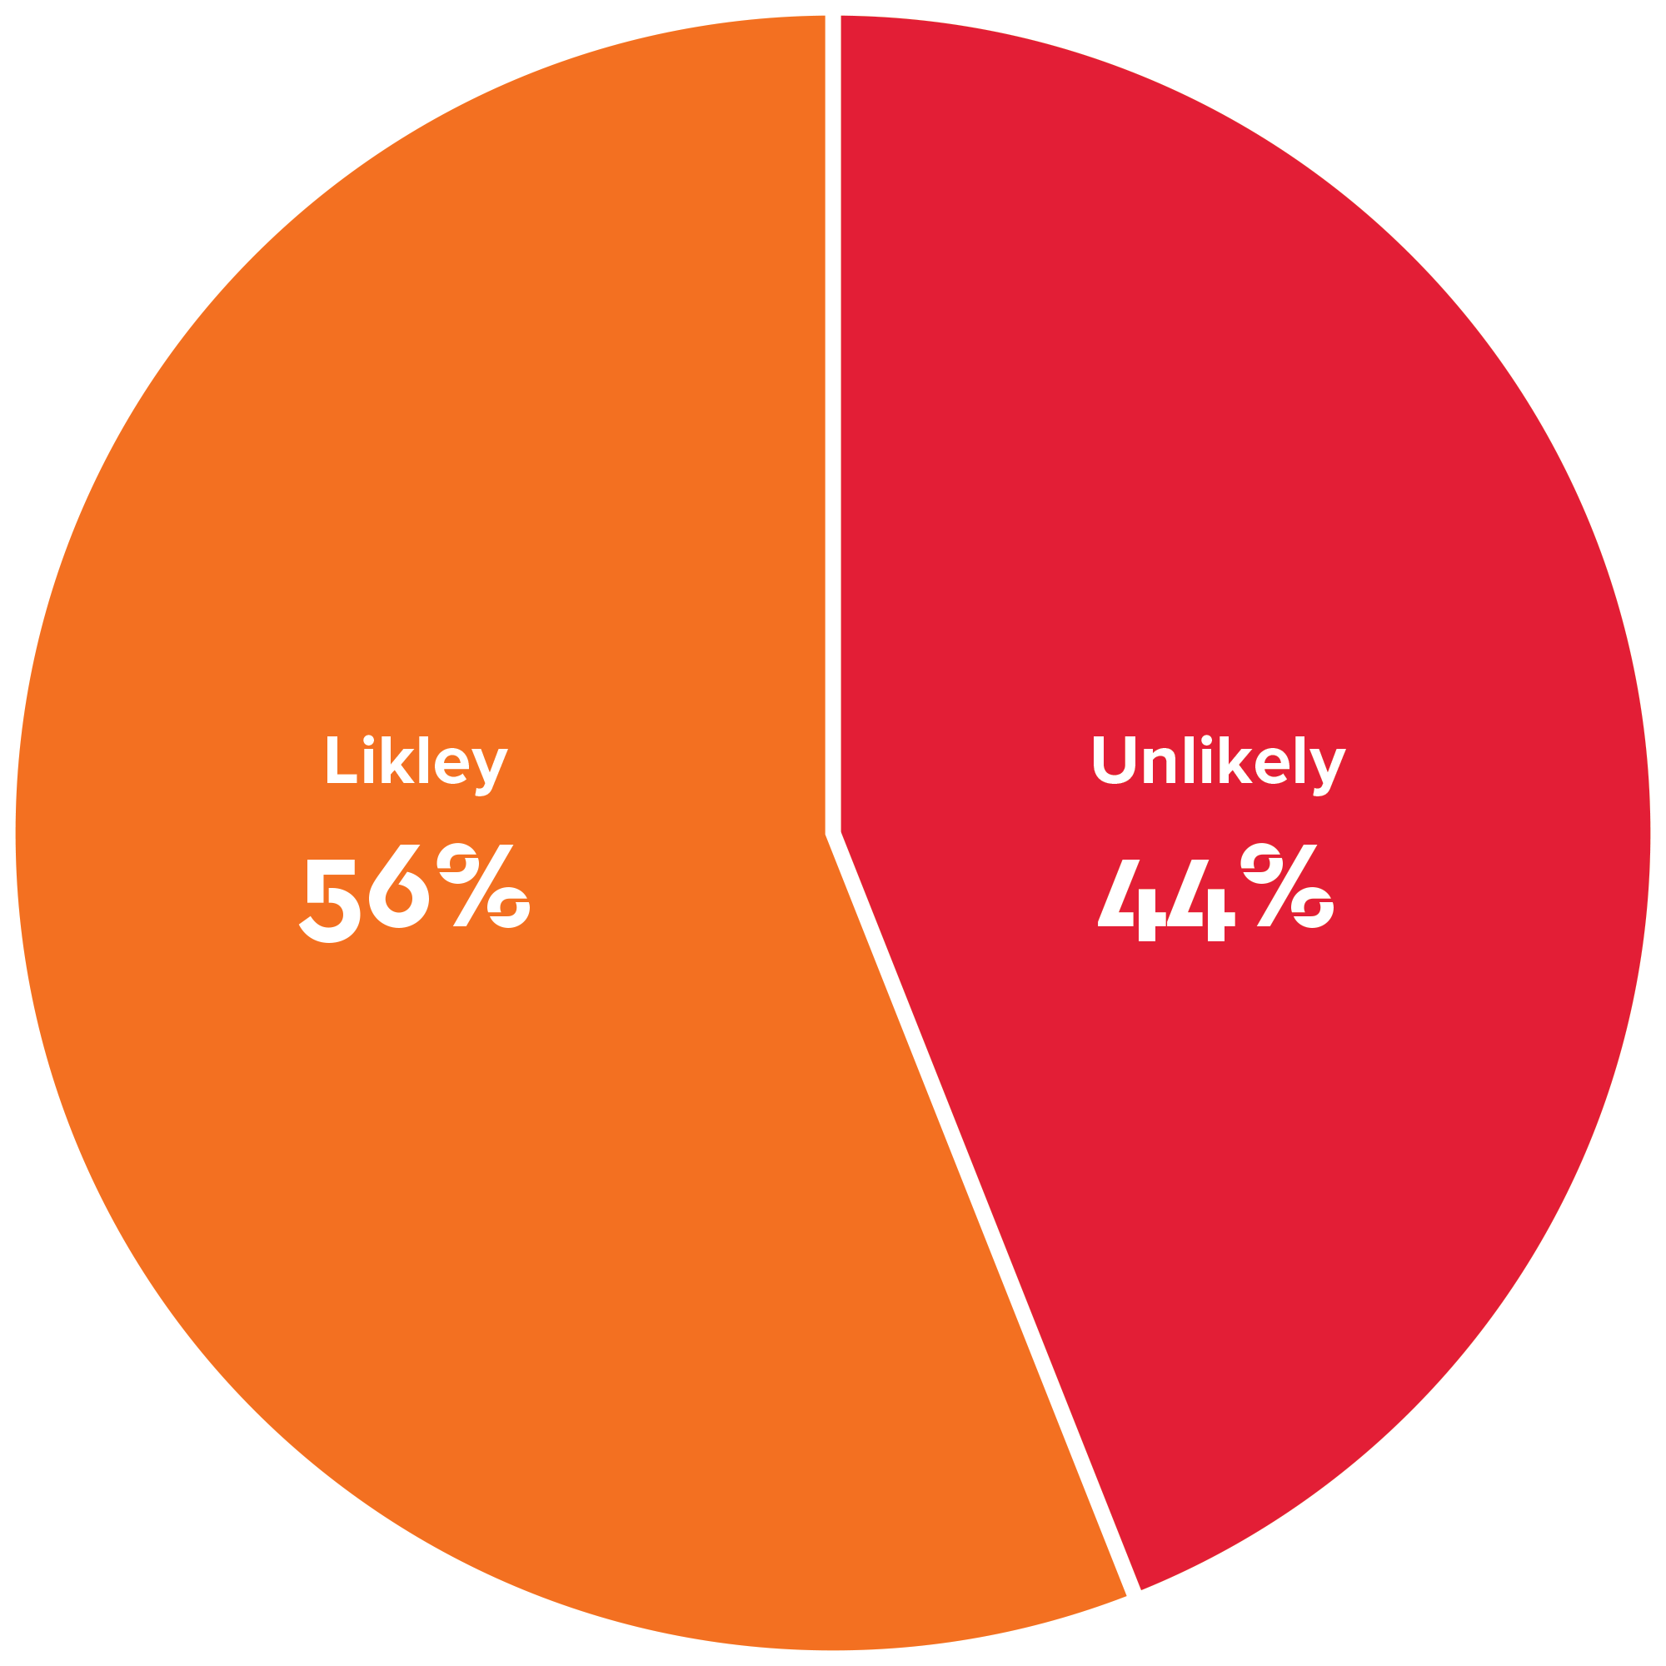
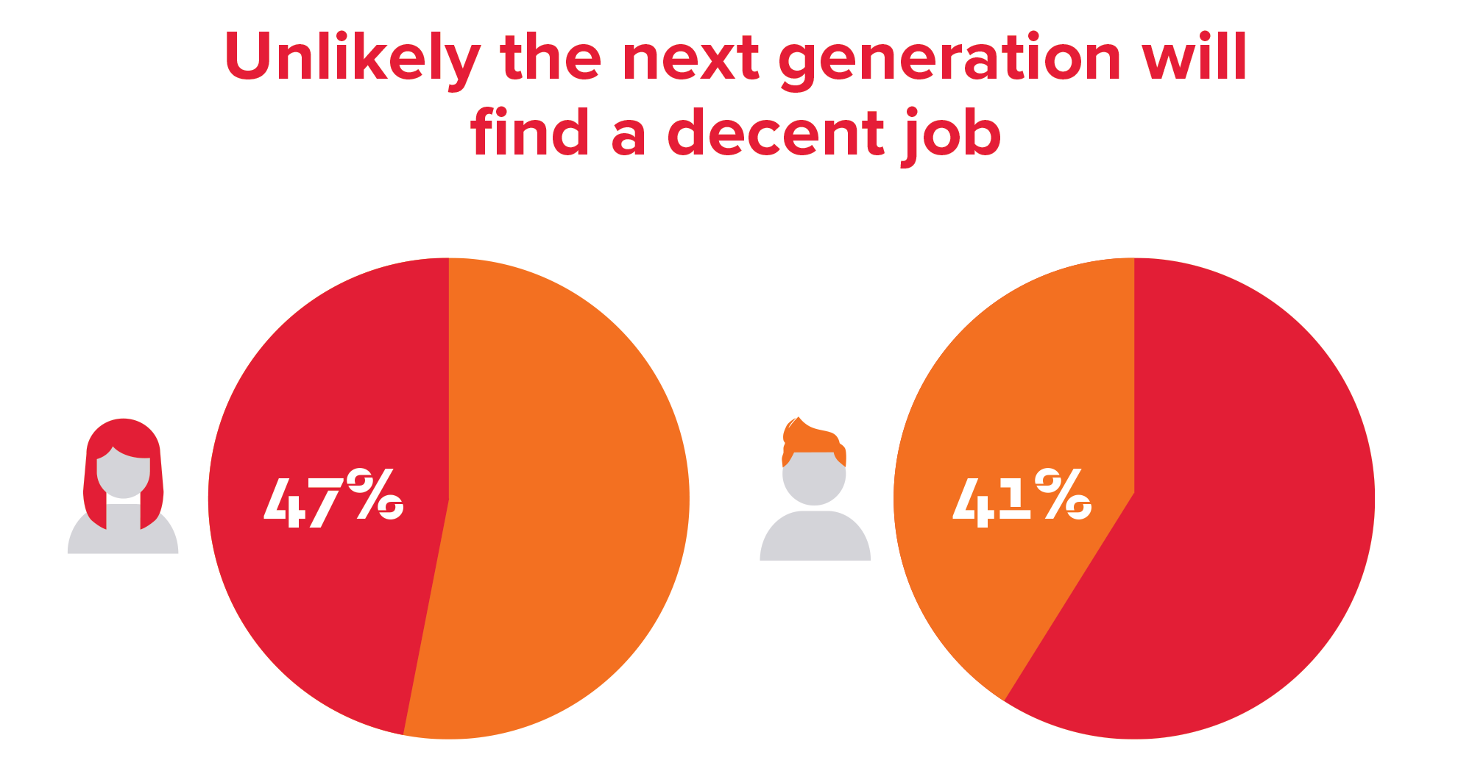
Not enough jobs for the next generation
Will the next generation find a decent job?
Target findings

Slide 29
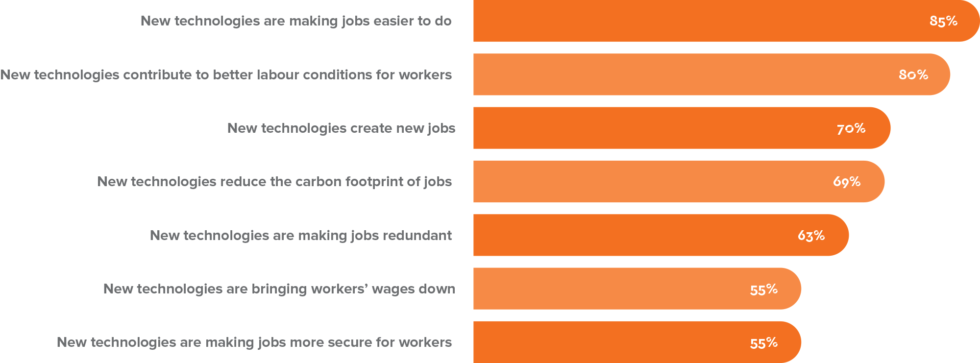
The future of work – it’s not the tech it’s the jobs
What do you think about new technologies and jobs?

Slide 30
Young men embrace new technologies

Slide 31
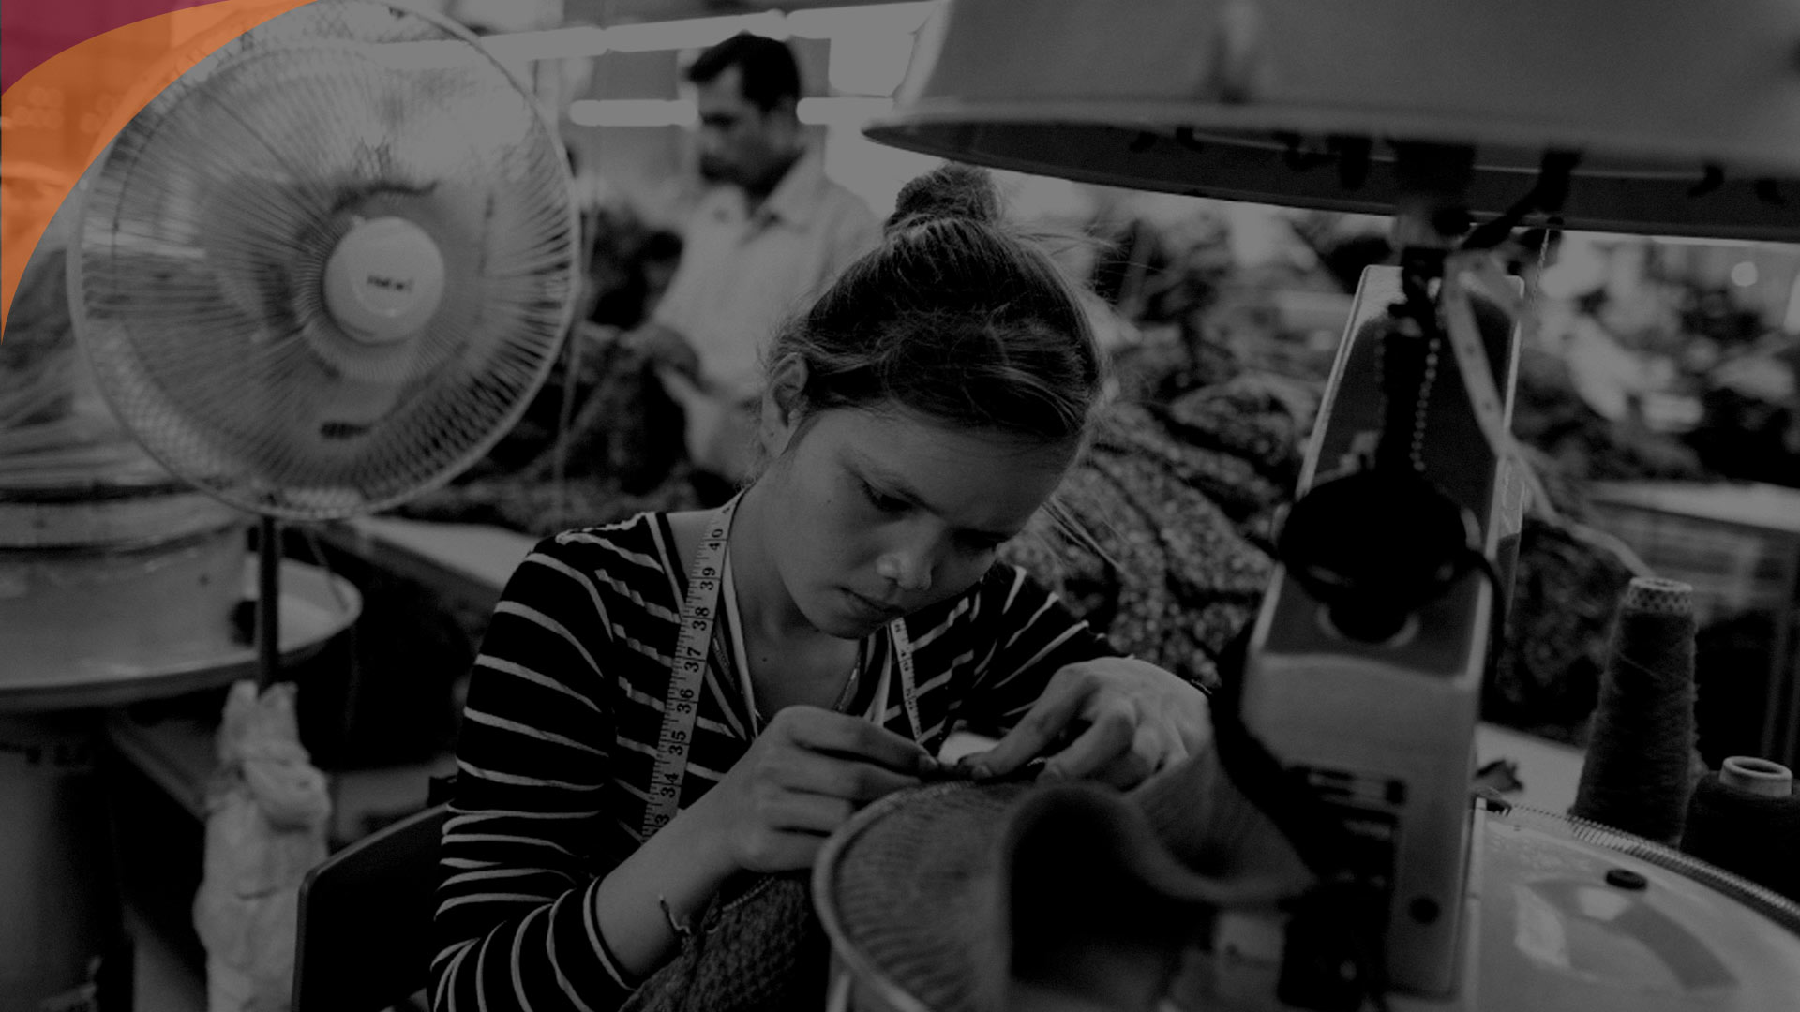
6.0
Key Findings Labour Laws and Social Protection

Slide 32
Public support for labour laws and the right to strike
Do you favour or oppose labour laws and the right to strike?

Slide 33
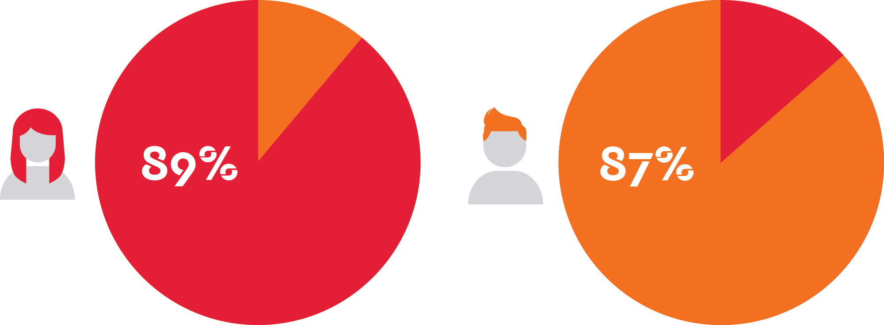
Women support labour laws
Women slightly more supportive than men of the five labour laws

Slide 34
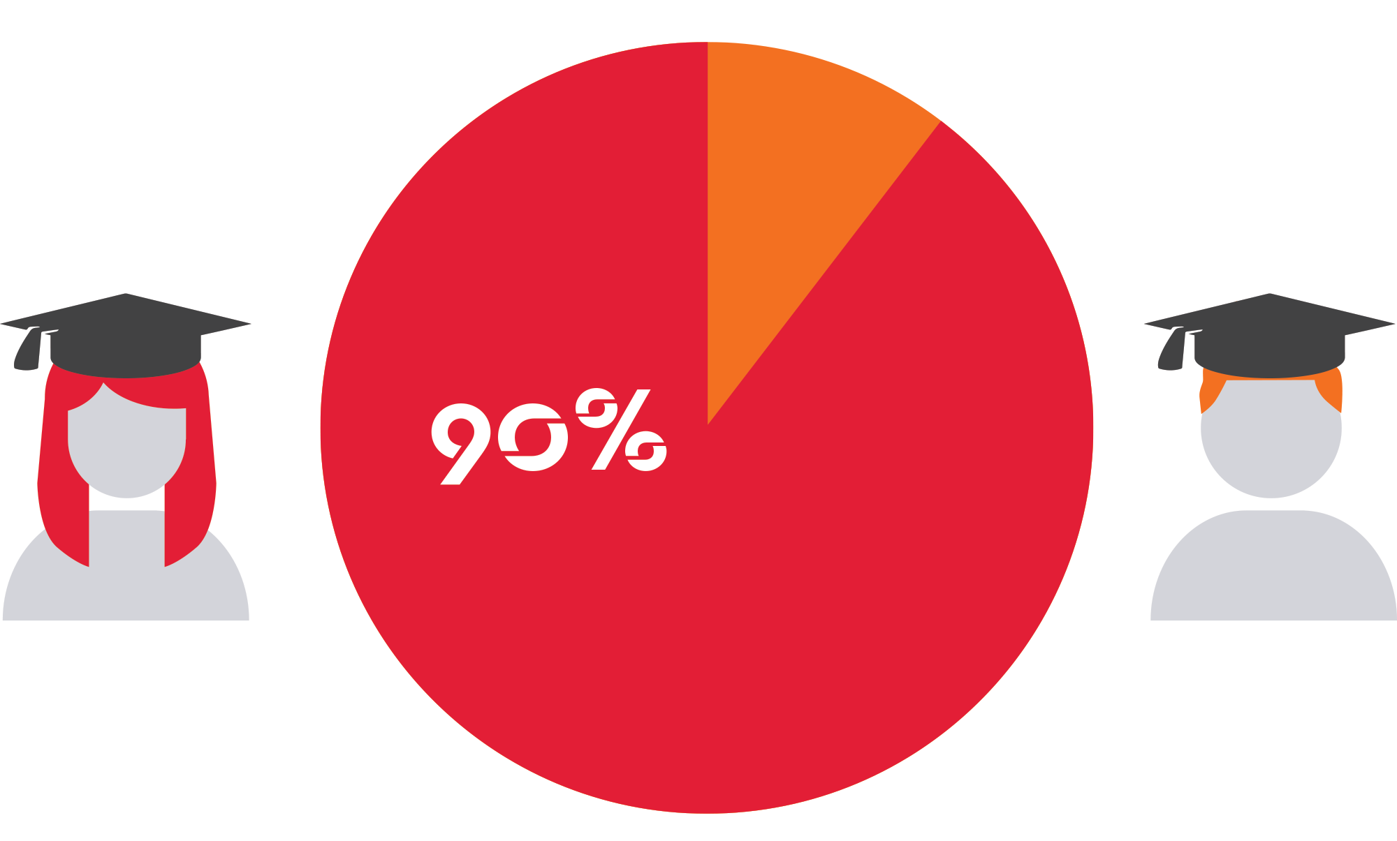
Education and labour laws
Support for labour laws - Years of formal education

Slide 35
Governments upholding a social protection floor
Should the government provide people with education, retirement income, health care, maternity leave, unemployment benefits?

Slide 36
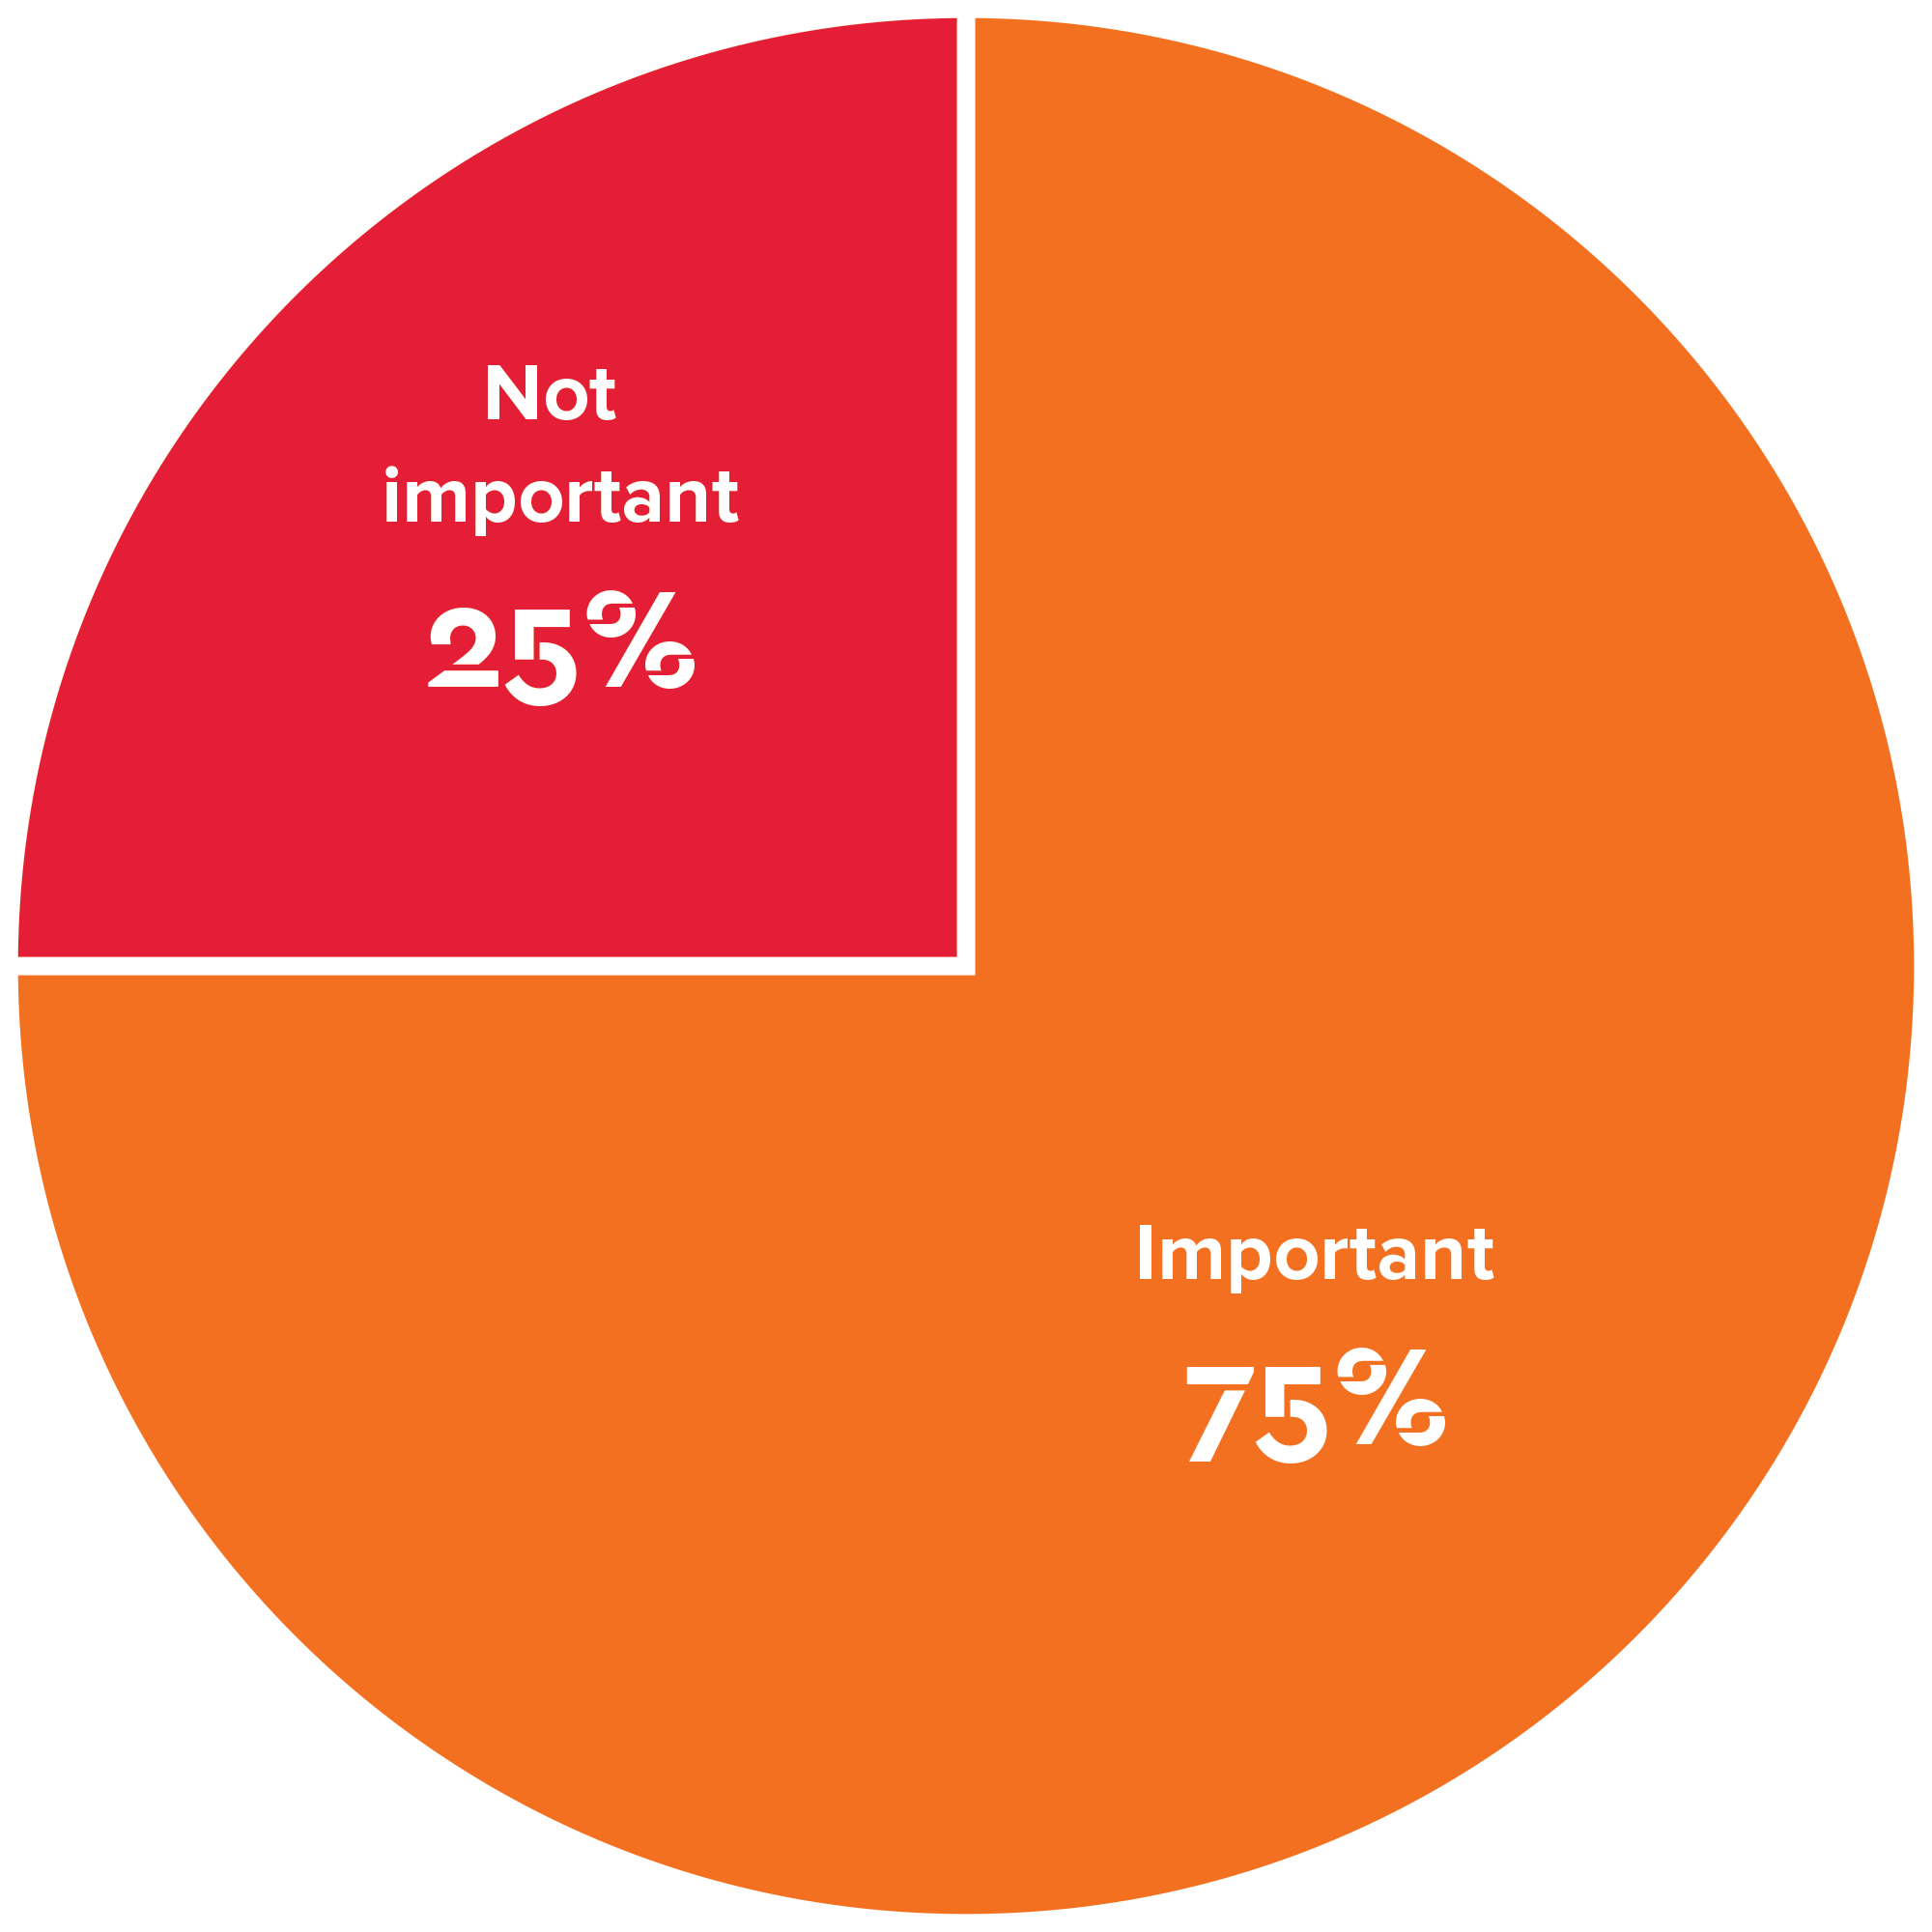
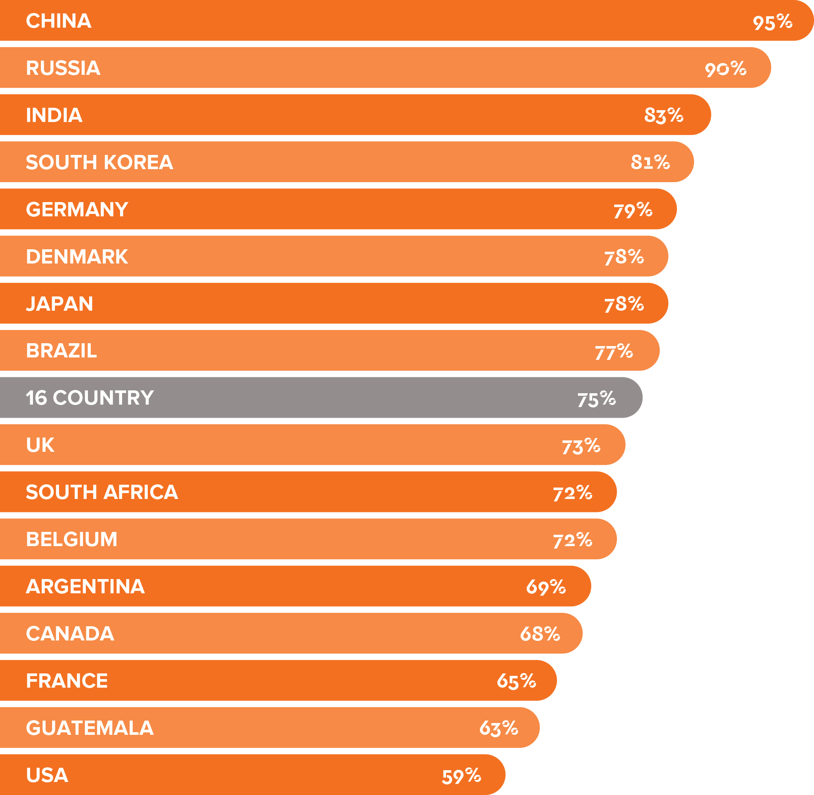
The responsibility of unions
Should unions play an active role in society?

Slide 37
3.0
Key Findings Global Action Plan for Governments - Jobs and Security

Slide 38
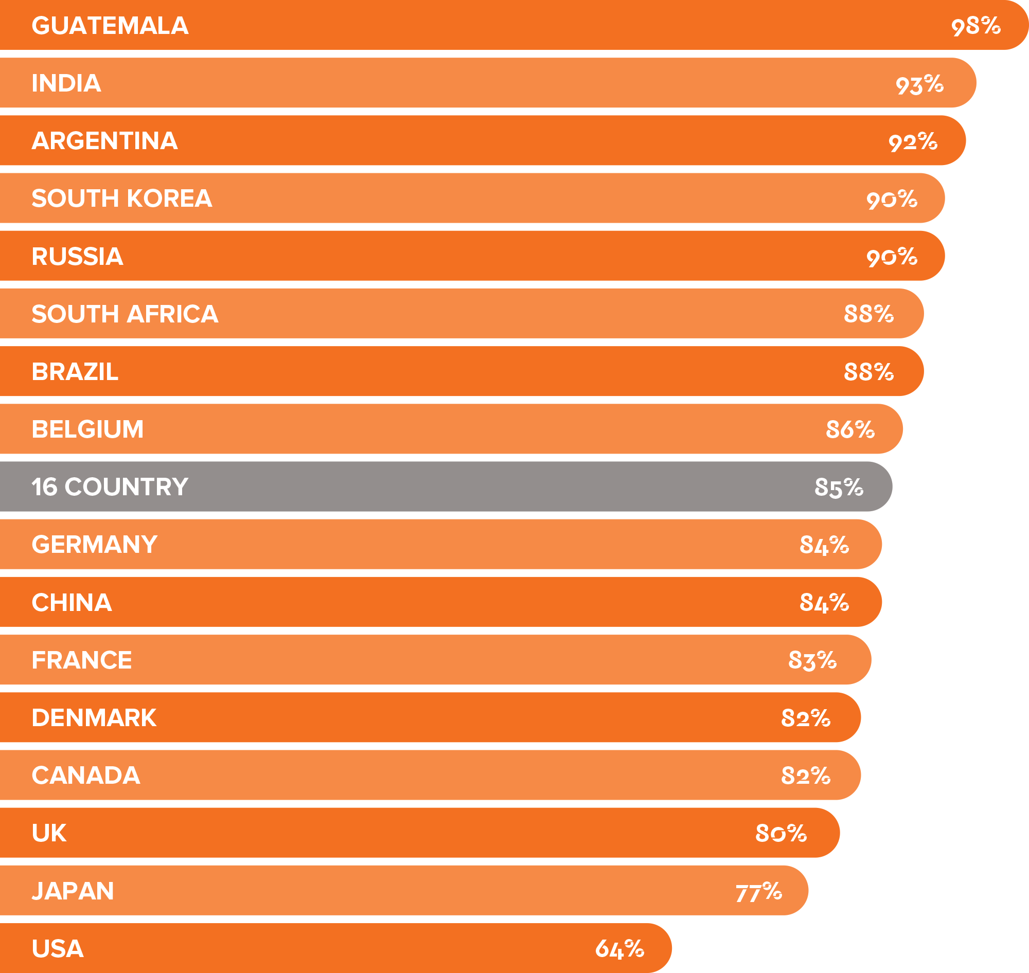
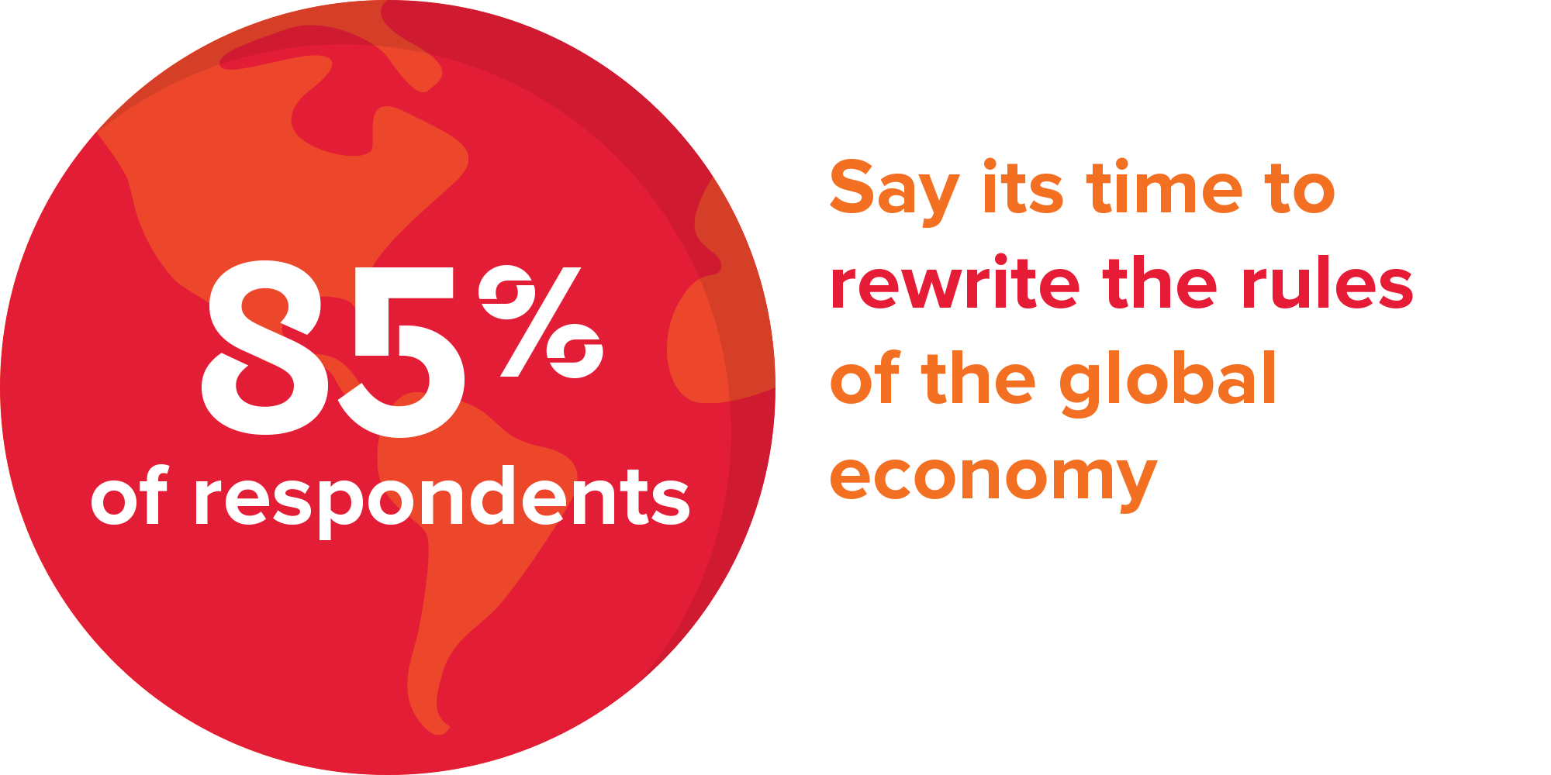
Rewrite the rules of the global economy
Should we rewrite the rules to promote growth and shared prosperity?

Slide 39
Support for rewriting the rules

Slide 40
Tame corporate power - a global action plan for governments

Slide 41
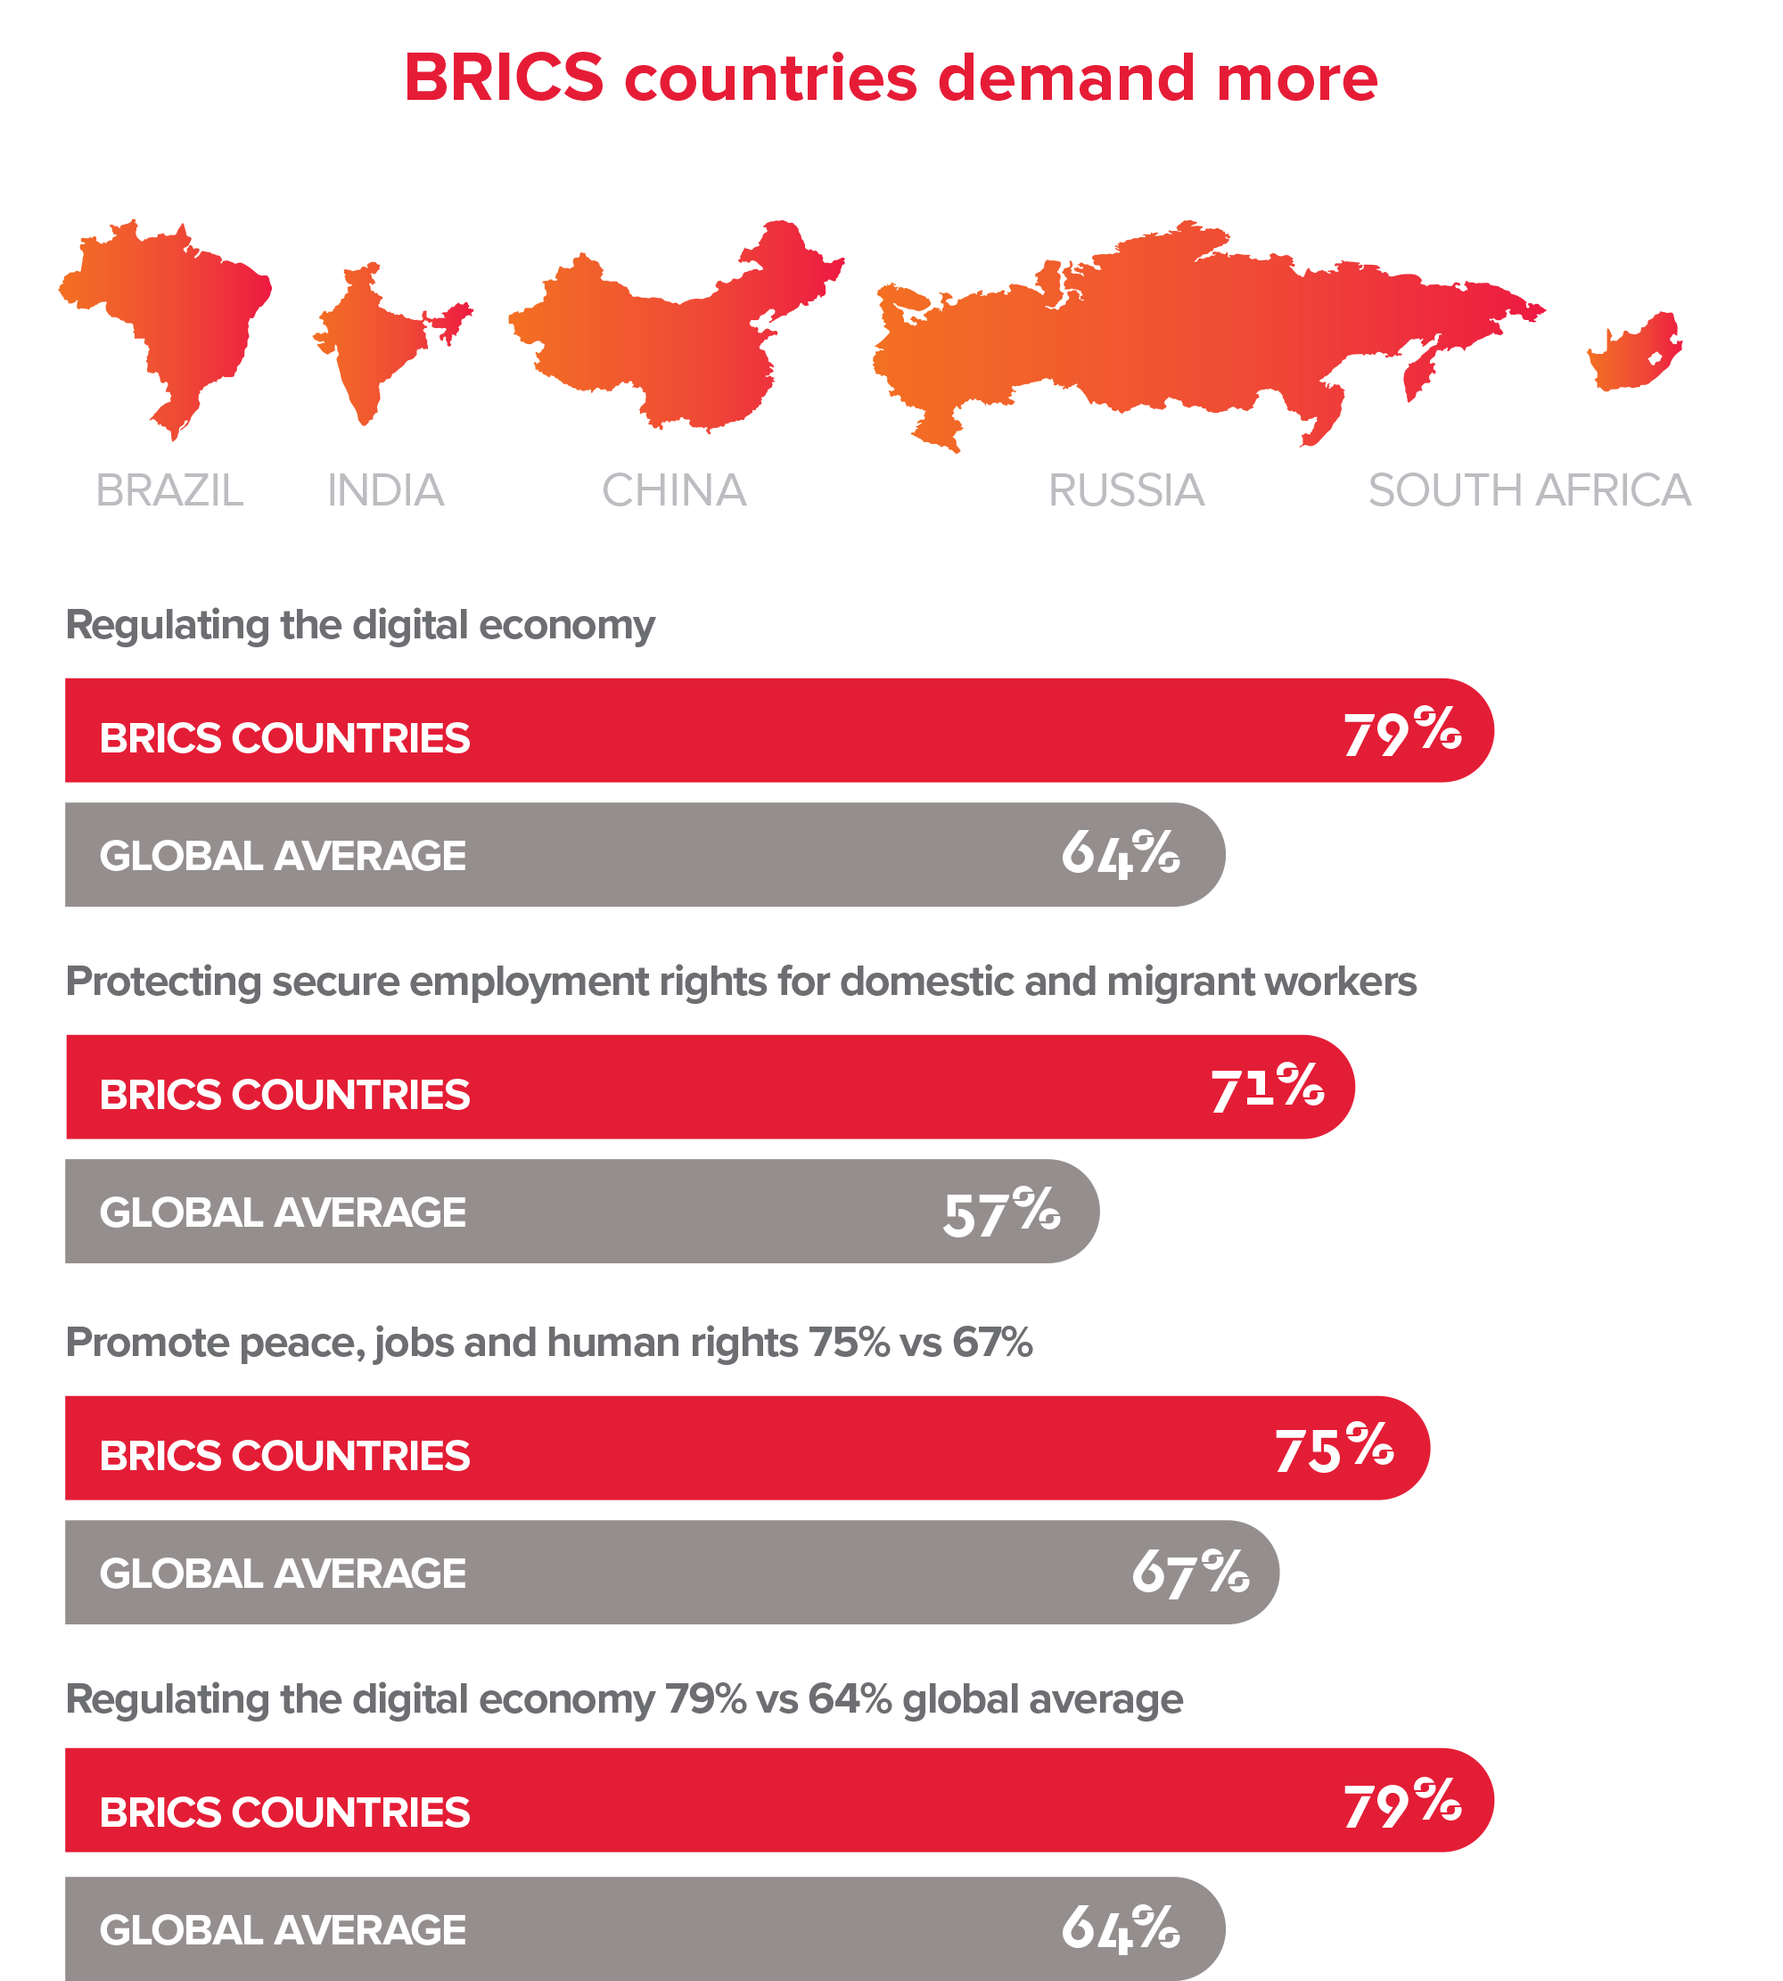
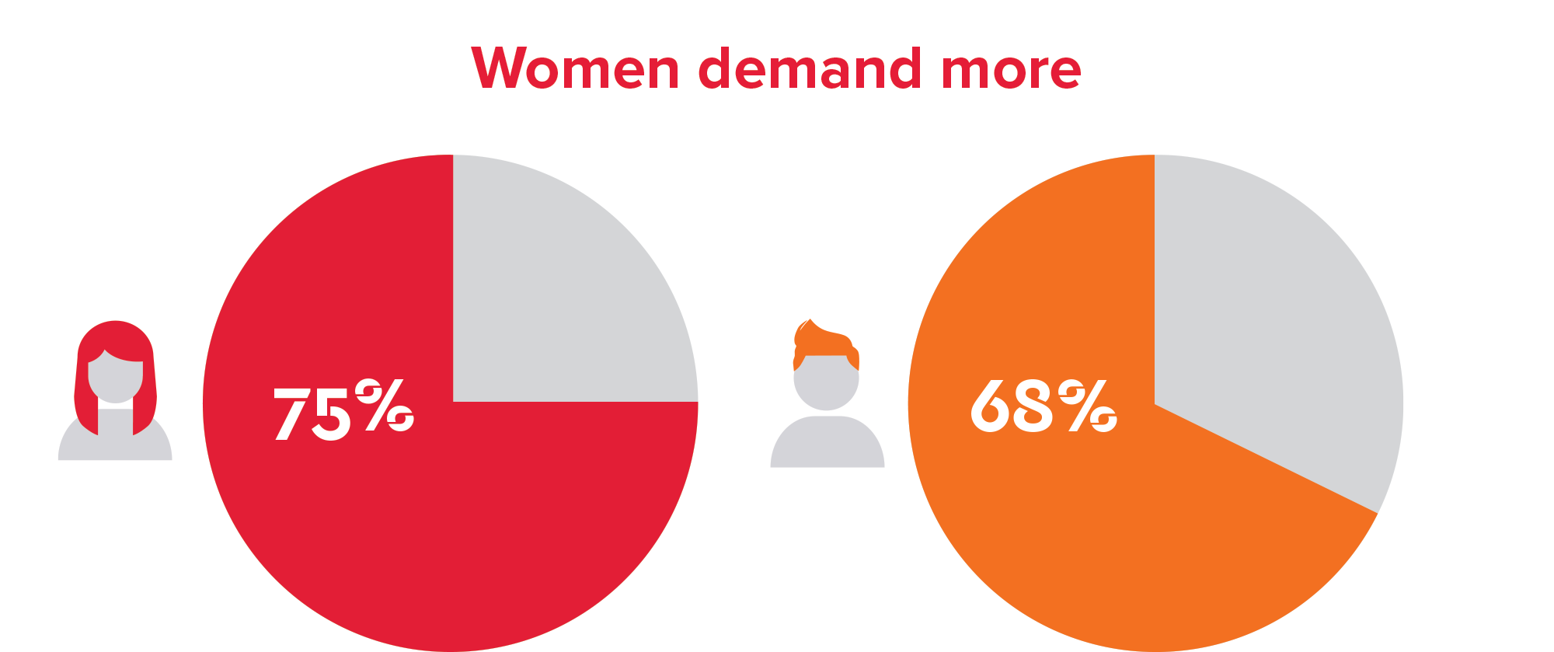
BRICS countries and women demand more

Slide 42
Policies that break down barriers between nations
Would the world be a better place with commitments on jobs, rights, shared prosperity and climate change?
Should your government take a stand against discrimination and abuse?

Slide 43
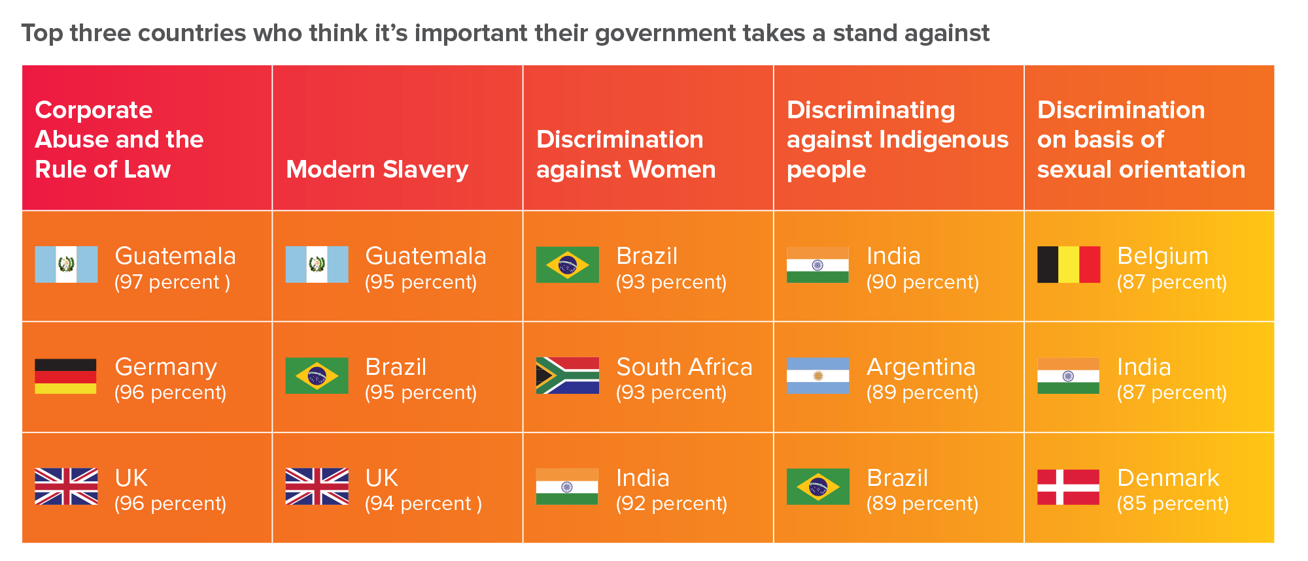
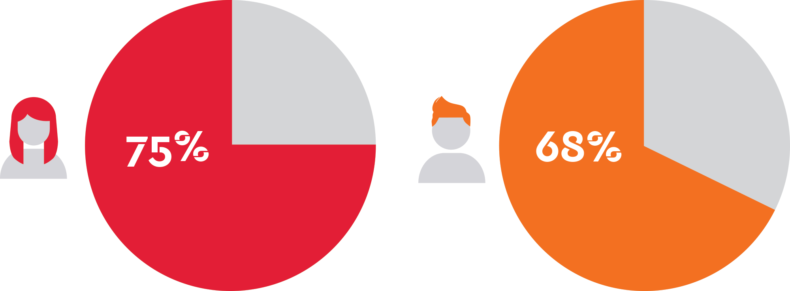
Governments must fight modern slavery and corporate abuse
Target findings
Women are more supportive than men across all issues

Slide 45
