Slide 1
HLF-4: SHARED PRINCIPLES AND DIFFERENTIATED COMMITMENTS
Building Blocks
Core Busan Commitments
Common principles

Slide 2
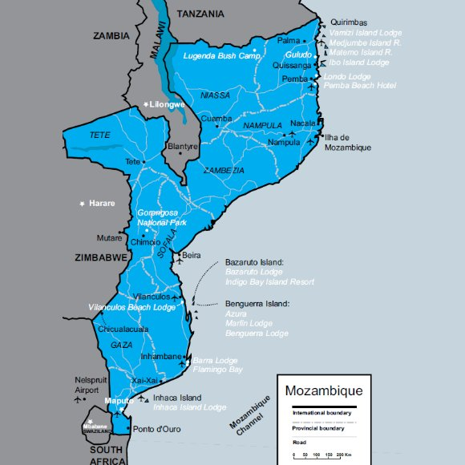
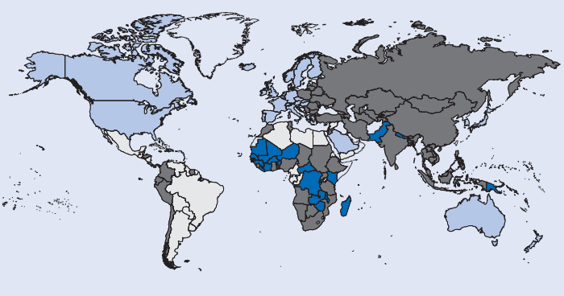
Monitoring framework:
COUNTRY LEVEL FRAMEWORKS
Own indicators and targets
Lead by the country
Results made public
+
INTERNATIONAL LEVEL FRAMEWORK
Selective indicators and targets drawing on a set of core country level indicators
Monitor progress on a rolling basis
Managed by the Global Partnership
Notes:
Issues under discussion:
Scope of monitoring – broad convergence around a number of themes, but desirability to prioritise further? No convergence regarding the number (
Linkages between global monitoring and country level efforts
OECD tasked to develop indicators by May 2012 and consult with all relevant stakeholders.
Likely outcome:

Slide 3
Core Busan commitments
New Deal Fragile states
Statistics
Gender
Climate Change Financing
Effective Institutions
Results & accountability
Public Private cooperation
Transparency
South South Cooperation
Diversity & Fragmentation
Building Blocks

Slide 4
Core Busan commitments
New Deal Fragile states
Statistics
Gender
Climate Change Financing
Effective Institutions
Results & accountability
Public Private cooperation
Transparency
South South Cooperation
Diversity & Fragmentation
HRBA
Building Blocks

Slide 5
Questions to address
Which Building Blocs are most relevant (1-5)
How should we engage?
Global but also in-country
Country list
Support (research, drafting positions)
How do we relate/use the CSO platform
Who is volunteering/leading for bb
On-line support groups for building blocs
Reacting to documents
Oversight group (online + Paris)

Slide 6
CSO platform
15 sub-regions + 6 regions
Sectors: labour, women, faith based, rural folk, indigenous, youth, INGOs, …
6 TU representatives
Specific action plan for ITUC (integrated/separated?)
How to engage
Regional/sub-regional level
International level
How important should this be for us

