Slide 1
ITF/IUF Programme
Organising the Fisheries Industry
“From Catcher to Counter”

Slide 2
Objectives of the Global Programme
To organise workers across the fisheries industry including:
  neutralising anti-union practices from transnational companies
  asserting pressure for the ratification of the ILO Convention 188
  inter-connect with other global campaigns
  contribute to the reduction of the use of casual, child and forced labour
  contribute to combating illegal, unreported and unregulated fishing
Notes:
Unique opportunity and a firm commitment from 2 GUFs
Timing for this programme is perfect: writing, studies , reports and investigations into environmental and sustainability concerns all focus on the fish. Whilst this is all genuine and necessary, our responsibility is to shift the emphasis and resources to the workers.
The aim of the programme is clear, to organise workers in the fishing industry and the objectives are even clearer.
These are all the basis on which we will develop our leverage – corporate, political, industrial or economic.
It is also our responsibility to organise workers with not only the lowest unionisation, but also the highest mortality rate of any industry in the world
Reported global workforce of 120m including the supply chain
Most unsafe occupation in the world – mortality rate of 23,000 per annum
117 union with 115,000 members worldwide
An industry worth in excess of US$2

Slide 3
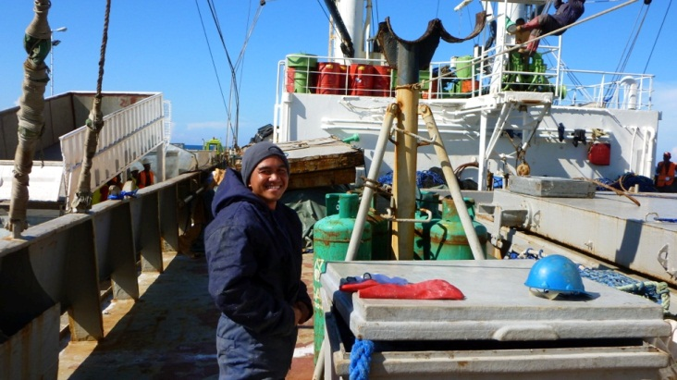
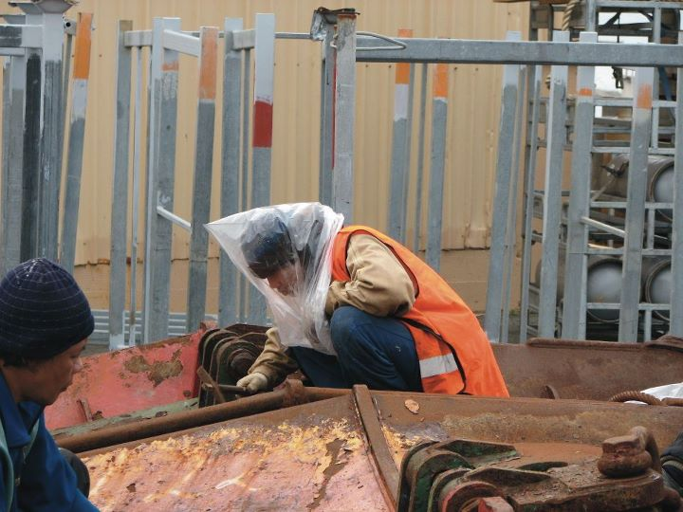
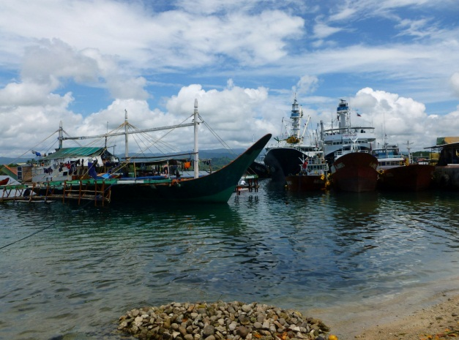
Conditions of work for fishers
length of time at sea
protective clothing
living conditions
Notes:
Regular reports of abandonment, slavery and forced labour on fishing vessels are conditions that are being reported and witnessed around the globe by brothers and sisters in the union movement, missionaries in ports, ITF Inspectors and
Photo from MUNZ of a workers using a plastic bag as safety gear
Philippe from the Philippines who hadnt been home or had contact with his family for 27 months
Workers who you can’t see but are actually bathing, going to the toilet and doing their washing (doby) in the sea as there are no onboard failities

Slide 4
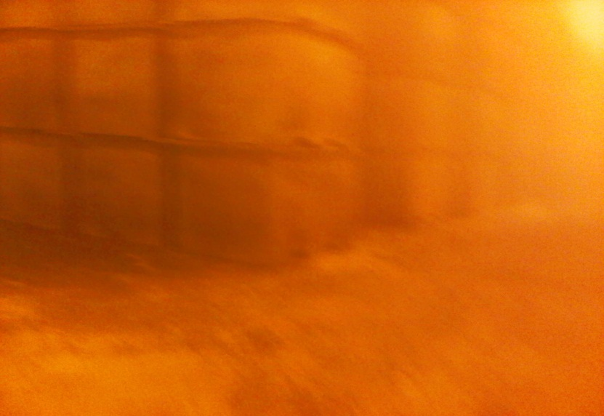
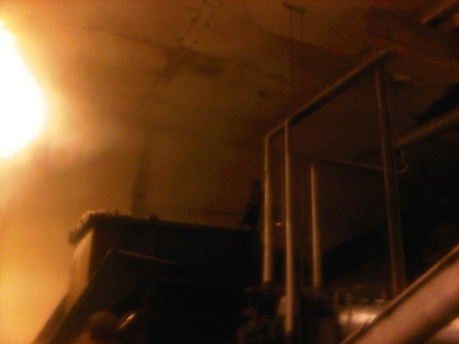
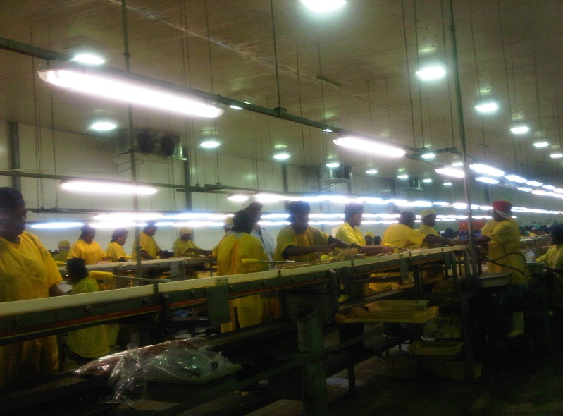
Conditions of work in processing plants
Extreme temperatures
Hazardous work
-15c
worker
Protective clothing
grinder
Notes:
Regular reports of abandonment, slavery and forced labour on fishing vessels are conditions that are being reported and witnessed around the globe by brothers and sisters in the union movement, missionaries in ports, ITF Inspectors and

Slide 5
Global density

Slide 6
supply chain map for fisheries

Slide 7
Governance of the fishing sector
United Nations
UNCLOS
ILO
FAO
Straddling Fish Stocks Agreement
C188
ILO and ITF training
STCW-F
Torremolinos
IMO
COFI
Sub-Committee for Trade
Sub-Committee for Aquaculture
Global Compact
Regional Fisheries Management Organisations
Member States Fisheries Authorities
Technical Management of Vessels
Allocation of Quotas
Fishing Licenses
Monitoring and Surveillance
Code of Conduct on Sustainable Fisheries

Slide 8
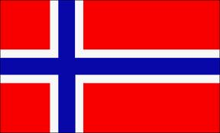
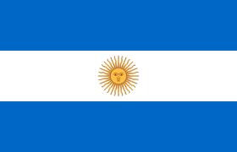
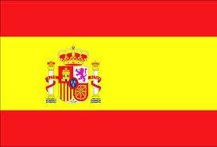
Integrated corporate map
Laco Holdings
DOF ASA
094611
Norway
Laco AS
Marine Freight & Offshore development
Austevoll Seafood Norway
Austral Group Registration Peru,
Control Norway
Surpesca SA
Registration Peru, Control Norway
Foodcorp SA
Registration Chile, Control Norway
BR Birkeland Fiskebatrederi AS
1611831
Noway (Storebo)
Pesquera del Norte
Registration Chile
Nueva Cadiz Pesquera
Registrsation Peru
Control Norway
Pesquera Nueve Esparta SA
Registration Peru
Control Norway
A Fish AS
Austevoll Fisk AS
Managing Director Arne Mogster
Lafisk II
1580541
Talbor AS
5153800
Norway (storebo) finfish Fishing
AS Polarbus
1588299
Norway
Shetland Catch Ltd (25%)
Austevoll Fiskeindustri AS (100%)
North Capelin Honningsrag AS (50%)
Modolv Sjoset AS (66%)
Norway Pelagic ASA (43%)
Merger with Atlantic Pelagic AS operations providing a production, processing, sales and distributuion network
DOF Holdings
Bravo Tug
Mogstein & Mogster Management
Mogster Offshore AS largest Shareholder - 61.51%
Cross reference with Austral Group SAA, Chairperson Mogster
Murman ishing Co Ltd
1811481 Cyprus
(was 3rd Party anagement Companyu
Austevoll Supply AS
5368271 Norway
Owns 1 search and rescue vessel Ringasund
Mogsterhav AS
1775822 Norway
Mogsterfjord I AS
5172781 Norway
Ole Rasmus Mogster
2103141
Chair of Austral Group SA and MD of Austevoll Seafood ASA
Lafjord Fiskebatrederi
1930034 Norway
A/S Veabas
1490145 Norway
Austevoll ASA was 3rd Party management company as is c/o address
Subsidiary of Vea O
Oddvar Vea AS
0740820 Norway
? part of the Vea O Group?
P/R Vea & Vea DA
1665804 Norway
K/S Veafisk A/S
1096751 Norway
Celine Fishing Co Ltd
1709247 Norway
Cindy Fishing
1709247 Norway
K/S A/S Rubens
0423876 MNorway
Oddstein
1011008 Norway
Sea Knave
1752357 Norway
Cevitas AS
1714914 Norway
Co called Oceangoing is a 3rd party mgmt compaby
Janne Shipping
5033674 Norway
Arctic Wolf
1822851 Greenland
Veahav ANS
127251 Norway

Slide 9
Campaign Overview
Political
Ministers
Industrial
National Fisheries Authority
Community
Commercial
Brand retailers
TUC
Wider movement / GUFs
Employer Bodies/ Organisations
Regional Fisheries Management Organisation
Other unions
Communities
Export market retailers
Bi-lateral access governors
NGOs
Suppliers
ILO
Domestic laws
Families

Slide 10
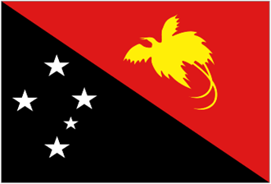
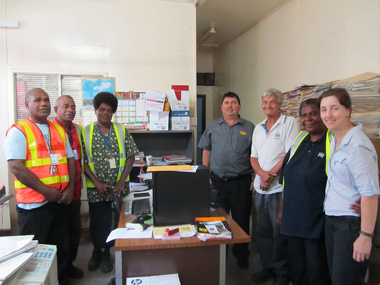

Papua New Guinea Pilot
Notes:
2005-2010
3 attempts for fisheries workers to organise into unions were “busted”
2011
Carried out desk-top analysis, field research and risk assessment
National workshops to launch pilot campaign in conjunction with other industries
Union identified 3 companies as priorities within the project
Union allocated resources to support campaign
2012
Workshop to develop a strategy including the objectives for each company
Working in conjunction with company based unions to agree joint working framework
ITF pilot to develop union capacity in visiting fishing vessles and conducting “inspections”
Decision of union to expand campaigns within project from 3 to 8 companies
Mapping of all vessels, type of fishing, crews, flags and licences

Slide 11
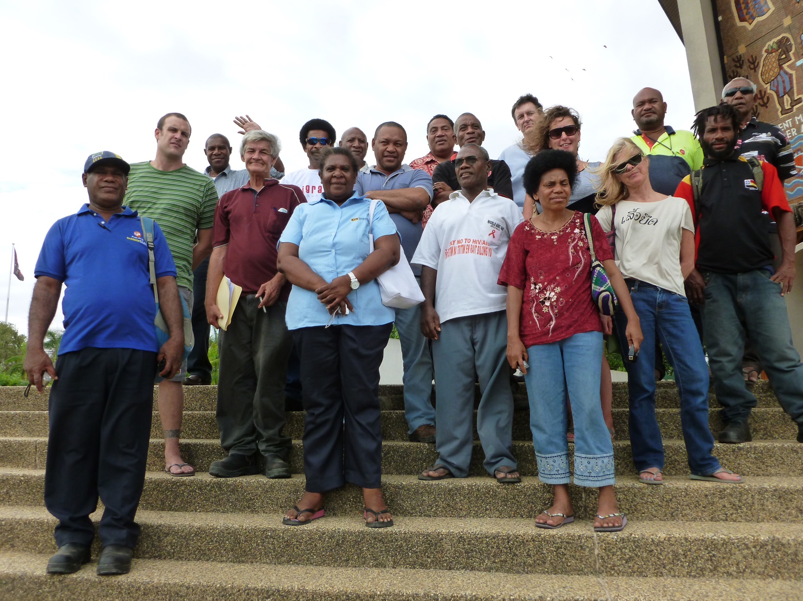

Slide 12
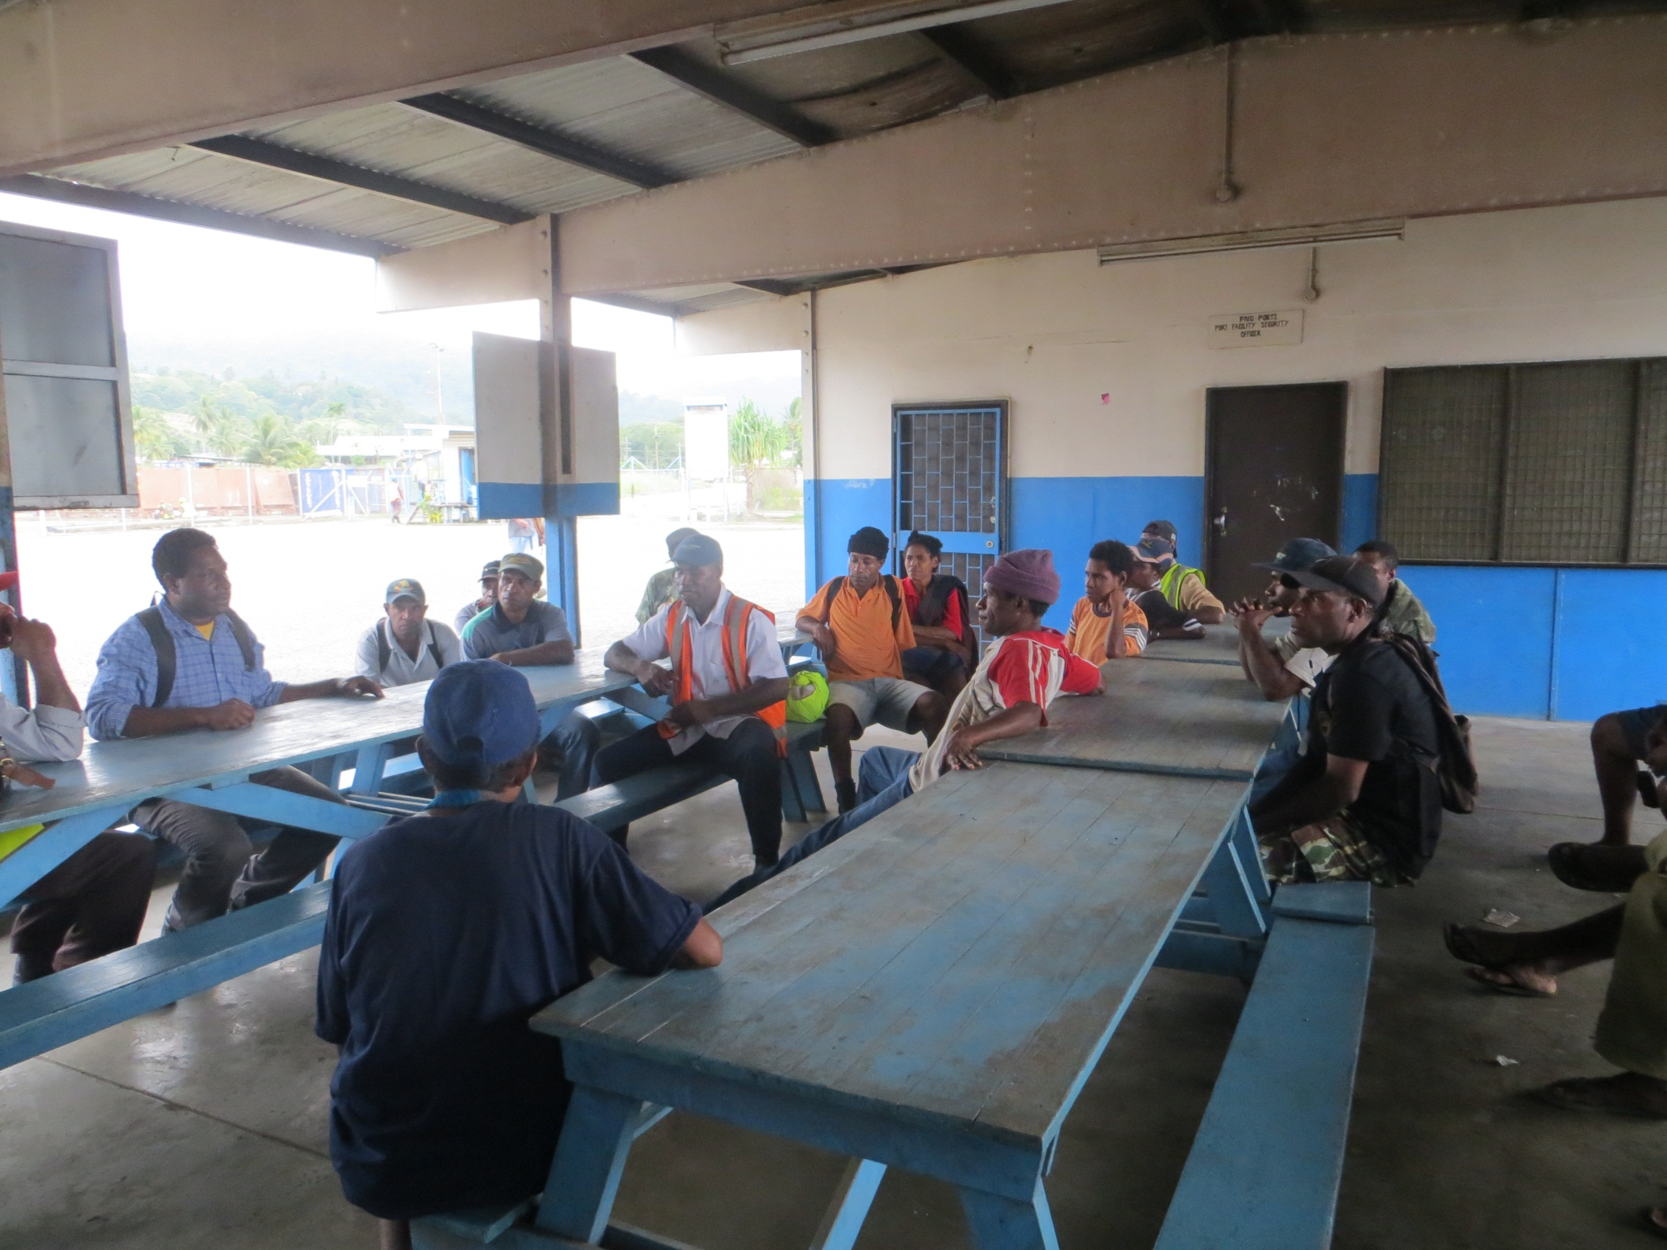
Insert action photos x 3 from Oct 2012 - 1

Slide 13
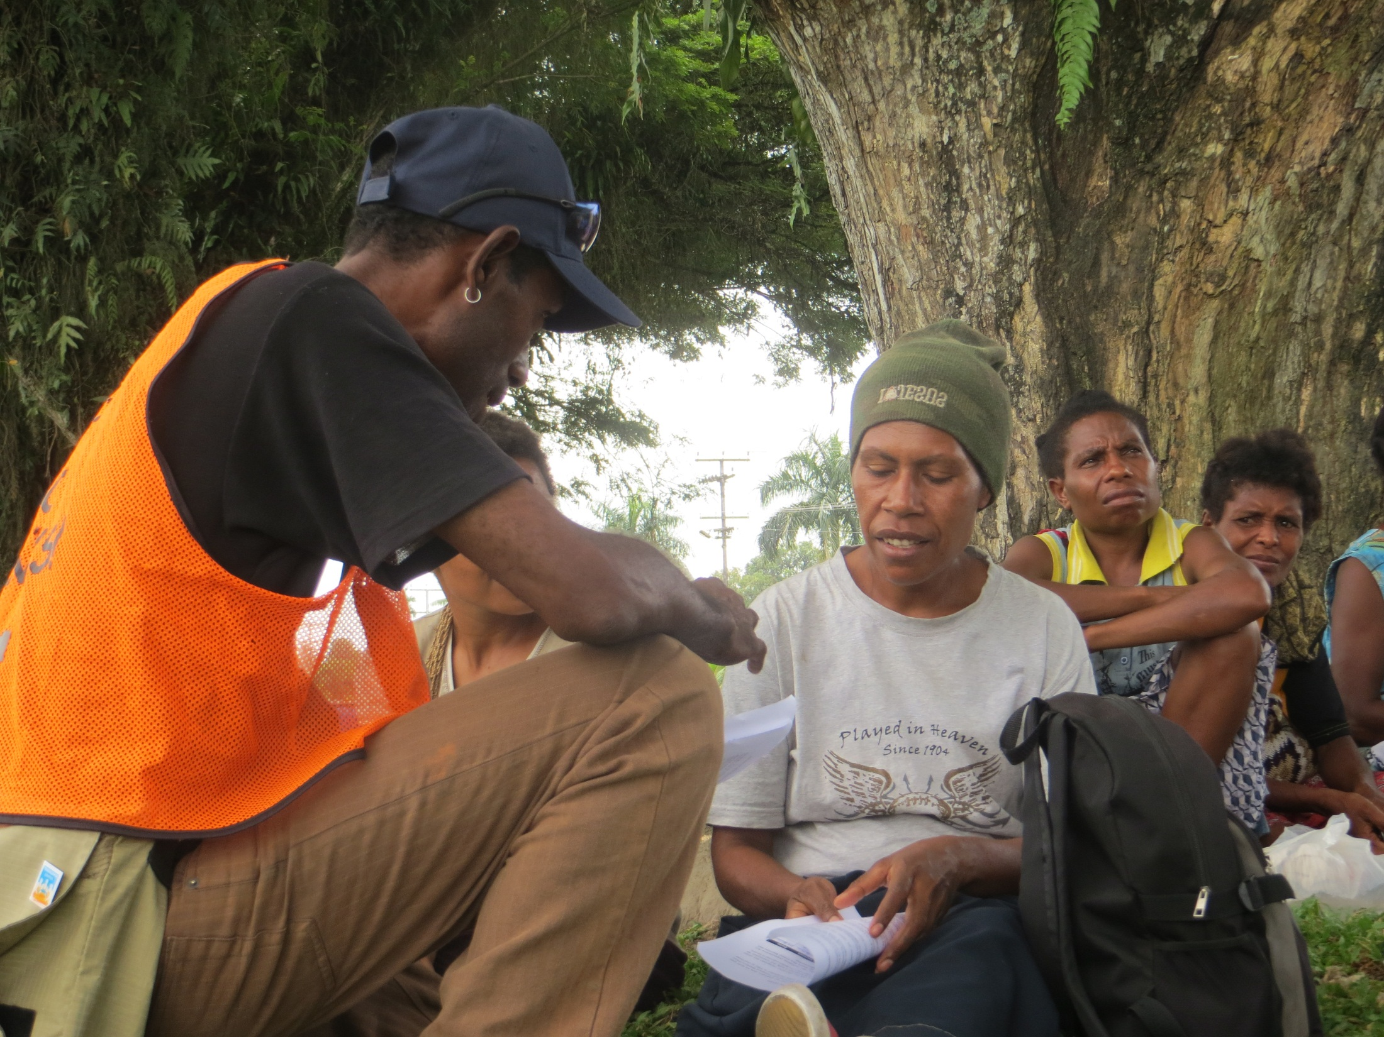
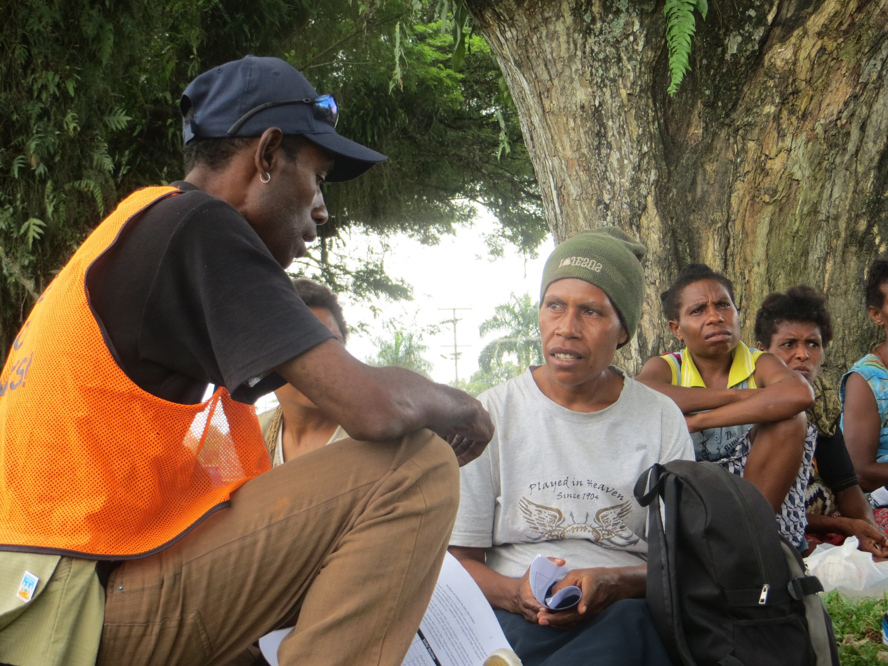
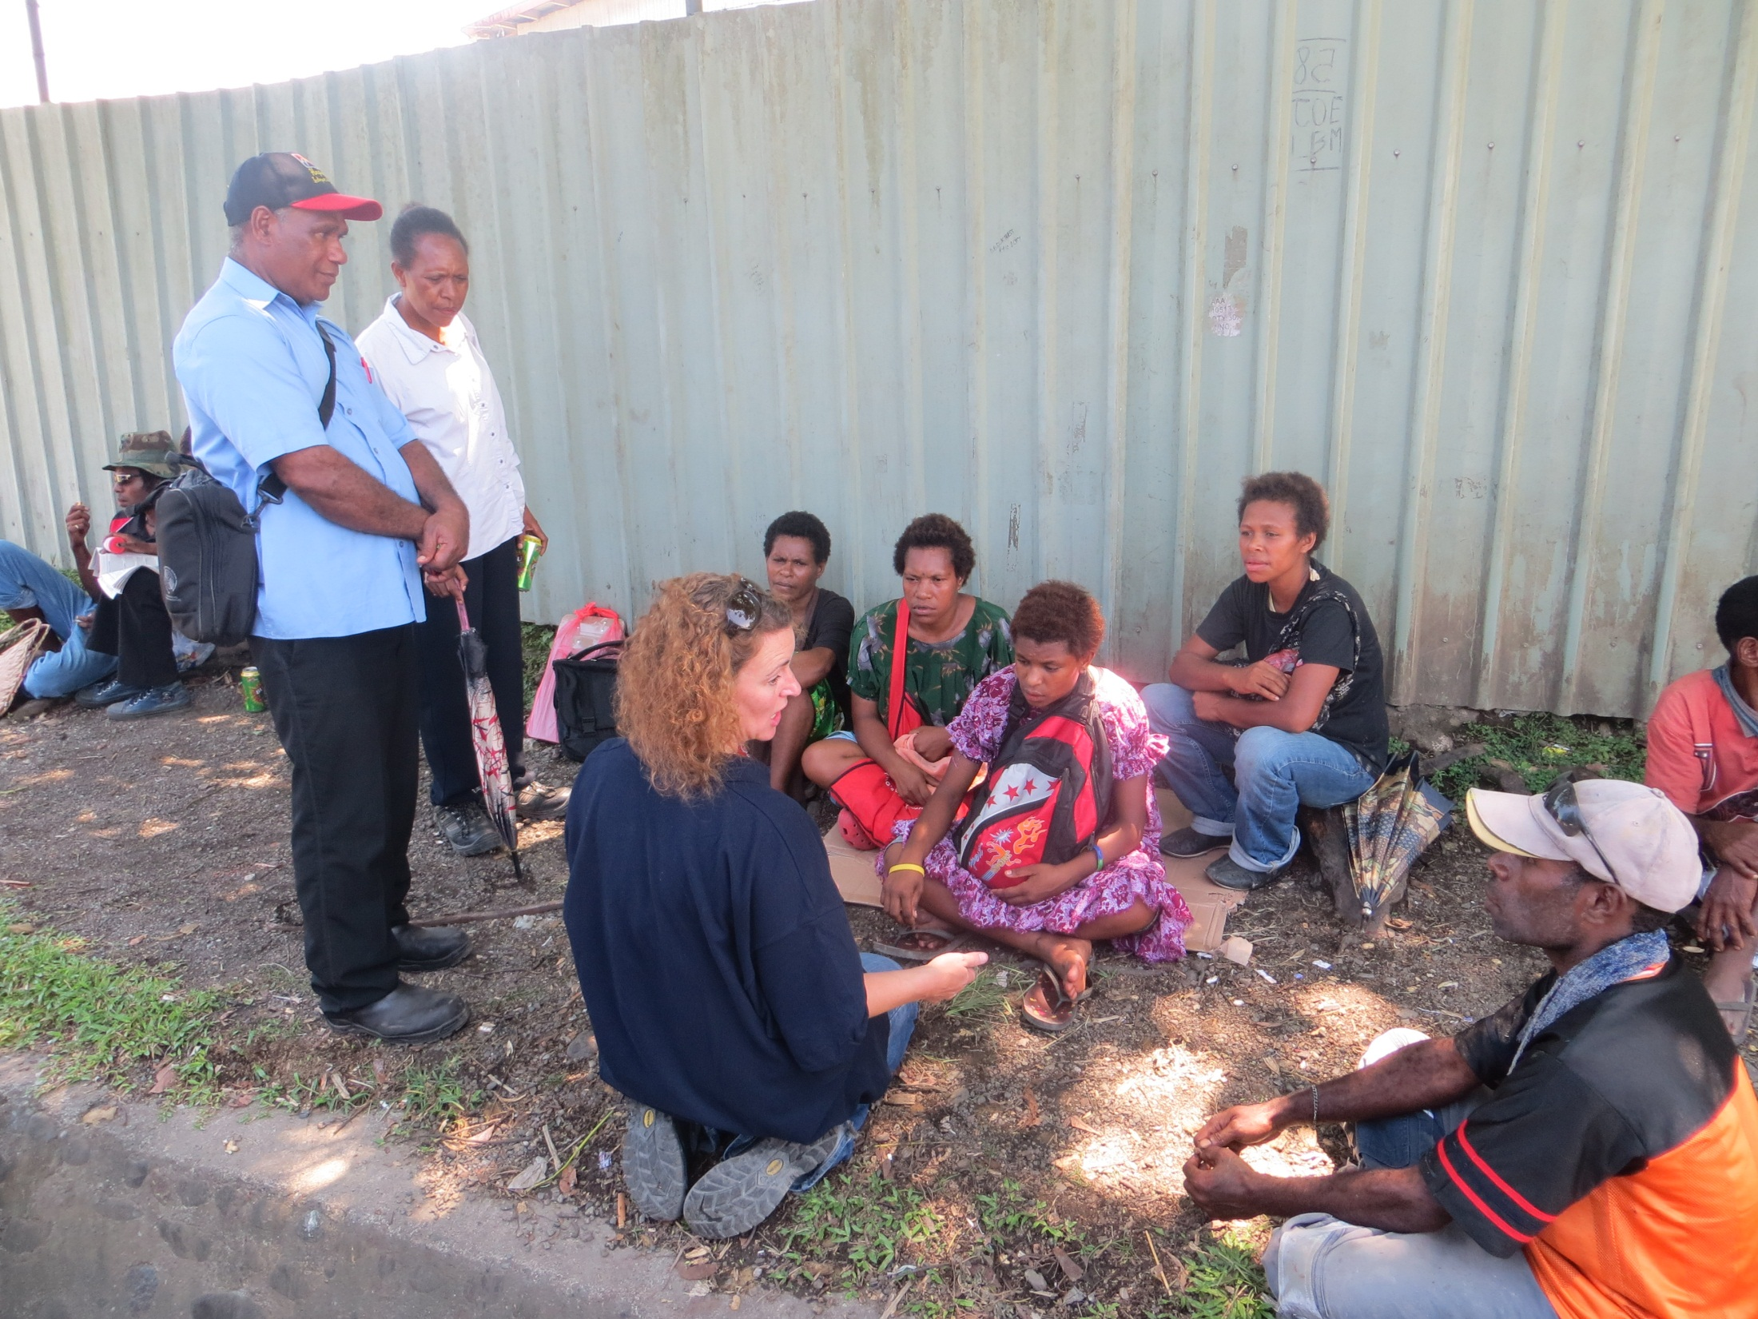
Insert action photos x 3 from Oct 2012 - 2

Slide 14
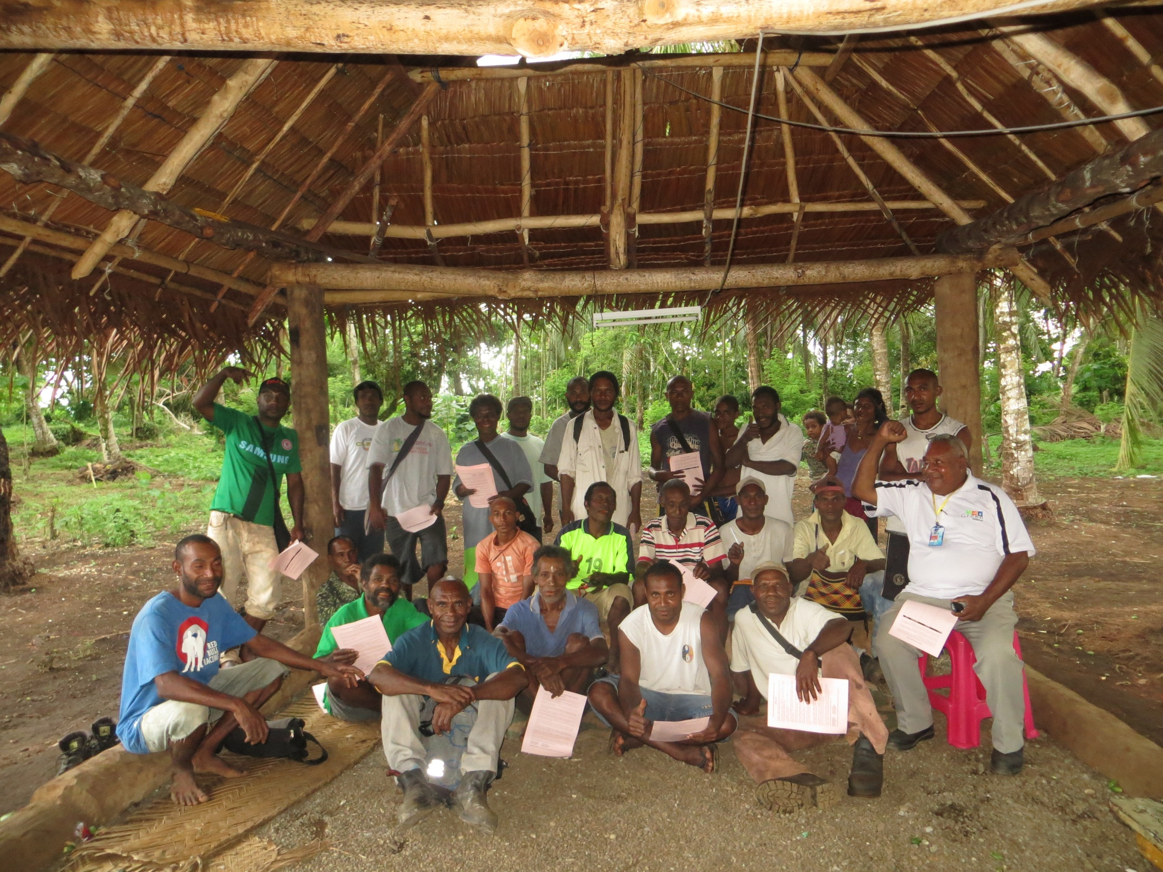
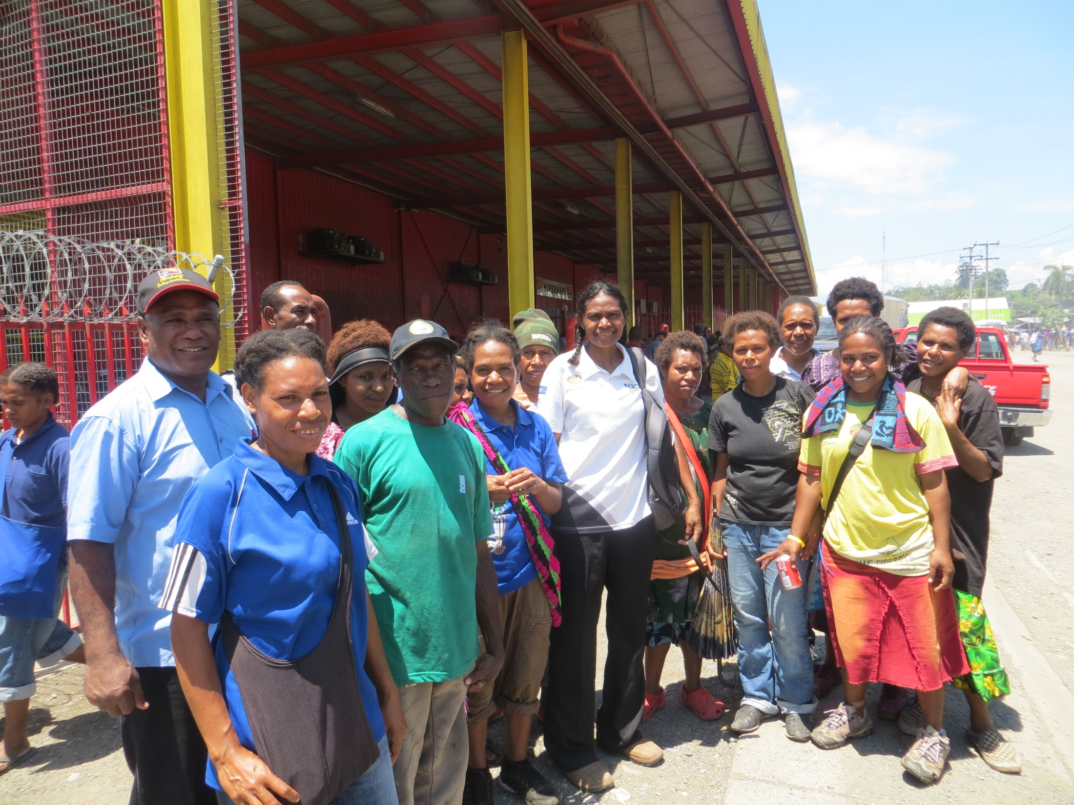
Insert action photos x 3 from Oct 2012 - 3

Slide 15

2013:Increased union coverage in fishing and fish processing
  5000+ new union members
  8 company campaigns
  4 trained organisers
  28 trained reps across 4 companies
  opened collective bargaining negotiations in 4 companies
  unionising East-West haulage company
  9 trained union fishing vessel visitors
  lobbying the government for ratification of ILO C188
  union subscriptions income increase
  affiliation to IUF of Canning workers

Slide 16
By end of 2014?
  Political mandate from ITF Congress 2014 to Congress 2018 (IUF 2017)
  Increased capacity from existing and new affiliates in both GUFs
  Be in / have completed CBA negotiations with 3 target companies
  C188 ratification minimum of 10 countries met
  Plan for implementation and enforcement with Fisheries affiliates
  Have active campaigns across 10 more countries and regions
  www.itfglobal.org/fish

Slide 17
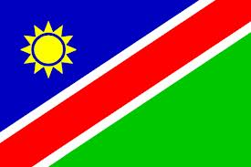
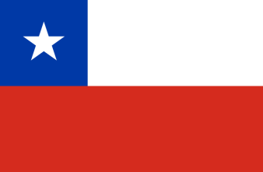

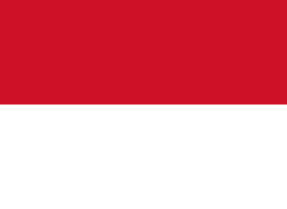
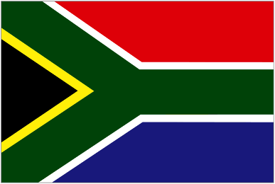
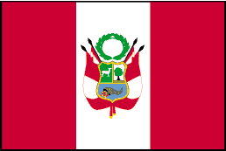
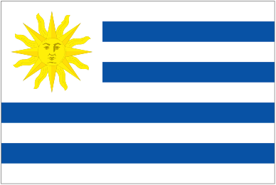
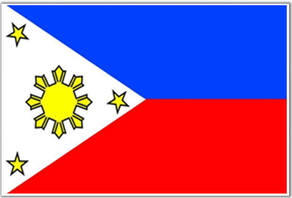
Examples of potential projects
Africa | Latin America (in partnership with other affiliates) | Arab World | Asia Pacific
Namibia South Africa | Chile Peru Uruguay | Egypt | Indonesia Papua New Guinea Philippines

