Slide 1
PH EU FTA
11th Asia Europe Labor Forum
Brussels, Belgium
Oct 16-17, 2018
NUWHRAIN-SENTRO PHILLIPINES

Slide 2
Trade for All strategy set out a vision for a trade policy that is transparent and responsible, benefits all citizens, provides jobs and growth, and modern solutions for the realities of today's global trade.
The fundamentals of the Trade for All strategy thus continue to guide the EU’s approach: openness combined with a level playing field, high standards of labour, environmental, consumer and social protection combined with the right policies at home remains the most fitting way to make globalisation work for all Europeans.

Slide 3
EU-ASEAN FTA
EU and ASEAN are determined to pursue their respective goals of greater regional economic development. Both see the expansion of markets for trade in goods and services and the easing of restrictions on investments as central strategies towards the attainment of their goals. There is a consensus among EU and ASEAN states to anchor regional integration on the free market corporate-driven paradigm with the pursuit of free trade and economic partnerships agreement as key element of the strategy.

Slide 4
NEGOTIATING HISTORY
2007 – EU LAUNCHES SIMULTANEOUS FTA TALKS WITH KOREA, INDIA AND ASEAN
2009- EU SUSPENDS EU-ASEAN TALKS SHIFTING APPROACH TO BILATERAL NEGOTIATIONS WITH SELECT COUNTRIES
2010 BILATERAL TALKS WITH SINGAPORE (JANUARY) AND MALAYSIA (OCTOBER)
2012 FTA TALKS WITH VIETNAM
2013 FTA TALKS WITH THAILAND
2015 PHILIPPINES AND INDONESIA

Slide 5
PH NEGOTIATING FRAMEWORK
THREE-PRONGED STRATEGY WITH THE EU
PH-EFTA FTA (signed in April 2016, ratified by the Senate March 2018)
GSP+
PH-EU FTA

Slide 6
GSP +

Slide 7
Benefits of the GSP+ on the Philippines
Philippine exports to the EU is expected to increase within the first year of implementation of the GSP+ scheme.
According to a study made by the DTI , Philippine exports under GSP+ will increase by $611.8M during the first three years of availment. - http://www.dti.gov.ph/2016-03-29-02-27-23/eu-gsp
The mid-term evaluation report noted that the Philippines shipped €213 million worth of goods to the EU in 2016, accounting for just 1.8% of total exports under GSP+. That year saw the Philippines ship 36.93% of its textile and clothing products under GSP+ last year. The country shipped a total of €6.2 billion worth of goods to the EU in 2016. http://www.interaksyon.com/ph-moves-to-assure-eu-on-gsp-fitness/

Slide 8
The products to benefit most from zero tariff are:
Product Regular GSP GSP Plus
Tuna 20% 0%
Pineapple 15% 0%
Bicycles 10.5% 0%
Textiles and garments 9.6% 0%
Footwear, headwear, umbrellas 9.6% 0%
The projected increase in exports will translate to more than 200,000 new jobs generated in both the agriculture and manufacturing sectors. Many of these new jobs will be created in the rural areas.
http://www.dti.gov.ph/2016-03-29-02-27-23/eu-gsp
Published: 09 February 2015

Slide 9
Market Access
“The benefits of GSP+ just started to be realized, as exports to EU for first half of 2017 grew by 36%,” Mr. Lopez noted in his text.
The DTI statement quoted Mr. Lopez as saying: “We want to follow through the dialogue on the expansion of the GSP+ and move to a long-lasting trade concession via free trade agreement.”
The Philippines bagged GSP+ status — which slashes to zero tariff rates on 6,274 exports to EU markets — on Dec. 25, 2014. GSP+ ranks now include seven other countries, namely: Armenia, Bolivia, Cape Verde, Kyrgyzstan, Mongolia, Pakistan and Paraguay.
http://www.interaksyon.com/ph-moves-to-assure-eu-on-gsp-fitness/

Slide 10
Market access through GSP+
“The Philippines was the only significant GSP+ beneficiary country which exported under the scheme over the period…” the report noted, adding that “the Philippines has steadily increased exports under the GSP+.”
“The withdrawal from GSP+ would therefore increase the price of Filipino imports and decrease the country’s competitive advantage vis-à-vis other GSP+… beneficiaries,” it warned.
“This could have a substantial impact on the trade between the EU and the Philippines as the EU was the Philippines’ third largest export destination in 2016.” http://www.interaksyon.com/ph-moves-to-assure-eu-on-gsp-fitness/

Slide 11
Conditions
Any developing country will benefit from GSP tariff preferences unless they have:
another type of special trade access to the EU granting the same tariff preferences as the Standard GSP scheme or better; or
achieved a high- or upper-middle income economy status for three consecutive years according to the World Bank Classfication
The EU can withdraw standard GSP preferences in some exceptional circumstances, notably serious and systematic violation of fundamental human rights and labour rights conventions.

Slide 12
PH EU FTA

Slide 13
10 Topics in the PH-EU FTA
Trade in goods
Rules of origin
Customs and trade facilitation
Trade in services
investments

Slide 14
10 Topics in the PH-EU FTA
Government procurement
Intellectual property rights (IPR)
Competition policy and subsidies and Rules related to state owned companies
Trade and sustainable development
Legal and institutional issues

Slide 15
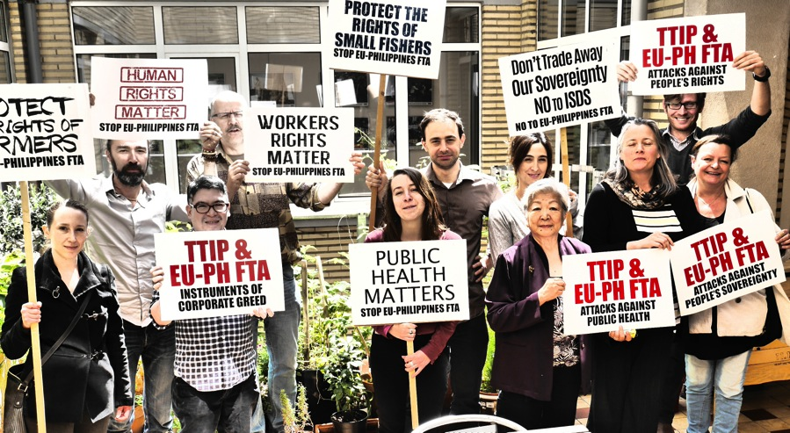
PH-EU FTA
FIRST ROUND (MAY 2016)

Slide 16
UPDATE FROM GOVERNMENT
First round was putting “the negotiation in process with basically a confidence building week of discussion between the parties.”
“most of the elements have been touched but no substantive discussions other than broad and general tackling of issues that maybe encountered.”
FOCUS ON EU’S ICS*: “We were in a sponge mode trying to absorb things and process of understanding it and implications to our regimes is something we have to deal with and work on in Manila.”
Notes:
Import Control System

Slide 17
ISSUES FROM FIRST ROUND
The repeated reference to EU-Vietnam FTA on the side of the EU, while PH made references to the EFTA agreement
Discussion on SUSTAINABLE DEVELOPMENT CHAPTER
QUESTION ON THE MANDATE
ORIGINAL MANDATE: EU-ASEAN NEGOTIATIONS BUT ORIGINAL MANDATE DOESN’T HAVE THE PROVISION ON INVESTOR PROTECTION

Slide 18
Leaked Text on ISDS

Slide 21
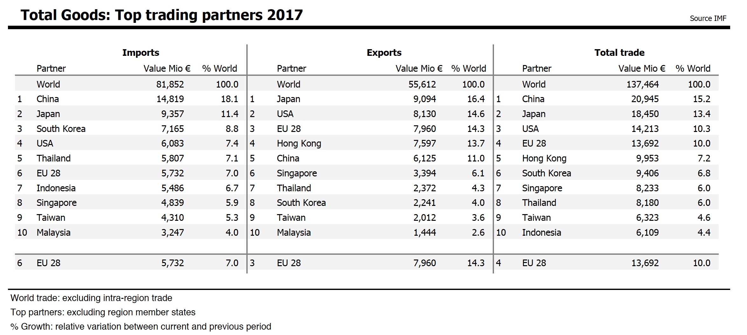
EU-PH Trade
Philippine Trading partners

Slide 22
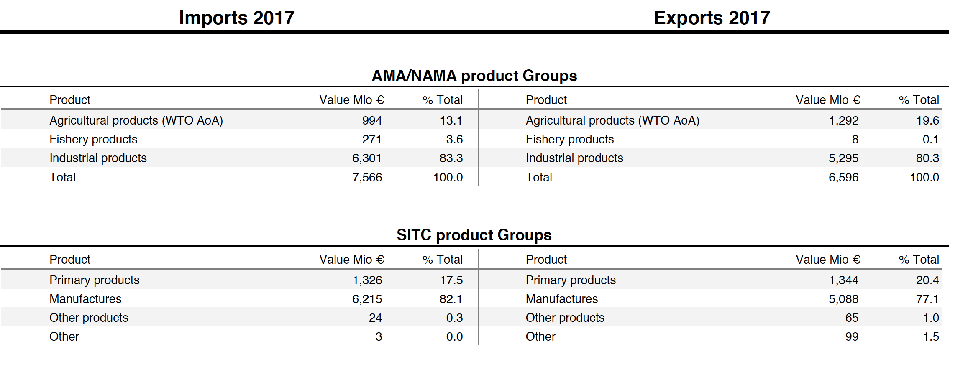
Trade by Products

Slide 23
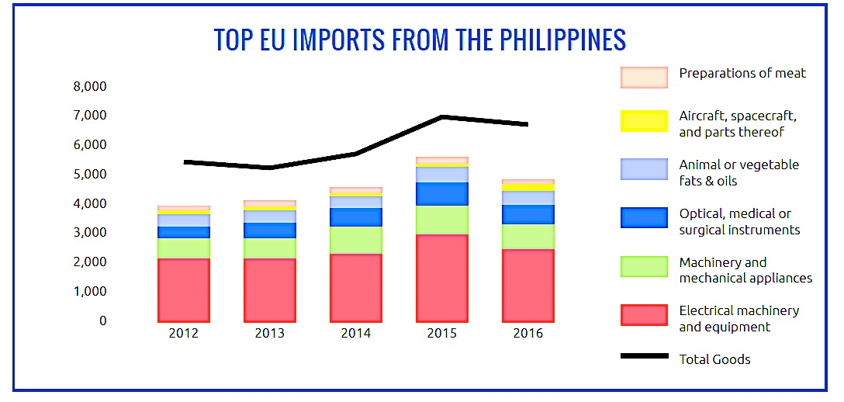

Slide 25
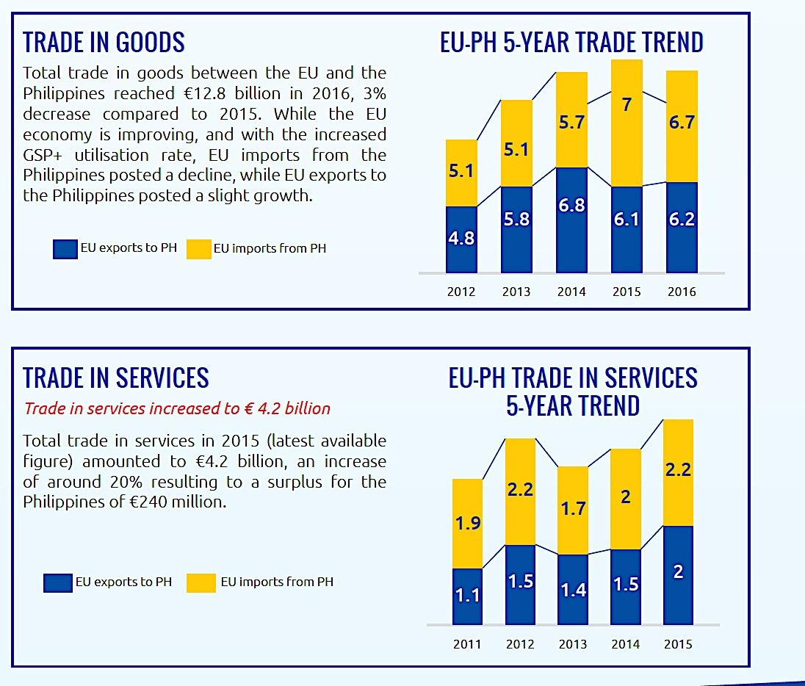

Slide 26
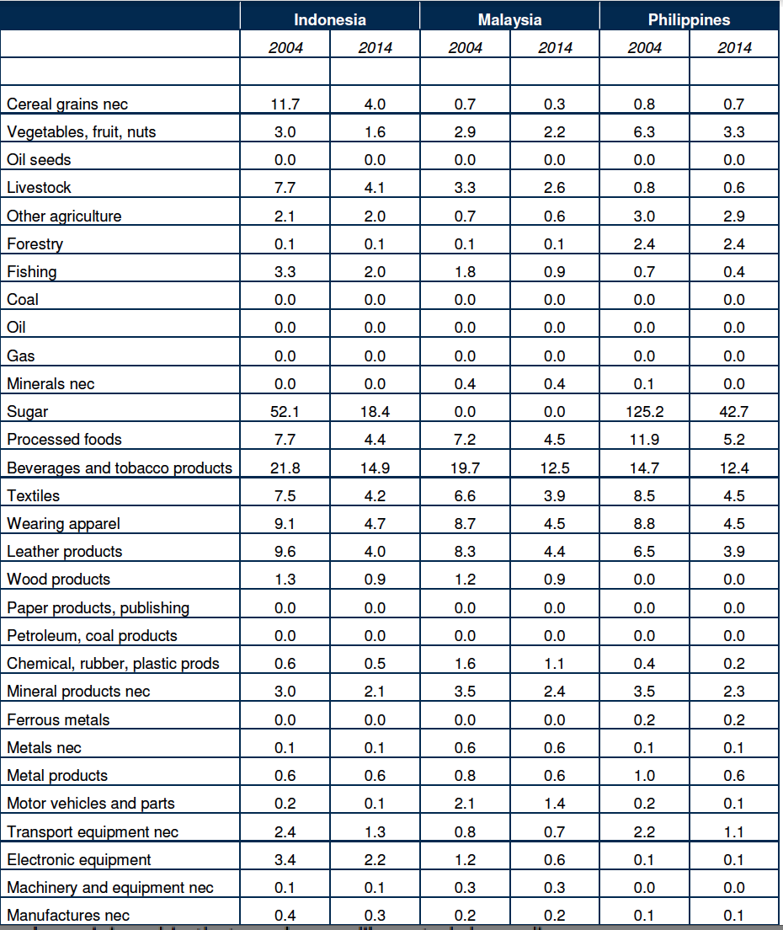
EU TARIFFS VS PH EXPORTS

Slide 27
While the negotiations have begun, the issues are lack of transparency and double standards.
Another 2 rounds of negotiations were completed in June 2016 and February 2017.

Slide 28
Stalled PH EU FTA
Deadlock on Intellectual Property Rights (primarily)
PH ought to push for a balance between the rights of the IPR holders and public interest as what India and other EU prospective partners are doing.

Slide 29
What is to be done?
Continuous mobilizations of Peoples’ Organizations and Social Movements against FTA, nationally and globally
Push for a comprehensive and participatory process to review the deals entered into by the Government
(call for a review of the trade and investment policies being pursued by the participating countries, particularly those the EU are aggressively pushing for in their FTAs: ISDS, expansive IPR, deregulation, etc.)
Assessment of these deals of their impact on peoples lives and human rights
Push for a binding treaty against TNCs

Slide 30
References
Philippines Alliances of Human Rights Advocates (PAHRA)
Focus on the Global South
SENTRO
Center for International Relations and Strategic Studies (CIRRS)

Slide 31
Thank you

