Slide 1

Regional Trade Agreements in Asia Pacific:
A Threat to workers, public services and sustainable development
Asia Europe Labour Forum
Kate Lappin

Slide 2
Key Points
Regional AP trade agreements central to geopolitical trade war
Capital vs capital
Trade unions need to chart an alternative to the globalisation vs nationalist protectionism narrative
Labour rights can be a prerequisite, but not a result, of trade agreements
Capital wins access to our public services, goods, knowledge and data, our democratic space
We have, and can, have an impact

Slide 3
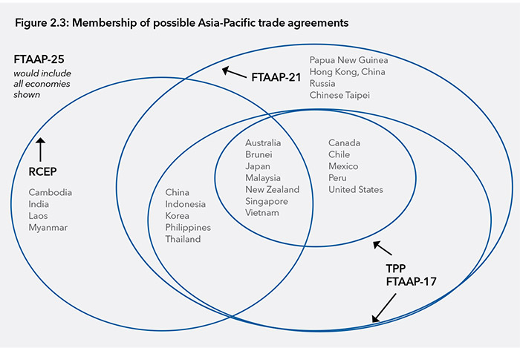

Slide 4
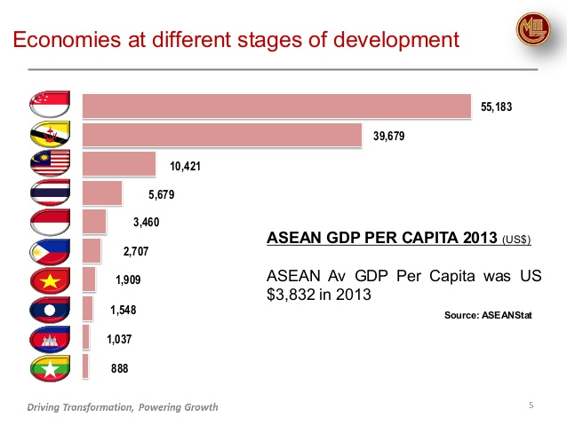

Slide 6
CHAPTER | RCEP | TPP
Goods Access | MODEST Example: tariff coverage could be at 80%, (20% excluded) and not all drop to 0 even at end of full implementation | VERY DEEP All goods included, and every tariff line addressed Most tariffs drop to 0, including sensitive items normally carved out or excluded from Trade deals
Services | MODEST ?? Possible limited list (positive list)? | UNPRECEDENTED (EXCELLENT) Every single service sector (160+) opened for TPP member firms except those explicitly listed as closed and most exceptions not commercially meaningful
Investment | STRONG Negative list includes ISDS | EXCELLENT Every investment sector also opened for TPP member firms (except for those listed as closed) Strong protection for all investors, including ISDS (although tobacco explicitly carved out of ISDS coverage)
E-Commerce | SHOULD BE GOOD | GOOD First major agreement to cover digital trade and e-commerce. New rules for data flows, encryption, source code.
Government Procurement | STILL DEBATING | OPEN TO TPP FIRMS
Transparency | Modest | Every chapter in TPP includes provisions for greater transparency, particularly in rulemaking to allow input and time for adjustment
Flexibilities | Nearly every provision includes extensive flexibilities for members | Flexibilities granted for public health, animal health, public security, etc. Otherwise, limited flexibilities in agreement

Slide 7
CHAPTER | RCEP | TPP
Intellectual Property | Possibilities for new rules including digital trade | TPP created new IP provisions in nearly every category of IP to update existing rulebooks
Labour Mobility | Unclear Priority for India | SOME Chapter on business mobility that allows the temporary movement of workers for services
Labour | No | Standard US Chapter with US side letters with Vietnam, Malaysia, Brunei
Environment | No | Yes TPP environment chapter contains commitments on fish, fish subsidies, endangered species trade, logging, ozone
SME | Not clear | Limited SME chapter in TPP is basically website, but note that commitments in agreement can be very helpful to smaller firms (even if the overall agreement is complicated to use)
Development | Extensive RCEP explicitly recognizes developmental dimensions of trade and builds in flexibilities for developing countries, LDCs, plus capacity programs | Limited TPP includes a norm that all members agree to same provisions with no distinction between countries—hence limited flexibilities and modest capacity building included in agreement

Slide 8
Public Services Threatened
Services
  If supplied on a commercial basis OR competes with commercial providers it should be included.
  Unless explicitly excluded, it must be open to investors.
  Ratchet – no new regulations
Government Procurement
  No local preference
  No ‘burdensome’ requirements
Ecommerce – Data should be protected property of investor, no requirement to disclose, no local presence, no
Intellectual Property Protections over monopolies

Slide 9
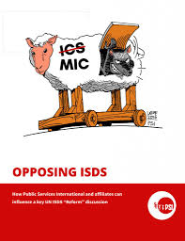
Investor State Dispute Settlement (ISDS):
Global Corporate Governance
“Far from contributing to human rights and development, ISDS has compromised the State’s regulatory functions and resulted in growing inequality among States and within them”
A “Magna Carta for Investors”
Corporations can sue government if they pass laws, policies or regulations that may impact on their profits including – public health, access to essential services, labour standards, affirmative action, corporate tax and finance rules and decisions, consumer laws, environmental protection, anti-corruption.
Regulatory chill, reduced govt revenue
Notes:
http://www.globalresearch.ca/te-devastating-impacts-of-the-tpp-trade-deal-on-vietnam/5487939
8

Slide 10

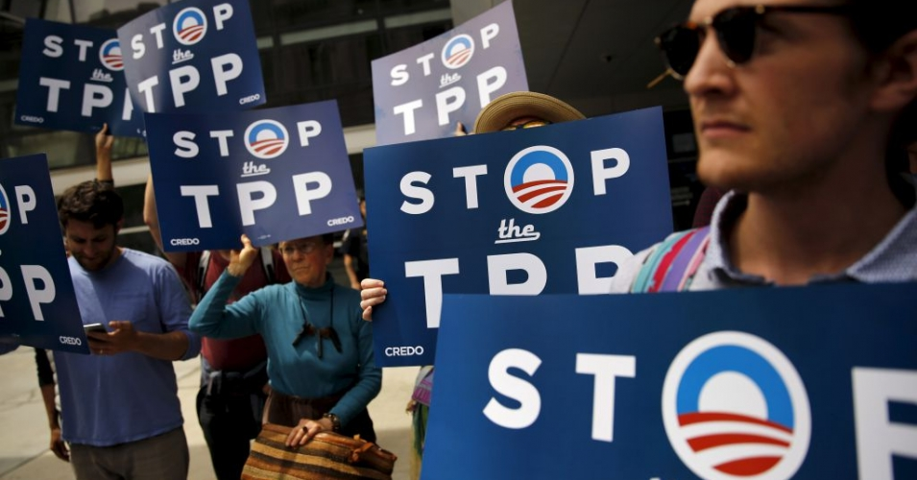
www.unionsfortradejustice.org
Malaysian shift important
Australian “A fair go for Australians in Trade Bill”
Elections 2019 – Indonesia, India, Australia
Notes:
PSI organised a workshop in early May where the network and joint strategies were developed. The network will adopt a unity statement and collaborate at regional and national levels to stop harmful regional and bilateral trade agreements with a primary focus on the Regional Comprehensive Economic Partnership.

