Slide 1
The Involment of TU Toward FTA, Particularly I-EU CEPA
SULISTRI
KSBSI-Indonesia
AELF, Brussles, 16-17 October 2018

Slide 2
Many countries negotiate Free trade agreements (FTAs) with other countries. The FTA can be bilateral such as: Indonesia-Australia, Indonesia-Pakistan, Indonesia-China etc.
But also can be between region with other countries, example member countries of ASEAN with other countries, we called as RCEP (Regional Comprehensive Economic Partnership). RCEAP between ASEAN and 6 ASEAN FTA partners (Australia, China, India, Japan, Republic of Korea and New Zealand), OR
FTA between countries with the European Union. In Indonesia we called CEPA (Comprehensive Economic Partnership Agreement), for example: CEPA between Vietnam-EU and CEPA between Indonesia and EU (still in negotiation process)

Slide 3
The objectives of the various FTAs are to achieve a modern economic partnership agreement, comprehensive, high-quality, and mutually beneficial between the parties that are negotiating.
As Indonesia's hopes for various trade negotiations conducted are to increase the number of investors entering Indonesia and increase the export of goods by getting premium rates or tariff-free. So that there will create many jobs.

Slide 4
Many trade union leaders and CSO’s are lack of involvement on negotiations on trade agreements that carried out by the government even though the impact of the trade will affect to the protection of the environment, natural resources, workers' working conditions, including wages, social security, overtime, OSH for all workers, including workers who work in mining, plantation, agriculture, finance and commerce, garment and other workers who work in other sectors.

Slide 5
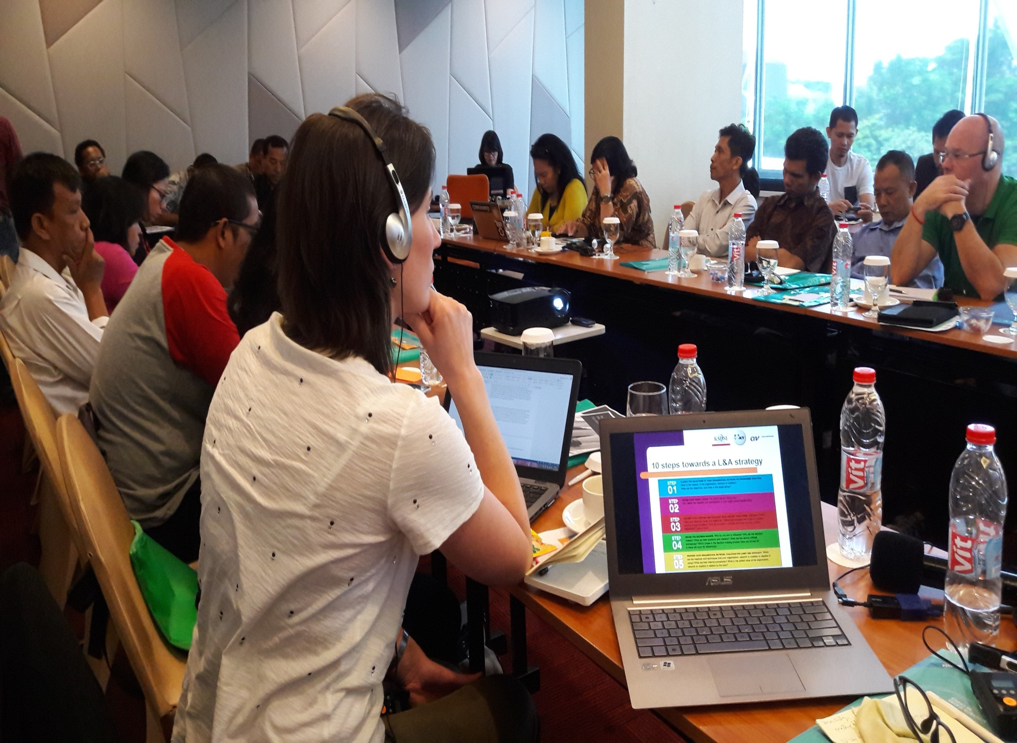

Slide 6
The Involment of TU and CSO in I-EU CEPA negotiation
Recently, trade union and CSOs involved in influencing the process of negotiation of trade agreement between Indonesia and EU, called as CEPA (Comprehensive, Economic Partnership Agreement), particularly on TSD chapter.

Slide 7
Rountable Discussion of CEPA
CEPA was launched on July 18, 2016, 1st Round of Brussels, September 20-21, 2016, Bali 2nd Round, January 24-28, 2017, 3rd Round Brussels, September 11-15, 2017, Solo 4th Round, 19 - 23 February 2018, 5th Round Brussels, 11-15 July 2018, 6th Round Palembang 16-20 October 2018.

Slide 8
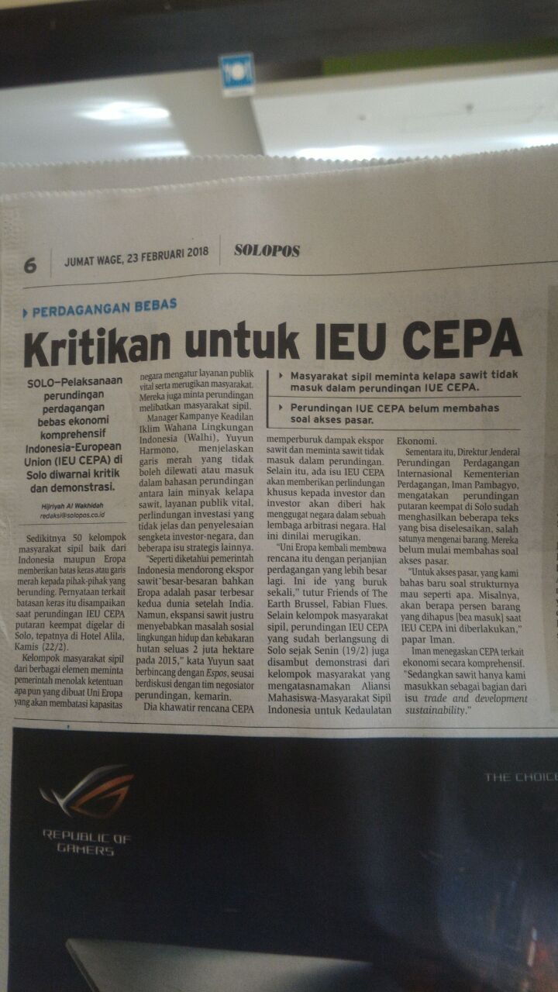

Slide 9
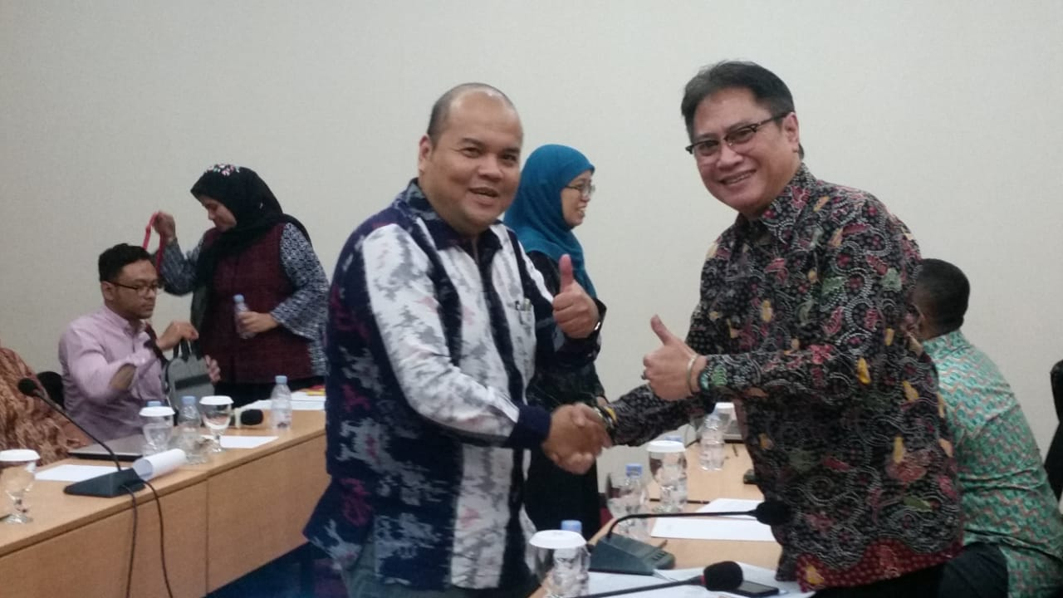

Slide 10
The Involment of TU and CSO in I-EU CEPA negotiation
Various activities such as lobbying, advocacy with trade ministry, negotiator team from both Indonesia and EU, Labor ministry, member of parliament. Networking with other TU and CSO in Indonesia and EU, campaigns, trainings, and publications were carried out for the awareness of the public and workers on the negative impacts of the trade agreement.

Slide 11
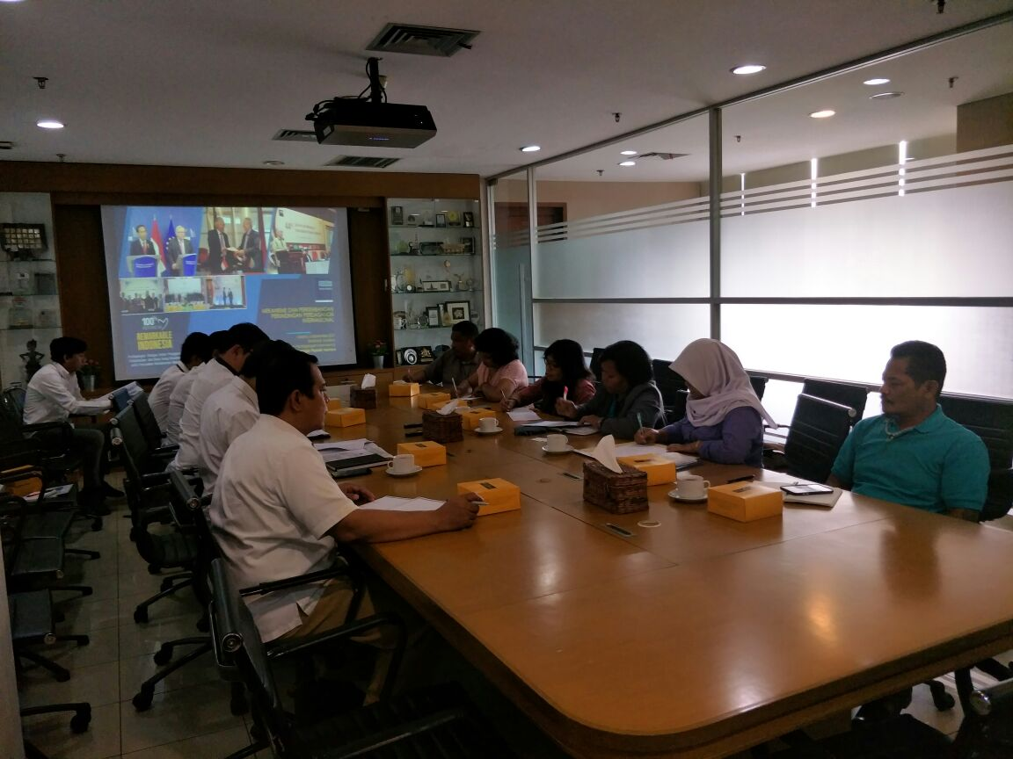

Slide 12
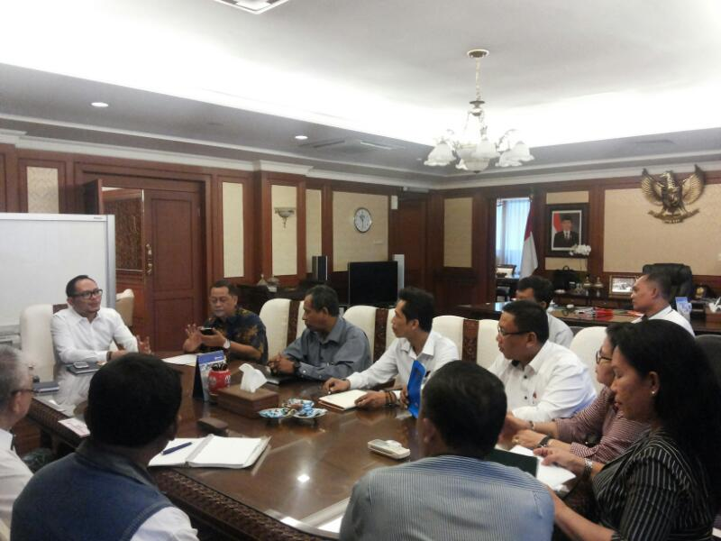

Slide 13
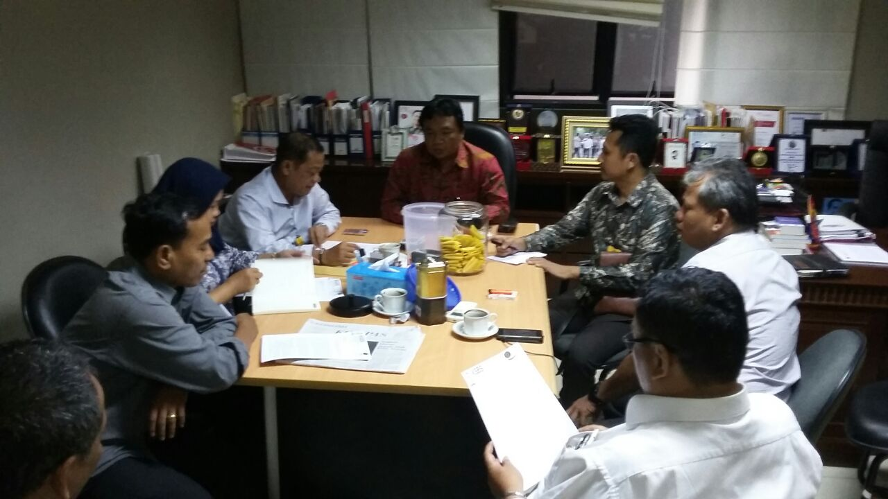

Slide 14
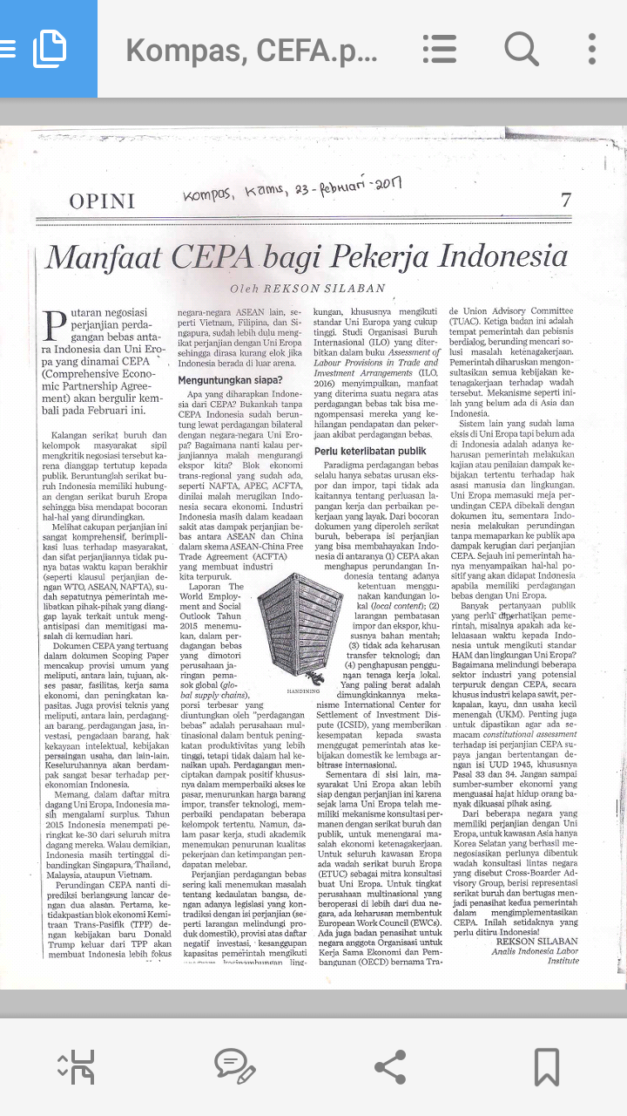

Slide 15
The Main Demands of Trade Union and CSO
The CEPA negotiation process must be transparant, consultation with trade union and CSOs, sharing information during the negotiation process, must be published and must be fully accessible to the public in easy-to-understand language

Slide 16
The Main Demands of Trade Union and CSO
Ratify and implement ILO core conventions. The contents of CEPA agreement must respect and ensure the implementation of International Conventions includes eight core ILO Conventions, the ILO Convention number 144 on Tripartite Consultation, the UN Convention on the protection of migrant workers and their families, the ILO Declaration on Decent Work, the ILO Declaration on Social Justice for a Fair Globalization and United Guidance Principle for Human Right dan Business (UNGP)

Slide 17
The Main Demands of Trade Union and CSO
Concrete demands to advance rights of workers. CEPA should include clear commitments to respect existing international labour legislation and national labour legislation both in the EU and in Indonesia. Any lowering of ILO standards or regression in domestic legislation due to a CEPA agreement is unacceptable.

Slide 18
The Main Demands of Trade Union and CSO
Ensure balanced stakeholder input. All stakeholders must have equal opportunities to provide input to decision makers during negotiations of trade agreements. This includes actively seeking input from under-represented groups, such as indigenous peoples

Slide 19
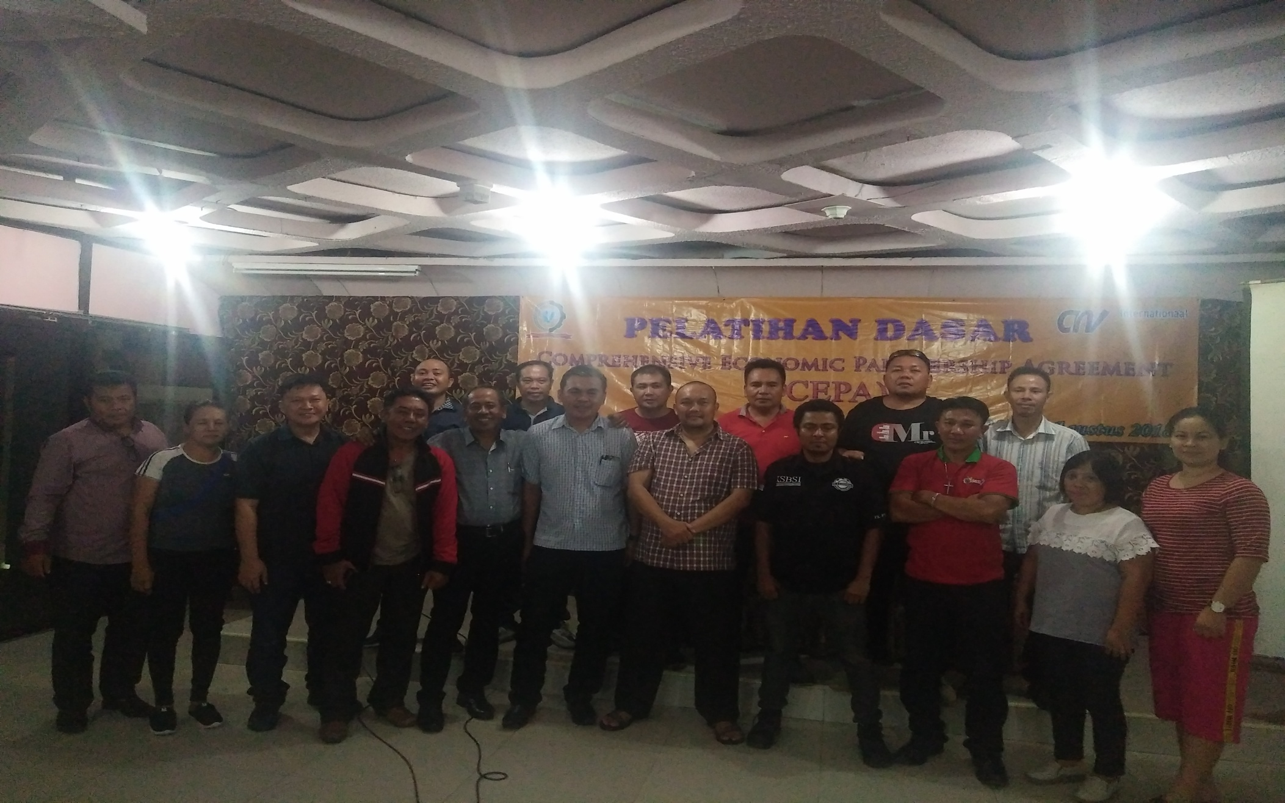

Slide 20
The Main Demands of Trade Union and CSO
End deforestation. The CEPA should not undermine but contribute to efforts to stop deforestation, bearing in mind both Indonesia’s and the EU’s commitments to stop deforestation

Slide 21
The Main Demands of Trade Union and CSO
Conduct and disclose impact assessments on human rights and sustainable development. To ensure the protection and promotion of human rights and to support equitable and sustainable development. it is vital that an in-depth assessment of its impacts on human rights and the environment is conducted prior to the conclusion of the CEPA negotiations.
The required Sustainability Impact Assessments and Human Rights Impact Assessment (HRIA) must be carried out not just before signing CEPA, but also after signing to evaluate and remedy any negatif impacts of human rights and environmental occurring as a result of trade and investment agreements.

Slide 22
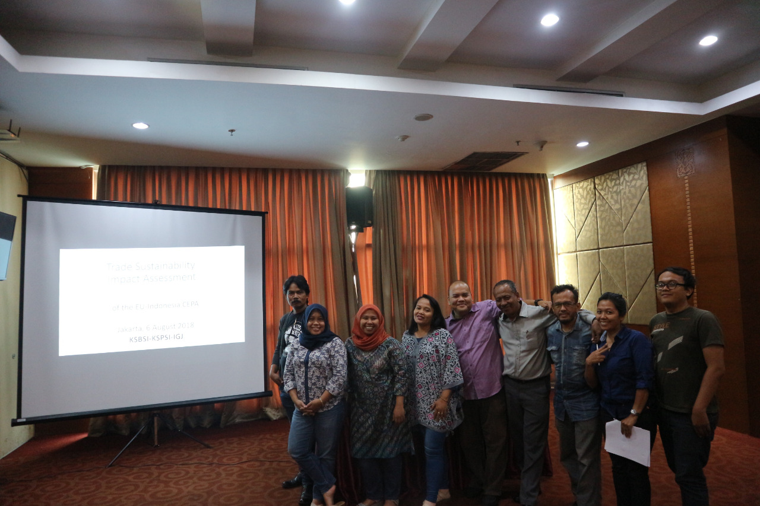

Slide 23
The Main Demands of Trade Union and CSO
Access to remedy for violations of human and labour rights, and environmental protections must be ensured. The CEPA should contain effective mechanisms to enforce human rights, environmental and labour standards. All stakeholders must have direct access to a complaints mechanism with effective remedies, and the Parties to the agreement must be under an obligation to act on complaints made, through state-state dispute settlement. Any chapter, clause or aspect of the agreement that compromises human rights and labour obligations or environmental protections can be subject to a complaint. The CEPA must ensure that, to this end, an effective monitoring mechanism is put in place, including by providing the necessary capacity and financial resources.

Slide 24
The Main Demands of Trade Union and CSO
Binding Sustainable Development chapters. Sustainable Development chapters included in the CEPA must have concrete and binding.
Clear goals to address trade-related violations of human rights, labour, environmental and climate standards that the CEPA should respect and uphold must be formulated, monitored and enforced.

Slide 25
The Main Demands of Trade Union and CSO
No restrictions on Indonesian export tariffs on raw unprocessed materials. The CEPA text should ensure Indonesian export measures aimed at promoting domestic processing of raw materials. Such measures aim to enhance domestic value added that will support the development of local downstream industry and help reduce unemployment and poverty.

Slide 26
Cooperation between Trade Union and CSO in Indonesia and Europe
Untill now, the cooperation between trade union and CSO in Indonesia and Europe is still exist.
WE have group email, skype and whatsApp (Indonesia),
Sharing the information (SIA), the result of the lobby and advocacy,
discussing the idea dan agenda every the roundtable discussion of CEPA

Slide 27
