Slide 1
1988 – 8888 peoples movement for Democracy – U Maung Maung left for exile 1991 – founding of the FTUB ( in exile with three members ) 1992 - FTUB started working with ICFTU and IUF. 1992 - FTUB attended ILC through the IUF portfolio and presented the Forced labor / Child labor /FoA status 1996 – joined Democratic Alliance of Burma and with the help of the ICFTU affiliates opened offices in - NSW / Washington DC / Tokyo - Australia Burma Council, Norwegian Burma Committee, Danish Burma Committee 2000 Nov – 279th ILO Governing Body implements article (33) Forced labor Convention 1930 ( No 29). Sanctions start 2009 – ITUC member ( at ITUC founding Congress in Berlin ) 2010 founding Congress of FTUB ( in exile ) 2012 – return to Burma 2014 Nov 28, 29 Second Congress of FTUB and founding Congress of CTUM 2015 receive Confederation registration 2015 till now Workers Delegate for Myanmar to the ILC. ( most representative Trade Union ) Building up the CTUM

Slide 2
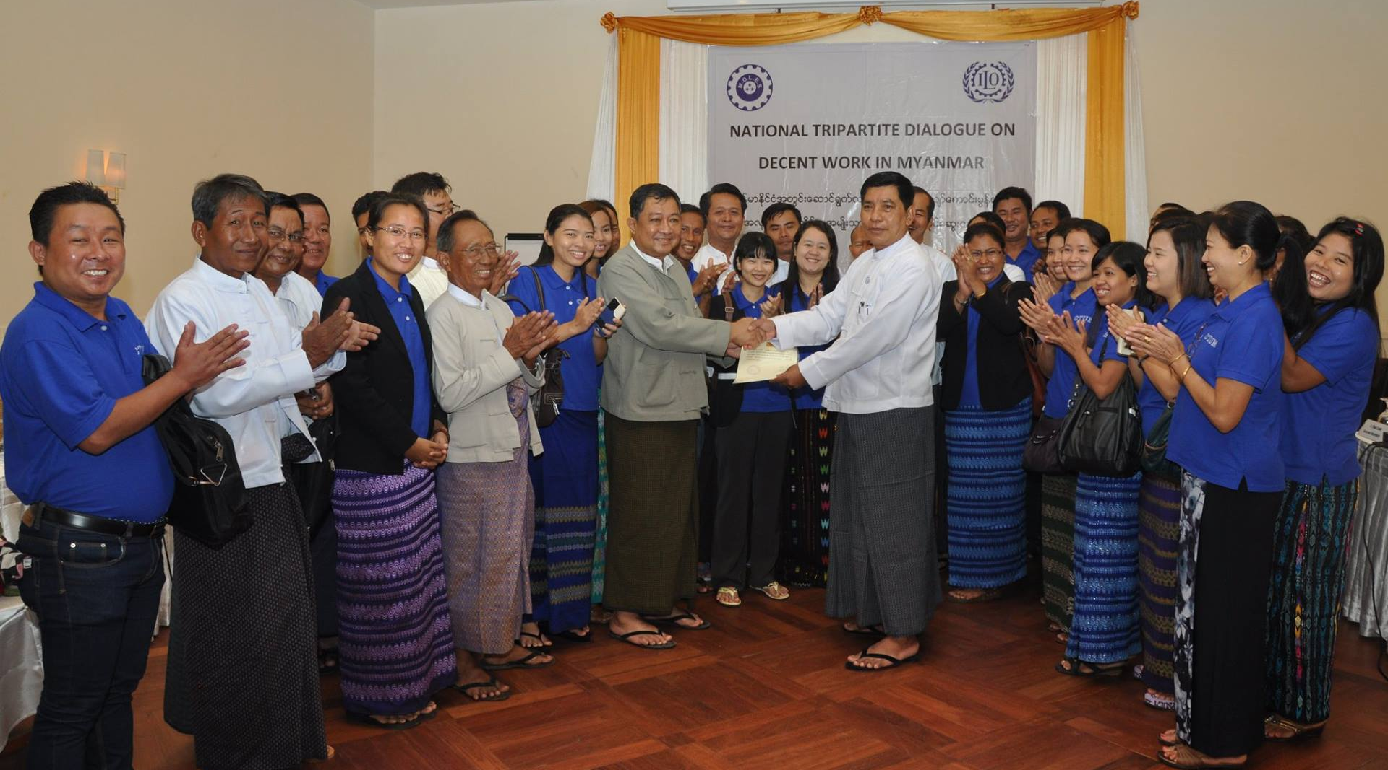
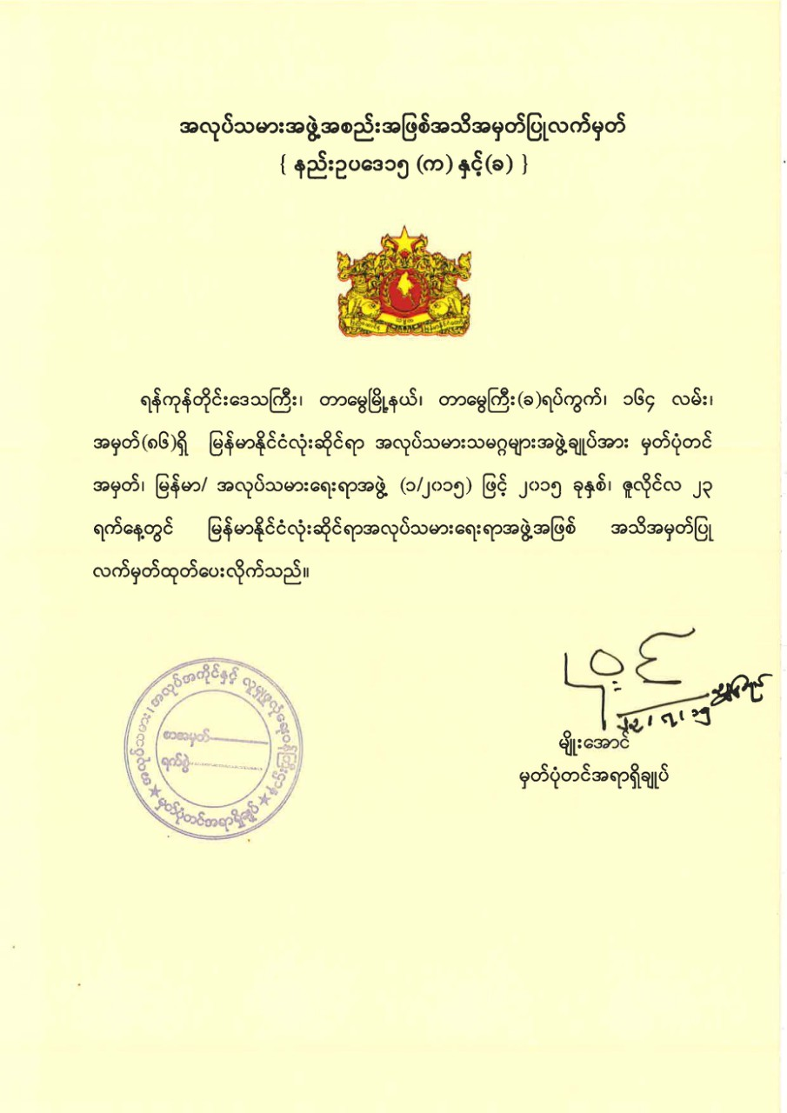
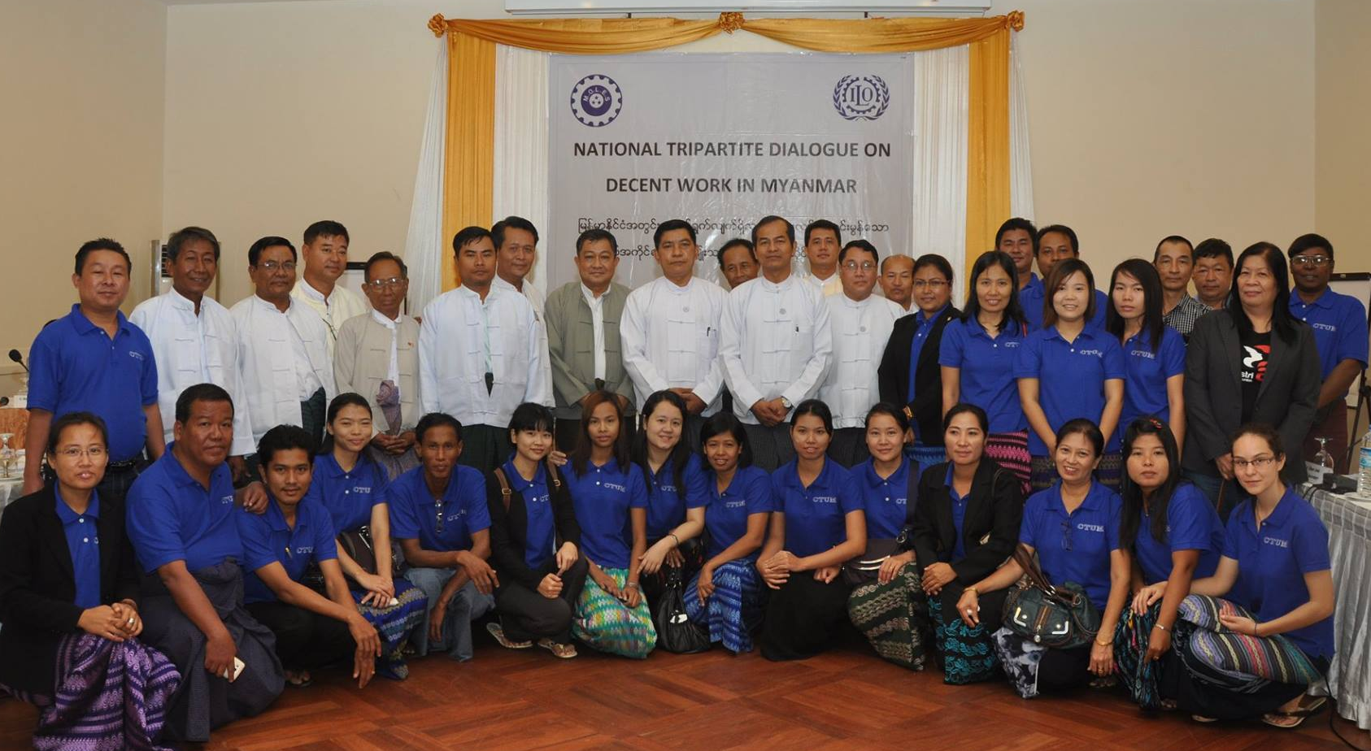
Chief Registrar of Ministry of Labour, Employment and Social Security presenting CTUM Registration
23rd July 2015

Slide 3
National Tripartite Dialogue Forum
National Minimum Wage Committee
National Social Security and Social Protection Committee
National Child Labour Elimination Committee
Labour Law Reform
Trade and Employment Committee
Occupational Safety and Health Committee
National Skills Setting and Skills Development Committee
National Communication Committee

Slide 4
Comparison of minimum wages in ASEAN
Country | Lowest minimum wage (US$) |  | Highest minimum wage (US$) | Effective date
Brunei Darussalam | No minimum wage
Singapore | A progressive wage model, based on skills, labour productivity and career |  |  | Since sep. 2014
Myanmar | The first national minimum wage at 3,600 kyat ($3) for 8 w/h -------------------- |  |  | Sept 2015 March 2018
Cambodia | $171 | $171 |  | Jan 2018
Lao PDR | $110 | $110 |  | April 2015
Viet Nam | $116 (2.6 million dong for region 4) | $166 (3.75 million dong for region 1) |  | 1 Jan. 2017
Indonesia | $98 (1,337,000 rupiah for Yogyakarta) | $247 (3.355,000 rupiah for DKI Jakarta) |  | 1 Jan. 2017
Malaysia | $263.40 (800 ringgit for Sabah and Sarawak) $217.4 (920 ringgit) | $296.30 (900 ringgit for peninsula) $236.4 (1,000 ringgit) |  | 1 Jan. 2013 2016
Thailand | Daily minimum wage at Baht30 $254.90 based on a daily minimum wage of 300 baht | Baht40 per day $262.00 |  | 2017
Philippines | Daily minimum wage at P491 ($9.5) | P512 ($9.87) |  | Oct 2017
Pong-Sul Ahn, ILO ROAP, 2018.

Slide 6
Second Minimum Wage
(From 2015 Sept 01 to 2018 May 14)
CTUM’s Proposed Minimum Wage was 6600 kyats
National Minimum Wage Committee decided 4800 kyats
72.72 of CTUM’s proposed Minimum Wage.
CTUM proposed Minimum Wage shall cover every worker.
National Minimum Wage Committee decided to cover the employers who have 10 workers and above

Slide 7
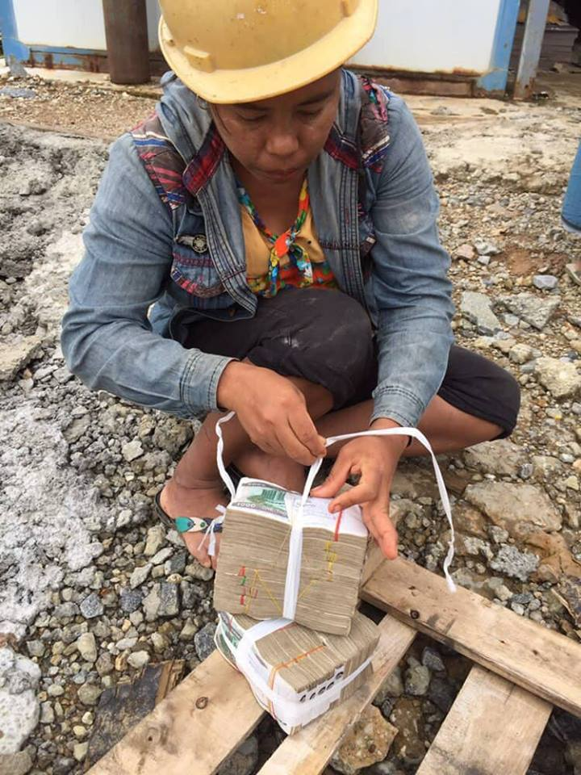
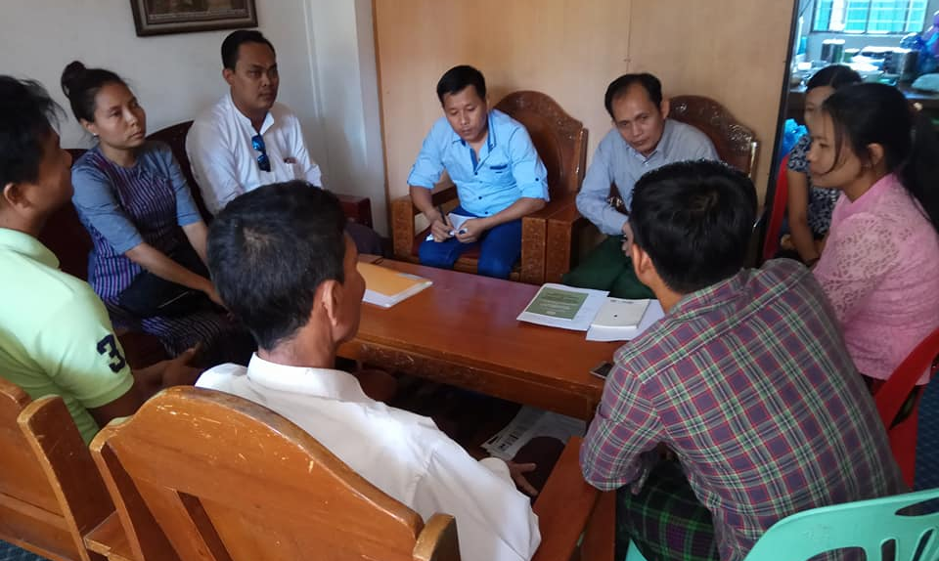
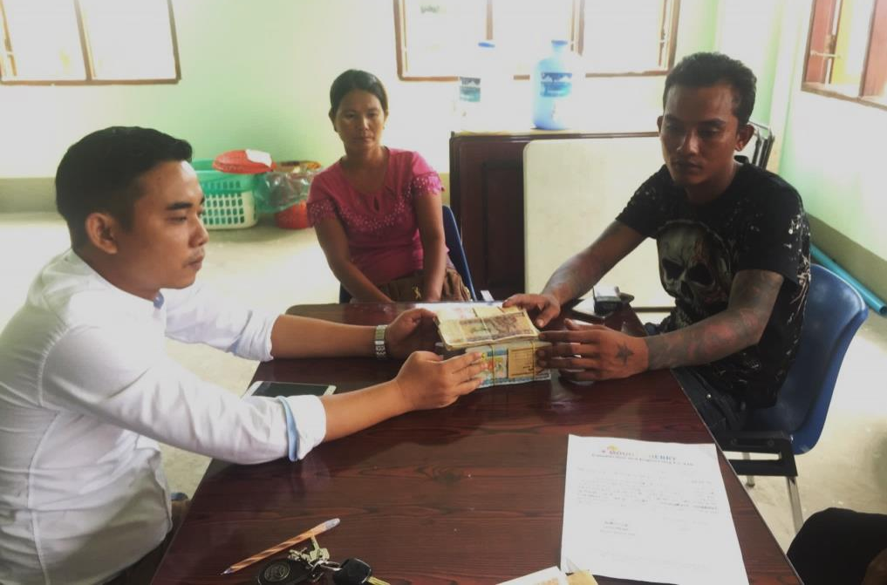
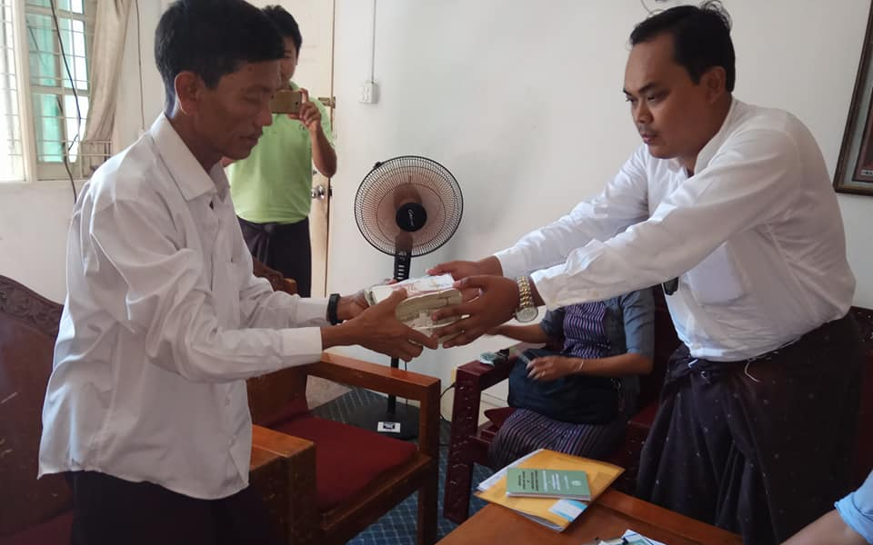
Wage Dispute Settlement in Construction Sector
Workers are from Special Economic Zones

Slide 8
2018 March 28

Slide 9
2018 March 5 Meeting with ACT

Slide 10
CTUM+MICS consultation meeting on Minimum Wage 2018 March 16

Slide 11
2018 March 16

Slide 12
Workers Groups’ Proposed Dispute Resolution System
Right Based Dispute
Interest Based Dispute
compulsory
compulsory
Workplace
Coordinating
Committee (WCC)
Workplace
Coordinating
Committee (WCC)
compulsory
compulsory
Township Level
Conciliation Body
Township Level
Conciliation Body
compulsory
Voluntary (right to strike or right to lock out can be exercised)/Industrial Action can be exercised by parties between these two steps)-
Both parties must agree to go to AC.
Competent Courts/Special Courts/Labour Courts – must make sure to have judges/layers/the period should be shortened. Etc.
Arbitration
Council
Binding Award
Binding Award by consensus
Appealing
Supreme Court
Appealing

